Slide 1
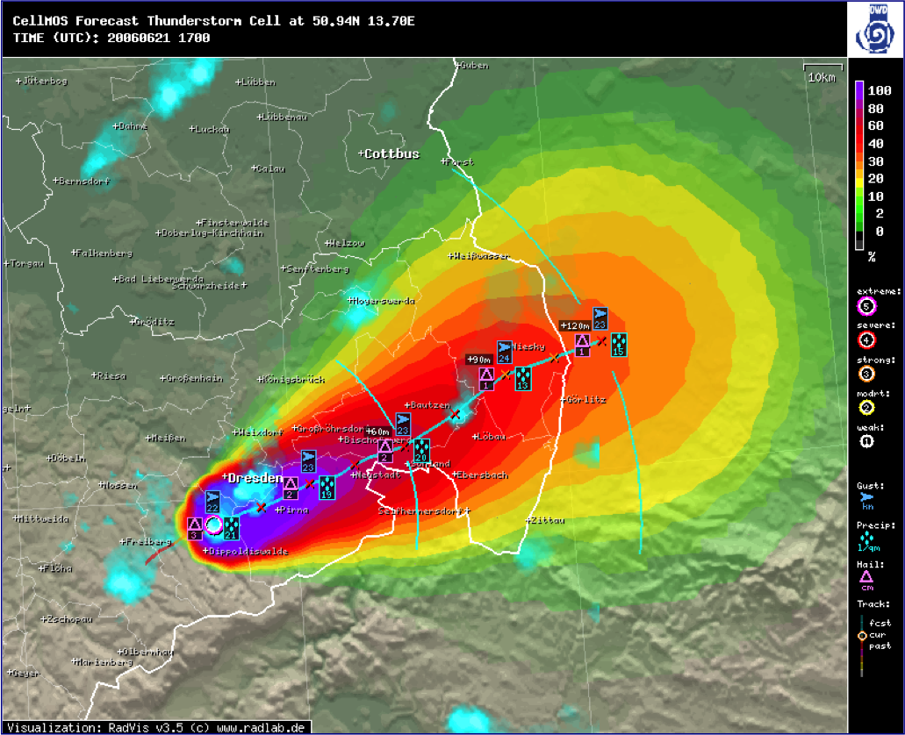
Nowcasting MOS
Klaus Knüpffer, Jan Hoffmann

Slide 2
Content
MSwr-MOS History
NowcastingMOS
  2.1 LightningMOS
  2.2 RadarMOS
  2.3 MSwr-CellMOS
Applications
  3.1 AutoTAF and WarnMOS
  3.2 Adoption of MSwr-CellMOS for Hail Alarm in
  Switzerland
Summary and Conclusions

Slide 3
1. MSwr-MOS History
1.1 The 90‘s: MOS (Model Output Statistics) for Standard weather elements
1.2 The 00‘s: NowCast-MOS
1.3 Recently: MSwr-CellMOS
1.3.1 MSwr-CellMOS (DWD)
1.3.2 MSwr-CellMOS (Hail/Switzerland)

Slide 4
1.1 MOS for standard weather elements
1.1 MOS for standard weather elements
Verification results
• Man(+Machine) versus Machine forecasts
• Introduction of MOS at DWD
• RV (MOS, DMO) = 50%

Slide 5

1.1 MOS for standard weather elements
Man(+Machine) versus Machine forecast

Slide 6
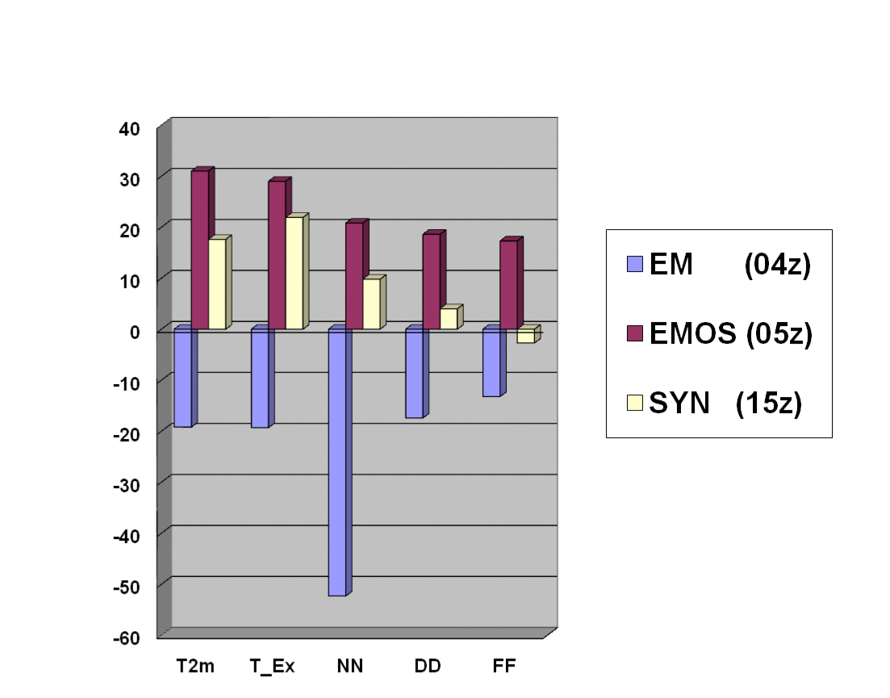
1.1 MOS for standard weather elements
Introduction of MOS at DWD
RV of different methods vs. reference Kalman filter (neutral axis) in %
Source: DWD short term
verification 1998/1999

Slide 7
1.1 MOS for standard weather elements
RV(MOS,DMO) = 50% - What does it mean?
• The sum of squared forecasts errors of MOS forecasts is half the sum of squared forecast errors of Direct Model Output (DMO) forecasts
• A MOS forecast of the year 1997 had the same accuracy as a model forecast of the year 2017
• A 3-day-ahead MOS forecast has the same accuracy as a 1-day-ahead DMO forecast - no matter what the resolution is

Slide 8
1.1 MOS for standard weather elements
„Probability is the language of the forecaster“
(Chuck Doswell)
MOS produces Probabilities in two ways:
• Explicitly: By pre-defining probabilistic predictands like probability of Hail
• Implicitly: By predicting a non-probabilistic element (e.g. T2m but also wind vector components) and its absolute forecasting error. From these two all probabilities can be calculated with normal (or other) distribution assumption.

Slide 9
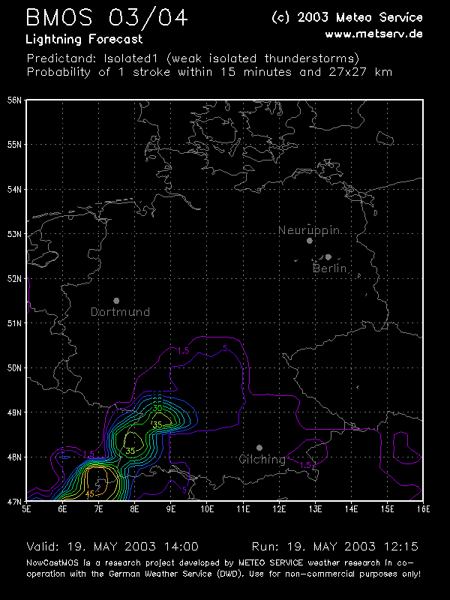
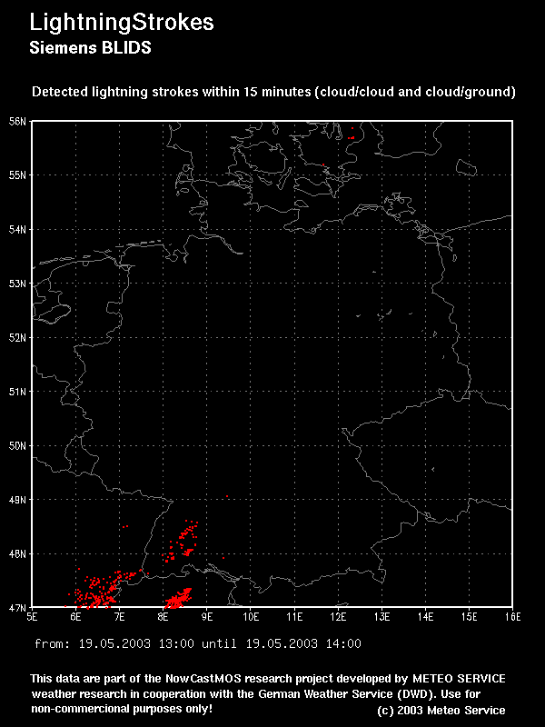
2.1 LightningMOS

Slide 10
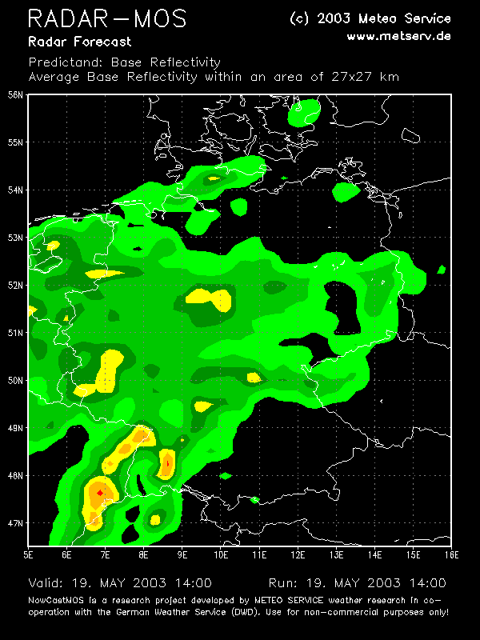
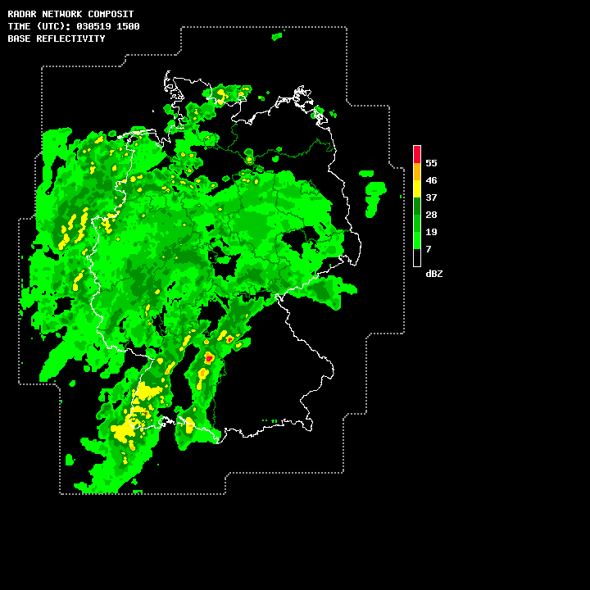
2.2 RadarMOS

Slide 11
2.3 MSwr-CellMOS
Derived Predictands from radar and lightning
• Movement (U, V, derived from cell detection)
• Absolute Errors of Movement U, V
• Hail Size / Probabilities
- “classic”: DWD MSwr-CellMOS
- Waldvogel
- SHI / MEHS / POSH
• Total precipitation
• Maximum estimated wind gust
• Lightning stroke rate
Forecasting
• Statistical forecasts are made for all individual detected cells
• Second step is calculation of field data derived from the cell forecasts using a Gaussian approach (assumption: cell properties and forecast location errors behave nearly like Gaussian distributions over space)

Slide 12
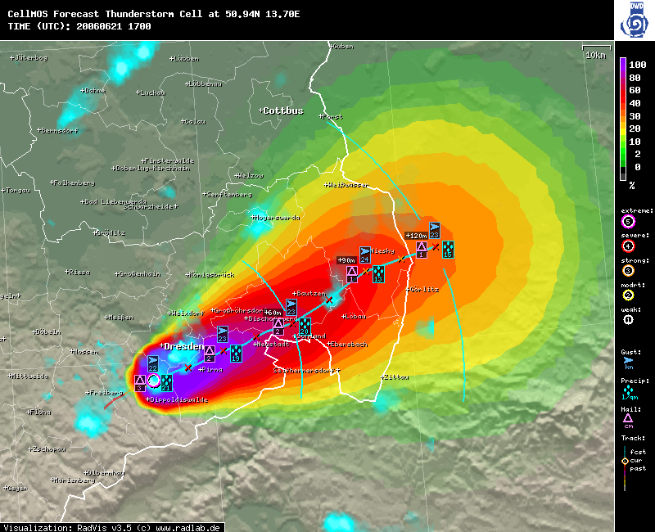
2.3 MSwr-CellMOS
DWD MSwr-CellMOS Convectice Cell Forecast
June 21th 2006, 17:00 UTC

Slide 13

2.3 MSwr-CellMOS
Gaussian field distribution derived from cell forecasts
• σ_shape (Gaussian shape) of the Cell:
expected value = predictand value minus environmental field value
sigma(shape) derived from cell size and
standard deviation = radius of 61% of expected value
• σ_position (forecast error of cell position):
derived from forecast of error of trajectory
Convolution of σ_shape und σ_position:
• σ_total

Slide 14
3 Applications
3 Applications
3.1 AutoTAF and WarnMOS
3.2 Adoption of MSwr-CellMOS for Hail Alarm in
Switzerland

Slide 15
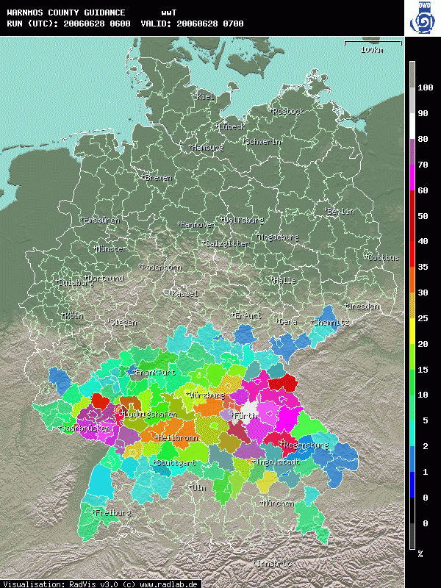
3.1 AutoTAF and WarnMOS

Slide 16
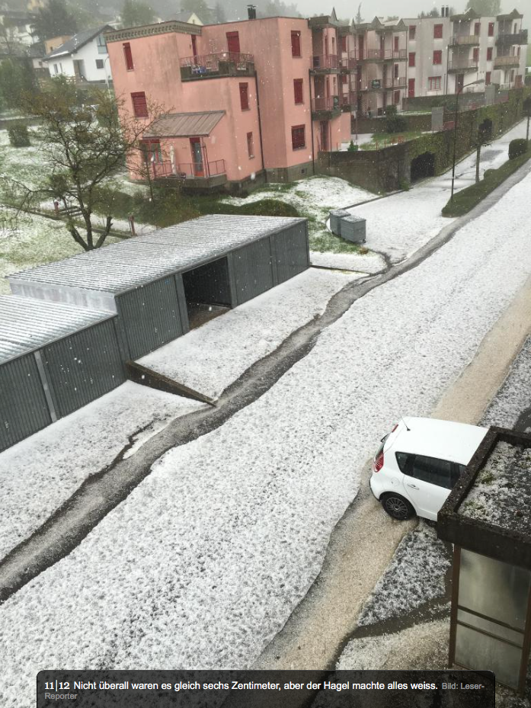
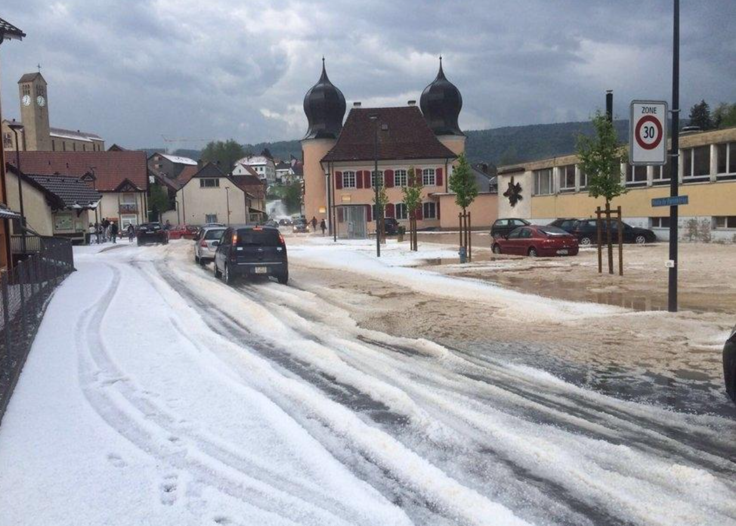
3.2 Adoption of MSwr-CellMOS for Hail Alarm
Adoption of MSwr-CellMOS for Hail Alarm in Switzerland
Case example
May 10th 2016, Canton: Jura
Image source: www.20min.ch

Slide 17
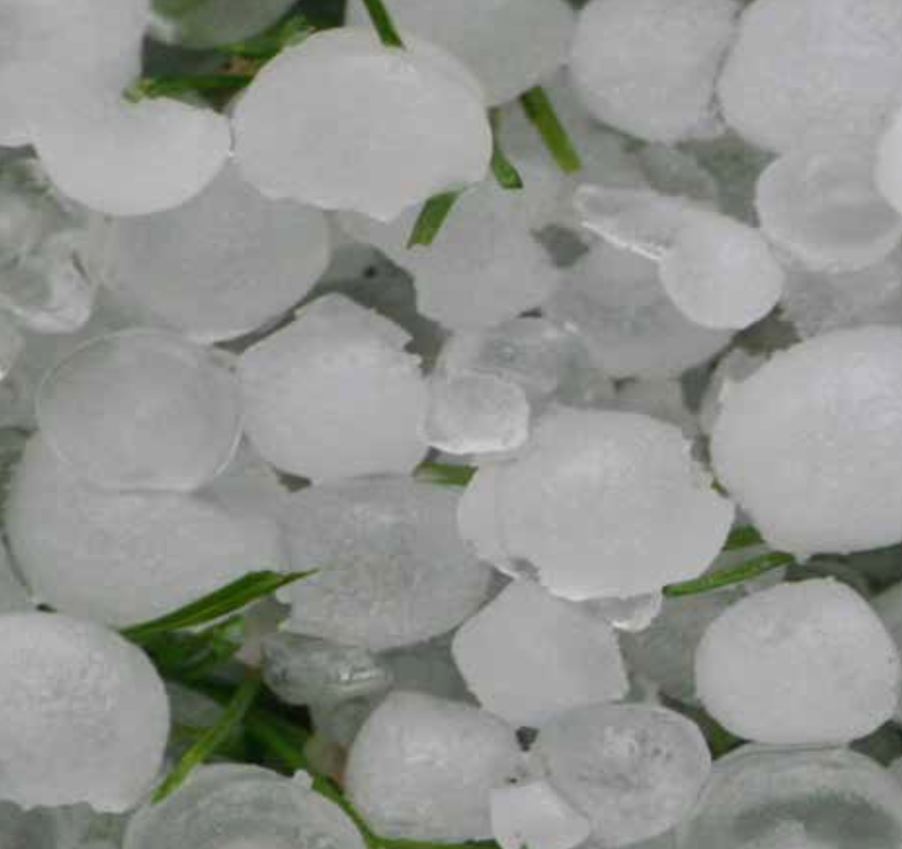

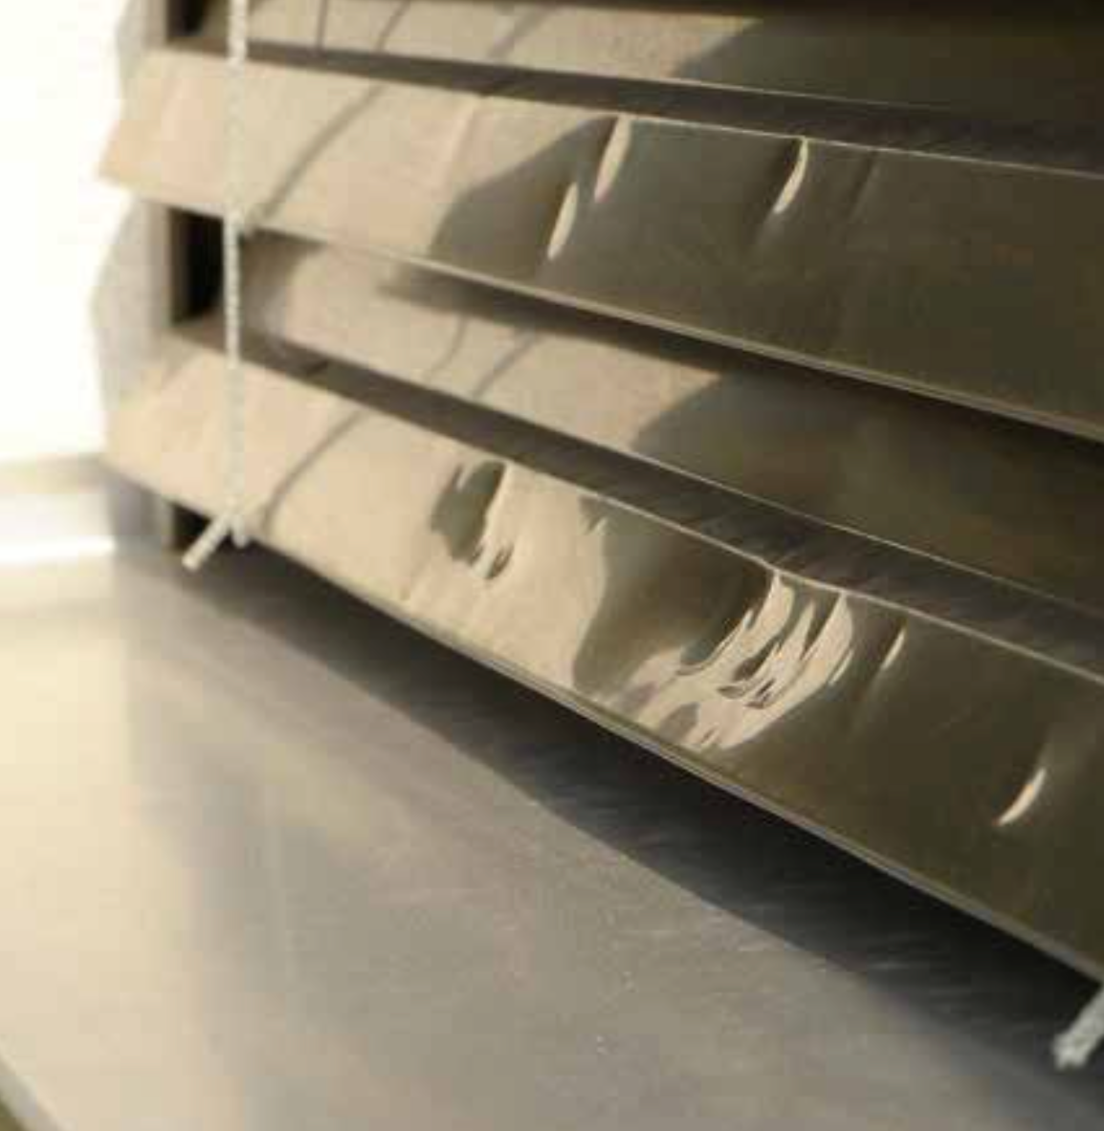
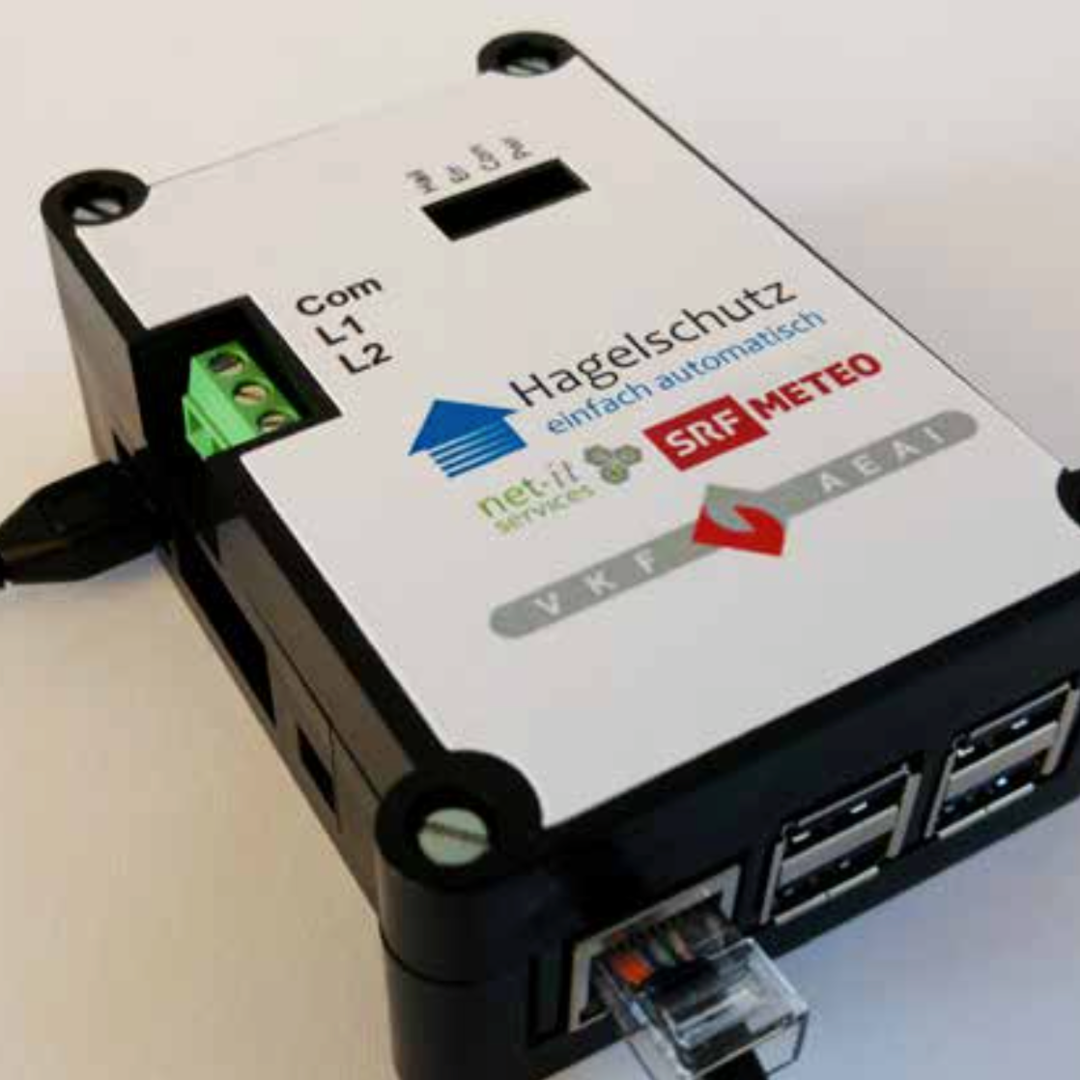






3.2 Adoption of MSwr-CellMOS for Hail Alarm
Adoption of MSwr-CellMOS for Hail Alarm in Switzerland
Hail… Protection... Simply
automatic!
Contributors

Slide 18
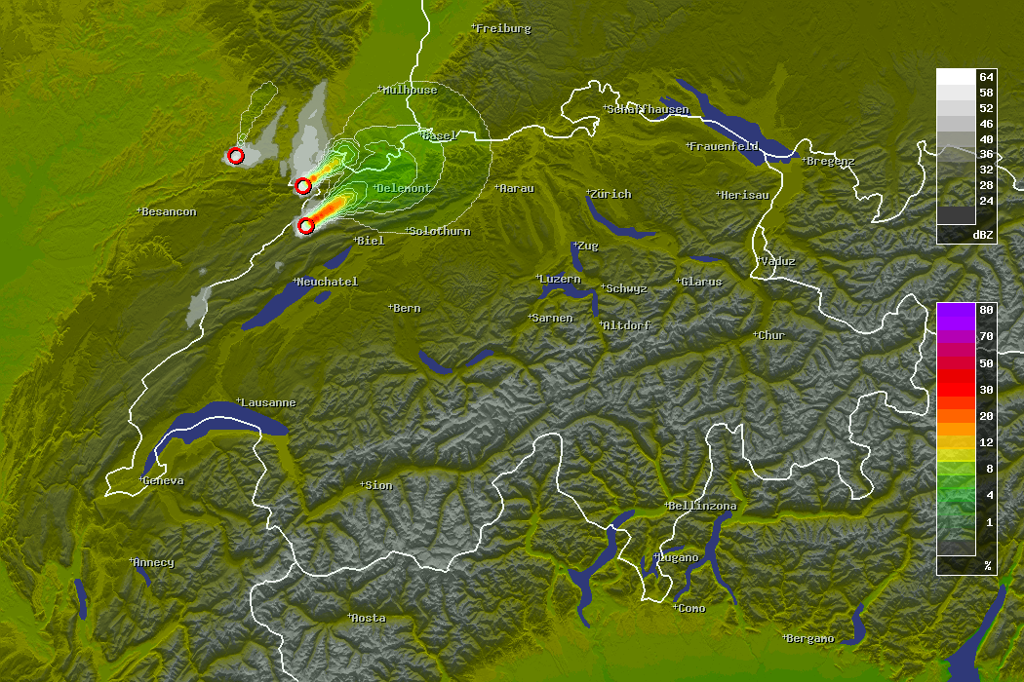
3.2 Adoption of MSwr-CellMOS for Hail Alarm
Radar Refl. 16:20 UTC
Prob Hail > 15mm / 120min
MSwr-CellMOS Hail Forecast
Full Run 16:20 UTC (0 – 120 min)

Slide 19
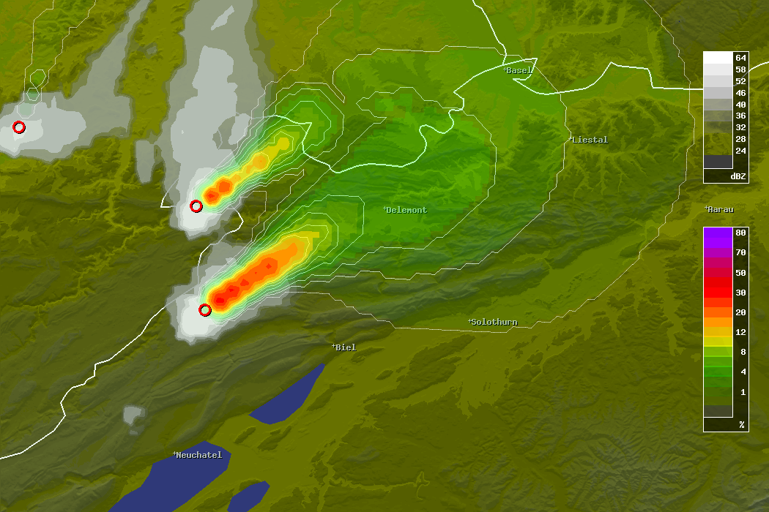
3.2 Adoption of MSwr-CellMOS for Hail Alarm
Radar Refl. 16:20 UTC
16:45 UTC, 1.5 cm
Prob Hail > 15mm / 120min
17:10 UTC, 3 cm
MSwr-CellMOS Hail Forecast
Full Run 16:20 UTC (0 – 120 min)
ESWD Hail Reports

Slide 20
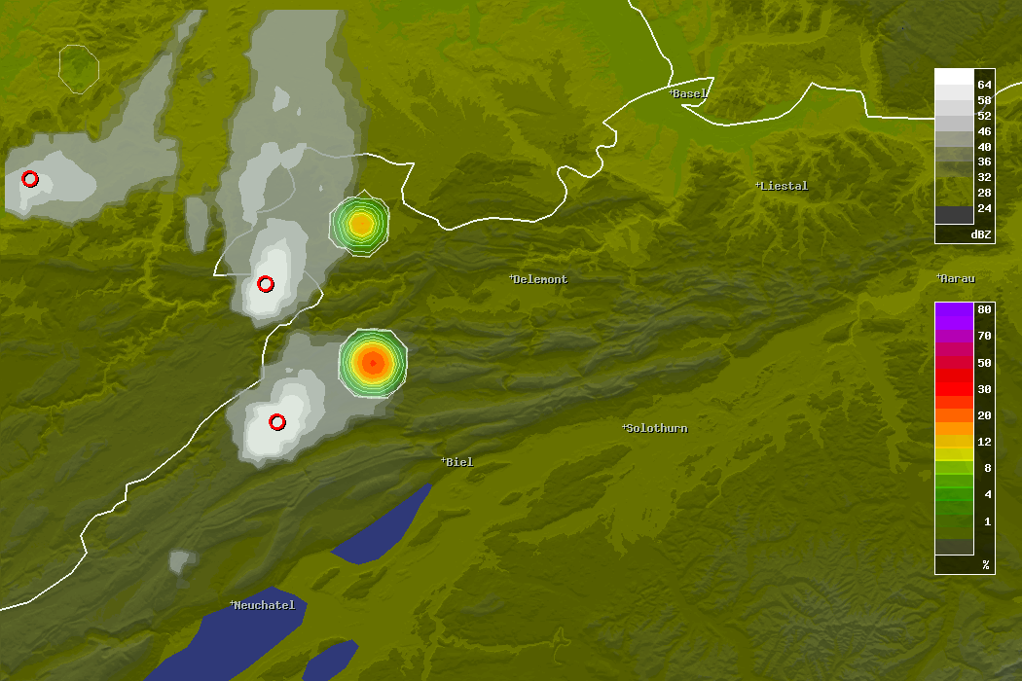
3.2 Adoption of MSwr-CellMOS for Hail Alarm
Radar Refl. 16:20 UTC
16:45 UTC, 1.5 cm
Prob Hail > 15mm / 5min
MSwr-CellMOS Hail Forecast
Run 16:20 UTC + 25 min / 16:45 UTC
ESWD Hail Reports

Slide 21
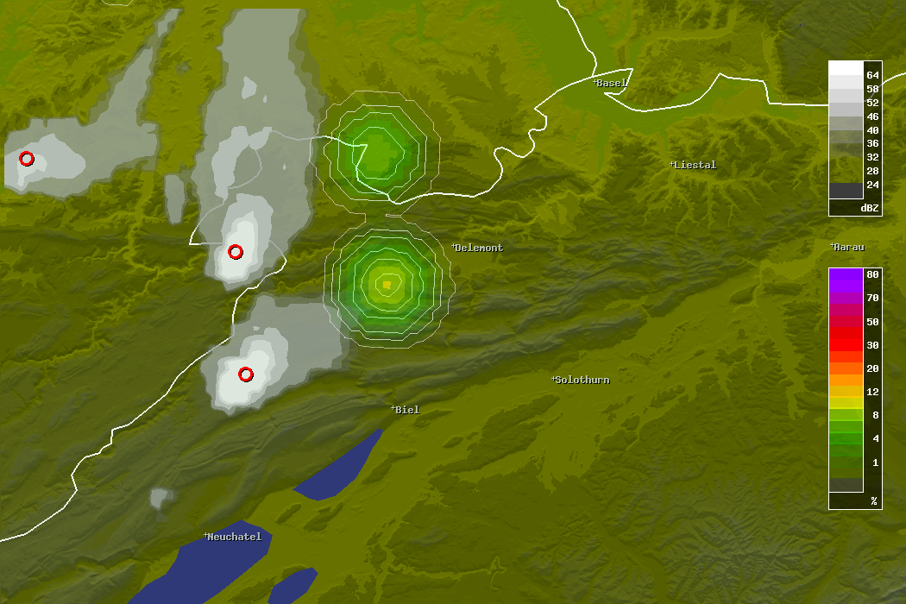
3.2 Adoption of MSwr-CellMOS for Hail Alarm
Radar Refl. 16:20 UTC
Prob Hail > 15mm / 5min
17:10 UTC, 3 cm
MSwr-CellMOS Hail Forecast
Run 16:20 UTC + 45 min / 17:05 UTC
ESWD Hail Reports

Slide 22
3.2 Adoption of MSwr-CellMOS for Hail Alarm
Optimized decision making based on Hail probabilities
Rule: If predicted hail probability exceeds the
cost-loss ratio then action has to be taken:
Cost: loss of living quality due to moving external venetian blinds up
Loss: expected damage if Hail occurs.
Formula: IF (Prob_Hail>15mm > Threshold)
THEN (move external venetian blinds up)
(with Threshold = Cost / Loss)
Current Threshold is 5% and subject of discussions

Slide 23
Thank you for your attention!

