Slide 1
Model Output Statistics (MOS): Methodik, Verifikation und Anwendungsgebiete
Dipl.-Met. Klaus Knüpffer
Currently, the most efficient way to improve the accuracy of local weather forecasts is the introduction of an advanced statistical interpretation system that operates on the outputs of numerical models.

Slide 2
Gliederung
Vor 1990
1990 bis 1999
Allgemeines zur statistischen Wettervorhersage
2000 bis Gegenwart
  wetterturnier.de
  MSwr-MOS – Vorhersagen
  MOS als NowCast-Warnsystem
Zusammenfassung und Ausblick

Slide 3
Statistische Wettervorhersage ist
Induktive Modellierung: Prinzip: ‘Frage die Daten!‘
im Gegensatz zu der bekannteren
Deduktiven Modellierung = ‘Axiomatische Methode‘
(‘Axiome‘ hier = Gesetze der Physik)

Slide 4
Vor 1990

Slide 5
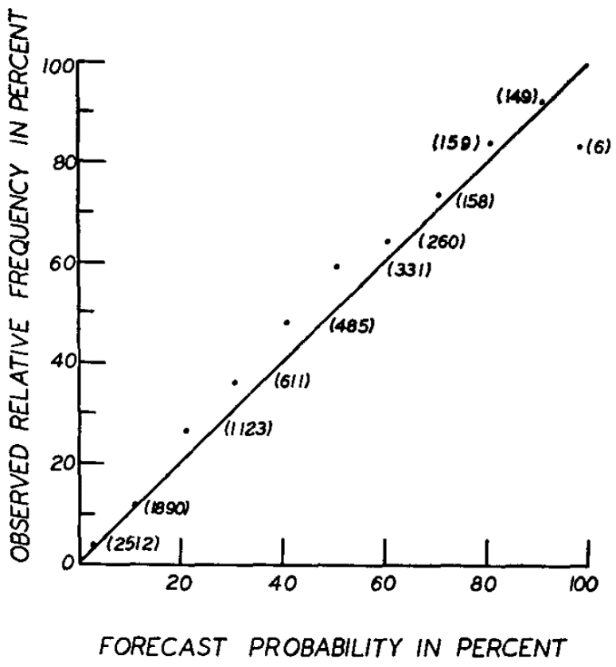
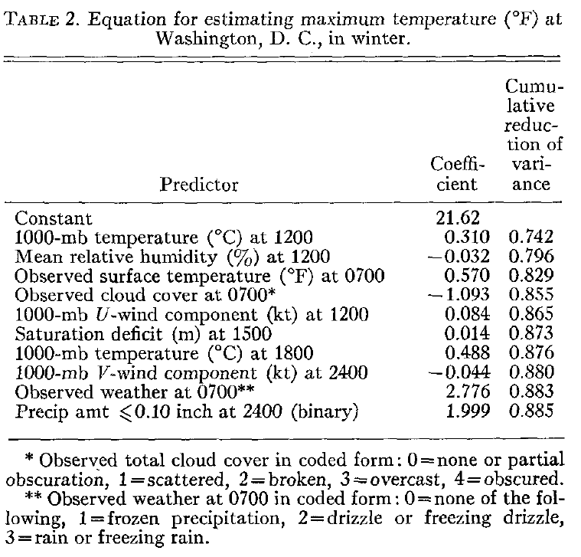
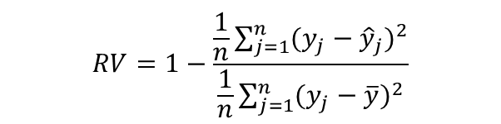
„The MOS technique is, in effect, the determination of the weather-related statistics of a numerical model.“ Glahn, H.R., Lowry, D.A.: The use of model output statistics (MOS) in objective
weather forecasting, J. Appl. Meteor., 11(1972),1203-1211
regression
procedure
$$RV=1−\frac{\frac{1}{n}\sum_{j=1}^{n}{(y_{j}−{\hat{y}}_{j})^{2}}}{\frac{1}{n}\sum_{j=1}^{n}{(y_{j}−\overline{y})^{2}}}$$
$$\hat{Y}=a_{0}+a_{1}X_{1}+a_{2}X_{2}+…+a_{K}X_{K}$$
maximum temperature
cloud amount
surface wind
probability of precipitaion
probability of precipitaion
conditional probability of frozen precipitation

Slide 6
Ab 1990:
MOS-Gleichung für die Windgeschwindigkeit an der Station: Nordsee Plattform K13
-------------------------------------------
Structure:
FF(T+dt) = Const + Coeff * FF_1000(T+dT)
-Predictand- -Predictor-
-------------------------------------------
dt/h Const/kn Coeff
-------------------------------------------
12 4.6 0.46
48 5.0 0.44
120 8.2 0.30
1000 14.8 0.00

Slide 7
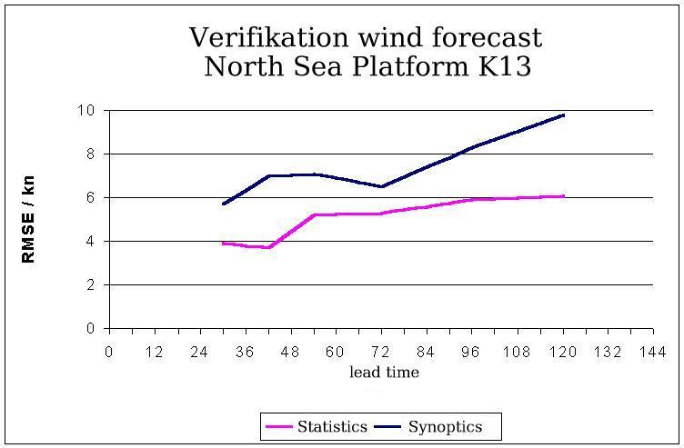

Slide 8
Zum Verhältnis von Mensch und Maschine
Chronologie der RV des SYNoptikers im Vergleich zum besten jeweils vorhandenen Automaten von 1991 – 2014
Mittel über Temperatur-, Wind- und Bedeckungsgrad-Vorhersagen von heute für morgen, alle DWD-Wetterämter.
Quelle: Verifikationsbericht zur Güte lokaler Wettervorhersagen, DWD März 2014

Slide 9
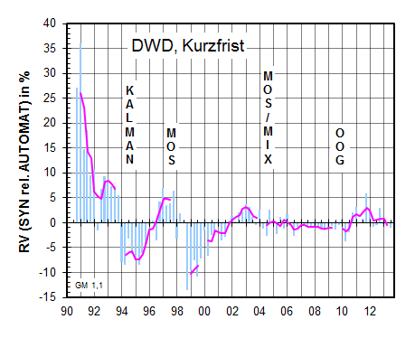

Slide 10
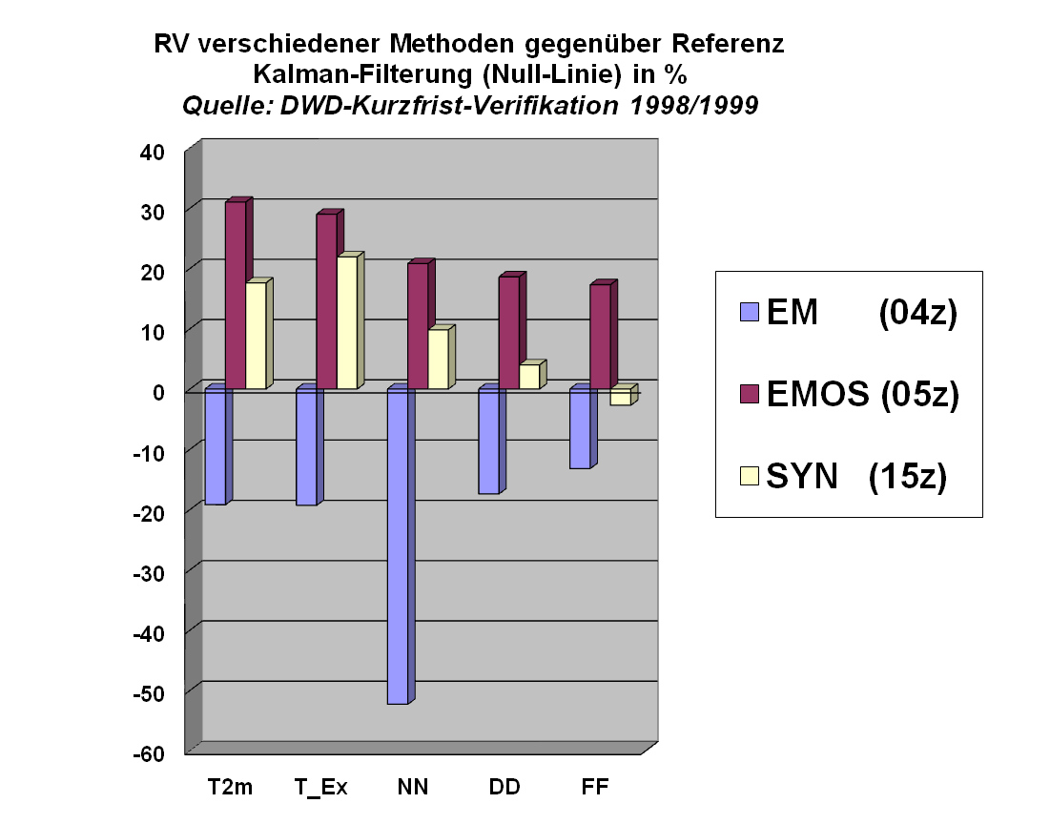

Slide 11
Allgemeines zur statistischen Wettervorhersage

Slide 12
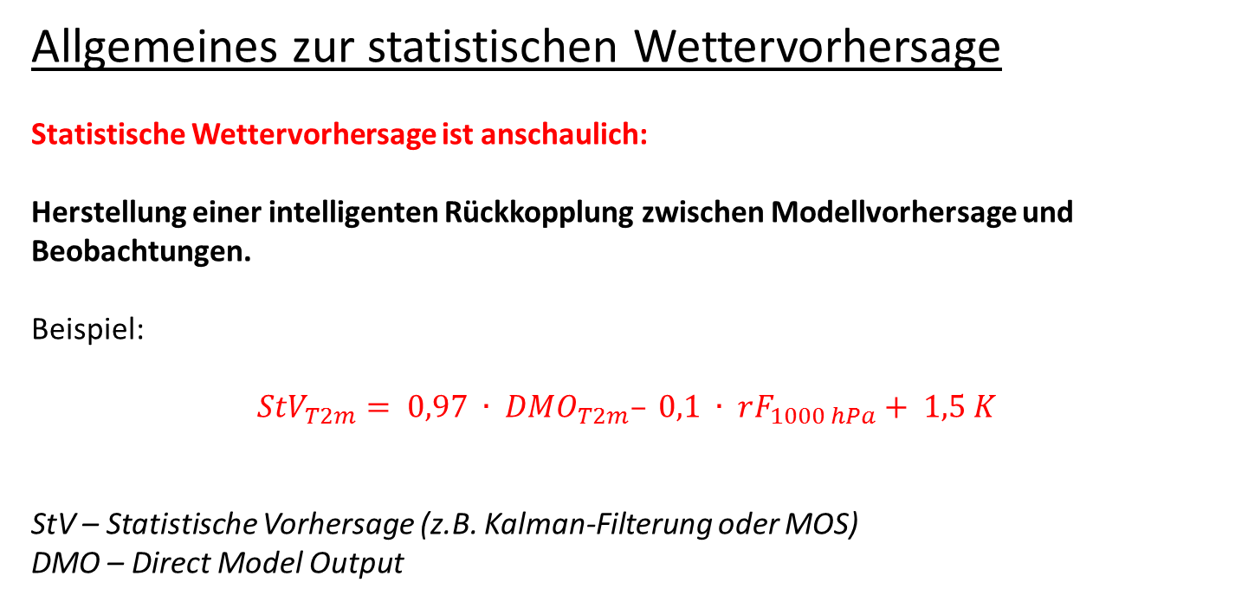
Allgemeines zur statistischen Wettervorhersage
Statistische Wettervorhersage ist anschaulich:
Herstellung einer intelligenten Rückkopplung zwischen Modellvorhersage und Beobachtungen.
Beispiel:
$$StV_{T2m}= 0,97 ∙ DMO_{T2m}– 0,1 ∙ rF_{1000 hPa}+ 1,5 K$$
StV – Statistische Vorhersage (z.B. Kalman-Filterung oder MOS)
DMO – Direct Model Output

Slide 13
Allgemeines zur statistischen Wettervorhersage
Es gibt verschiedene methodische Ansätze, z.B.
Einfacher Ansatz: Statistische Korrektur des DMO
- Beispiel: Kalman-Filterung = adaptive DMO-Korrektur
Umfassender Ansatz: Statistische Interpretation des Outputs numerischer Wettervorhersagemodelle unter Einbeziehung der letzten Beobachtungen (besonders wichtig für NowCast-Anwendungen).
Beispiel: Die hier vorzustellenden MSwr-MOS-Systeme
Andere Ansätze: z.B. neuronales Netz (bisher erfolglos)

Slide 14
Allgemeines zur statistischen Wettervorhersage
Anwendungsgebiete von MOS:
Standard-Wettervorhersage
Flugwetter
Wind- und Solarerträge
Pegelstände
Straßenzustand
Pegelstände am Beispiel: BSHMOS – Gleichungen für Stau Cuxhaven(T+1h)

Slide 15
FI_1000 -0.4311 ......
FI_950 -0.4251 ......
FI_850 -0.4163 ......
FI_700 -0.3935 .....
FI_500 -0.3459 ....
FI_300 -0.2783 ...
T_1000 0.0798 .
T_950 0.0129
T_850 -0.1455 .
T_700 -0.2026 ..
T_500 -0.1829 .
T_300 0.0292
O_1000 -0.5206 .........
O_950 -0.5313 .........
O_850 -0.3693 .....
O_700 -0.1901 ..
O_500 -0.0494 .
O_300 -0.0372 .
RH_1000 0.0681 .
RH_950 0.2024 ..
RH_850 0.4284 ......
RH_700 0.2604 ...
RH_500 0.1040 .
RH_300 -0.1504 .
CW_1000 -0.0485 .
CW_950 -0.0198
CW_850 0.2532 ..
CW_700 0.2072 ..
CW_500 0.0559 .
CW_300 -0.0256
DMO_U_1000 0.7060 ................
DMO_U_950 0.7093 ................
DMO_U_850 0.6679 ..............
DMO_V_1000 -0.1572 .
DMO_V_950 -0.2527 ..
DMO_V_850 -0.3284 ....
PSsurface -0.4337 ......
Prec_Water 0.0374 .
RH_column 0.1663 .
Lift_Index -0.3545 ....
CAPE 0.0673 .
Con_Inhib -0.0072
4Lev_Lift_Ix -0.2550 ..
CloudWater 0.1620 .
FI_0Cisotherm -0.0908 .
RH_0Cisotherm 0.2512 ..
DMO_T_sfc 0.0310
DownLongFlx3(+2) 0.2247 ..
UpLongFlx3(+2) 0.0215
UpLongFlxTp3(+2) -0.1747 .
UpShortFlxTp3(+2) 0.0985 .
UpShortFlx3(+2) -0.1066 .
DownShortFlx3(+2) -0.0946 .
DownLongFlx6(+3) 0.2319 ..
UpLongFlx6(+3) 0.0236
UpLongFlxTp6(+3) -0.1845 ..
UpShortFlxTp6(+3) 0.1132 .
UpShortFlx6(+3) -0.1053 .
DownShortFlx6(+3) -0.0964 .
DMO_C_High3(+2) -0.0344
DMO_C_Mid3(+2) 0.2022 ..
DMO_C_LOW3(+2) 0.3838 .....
DMO_C_High6(+3) -0.0305
DMO_C_Mid6(+3) 0.2160 ..
DMO_C_LOW6(+3) 0.3967 .....
PrecRate3(+2) 0.2376 ..
ConPrecRate3(+2) 0.2907 ...
PrecRate6(+3) 0.2753 ...
ConPrecRate6(+3) 0.3232 ....
DMO_T2M 0.0572 .

Slide 16
DMO_Tx2M_3(+2) 0.0424 .
DMO_Tn2M_3(+2) 0.0667 .
DMO_Tx2M_6(+3) 0.0322
DMO_Tn2M_6(+3) 0.0855 .
CldWorkFct3(+2) 0.2581 ...
CldWorkFct6(+3) 0.2930 ...
Bound_Layer 0.5005 ........
Albedo3(+2) -0.0231
Albedo6(+3) -0.0463 .
DMO_C_con 0.3983 .....
DMO_C_tot3(+2) 0.2739 ...
DMO_C_bound3(+2) 0.0971 .
DMO_C_tot6(+3) 0.2840 ...
DMO_C_bound6(+3) 0.0994 .
CategRain3(+2) 0.3719 .....
CategSnow3(+2) -0.0348
CategRain6(+3) 0.3835 .....
CategSnow6(+3) -0.0293
DMO_RH2M 0.0913 .
DMO_U_10m 0.7482 ..................
DMO_V_10m -0.1089 .
U_1000 0.6891 ...............
V_1000 -0.3972 .....
U_950 0.6963 ...............
V_950 -0.4024 .....
U_850 0.6804 ...............
V_850 -0.3582 ....
U_700 0.6345 .............
V_700 -0.2533 ..
U_500 0.5658 ..........
V_500 -0.1521 .
U_300 0.5214 .........
V_300 -0.1136 .
Tv_5_10 -0.1561 .
ThW_850 0.0086
ThW_950 0.0780 .
Grad_ThW_850_U -0.1475 .
Grad_ThW_850_V -0.0674 .
Rot_1000 0.0958 .
Rot_500 0.2285 ..
Rot_1000_LS 0.1495 .
Rot_500_LS 0.2715 ...
Grad_Tv_5_10_U -0.1102 .
Grad_Tv_5_10_V 0.1049 .
Grad_Rot_500_U -0.0807 .
Grad_Rot_500_V -0.3401 ....
Grad_DMO_T2m_U 0.0009
Grad_DMO_T2m_V -0.0541 .
D_U_MS 0.7551 ..................
D_U_LS 0.7555 ..................
D_U_XLS 0.7530 ..................
D_V_MS -0.1065 .
D_V_LS -0.1156 .
D_V_XLS -0.1261 .
DMO_T2m_MS 0.0444 .
DMO_T2m_LS 0.0415 .
PrecRate6_MS(+3) 0.2803 ...
PrecRate6_LS(+3) 0.2903 ...
Grad_RR6_MS_U(+3) -0.0372 .
Grad_RR6_MS_V(+3) -0.0383 .
Grad_RR6_LS_U(+3) -0.0732 .
Grad_RR6_LS_V(+3) -0.0309
Sin_Dag -0.0184
Cos_Dag 0.0403 .
Sin_2*Dag -0.0231
Cos_2*Dag 0.0436 .
Sin_3*Dag 0.0171
Cos_3*Dag -0.0048
Sin_4*Dag 0.0139
Cos_4*Dag 0.0132
Bin_1/04 0.0000
Bin_7/04 0.0000
Bin_1/05 0.0000
Bin_7/05 0.0000
Bin_1/06 0.0000
Bin_7/06 0.0000

Slide 17
Bin_1/07 0.0000
Bin_7/07 0.0000
Bin_1/08 0.0000
Sun_Alt_Degree -0.0079
Sun_Alt_Sinus100 -0.0067
Sun_Alt_Sin/1h(+1) -0.0101
Sun_Minutes/1h(+1) -0.0008
FFCos 0.7633 ..................
FFCos**1.5 0.7885 ....................
FFCos**2-285 0.7505 ..................
FFCos**2 0.7711 ...................
FFCos-285 0.7462 ..................
FFCos-305 0.7635 ..................
PersStau 0.8097 .....................
PersStau-6 0.7405 .................
PersStau-12 0.7108 ................
2D-Model 0.9207 ...........................
Pers2D-Mod-6 0.7489 ..................
Pers2D-Mod-12 0.6344 .............
Stau_Aberd 0.4631 .......
Stau_Aberd-3 0.4632 .......
Stau_Aberd-6 0.5735 ...........
Stau_Aberd-9 0.5735 ...........
Stau_Aberd-12 0.5810 ...........
Stau_Borkum-1 0.9667 .............................
Stau_Borkum-6 0.7847 ....................
Stau_Borkum-9 0.6750 ...............
Stau_Borkum-h 0.6747 ...............
RR3_Strat(+2) 0.1118 .
RR3_Conv(+2) 0.2852 ...
RR3_Tot(+2) 0.2186 ..
DMO_C_High3(+2) -0.0349
DMO_C_Mid3(+2) 0.1950 ..
DMO_C_LOW3(+2) 0.3711 .....
Albedo3(+2) -0.0243
DMO_C_tot3(+2) 0.2675 ...
DMO_C_bound3(+2) 0.0871 .
CldWorkFct3(+2) 0.2522 ..
DownLongFlx3(+2) 0.2189 ..
UpLongFlx3(+2) 0.0223
UpLongFlxTp3(+2) -0.1672 .
UpShortFlxTp3(+2) 0.0937 .
UpShortFlx3(+2) -0.0889 .
DownShortFlx3(+2) -0.0837 .
PrecRate3(+2) 0.2191 ..
ConPrecRate3(+2) 0.2829 ...
Sq_RR_Strat_3h(+2) 0.1085 .
Sq_RR_Conv_3h(+2) 0.2193 ..
Sq_RR_Tot_3h(+2) 0.1451 .
RR_Strat_3h(+2) 0.0551 .
RR_Conv_3h(+2) 0.1435 .
RR_Tot_3h(+2) 0.0830 .
DMO_DD_SE -0.6438 .............
DMO_DD_SW 0.4842 ........
DMO_Grad_SE_T2m -0.0226
DMO_Grad_SW_T2m -0.0399 .
DMO_TD2M 0.0963 .
FF_1000 0.4892 ........
SQRT_FF_950 0.4781 ........
FF_850 0.5597 ..........
SQRT_FF_700 0.4911 ........
FF_500 0.4544 .......
FF_300 0.4471 .......
DMO_FF_10m 0.4633 .......
T_1000_950 0.0532 .
T_1000_850 -0.0277
T_950_850 -0.0661 .
T_850_700 -0.1748 .
T_500_300 -0.1202 .
Stab_DMOT2m_T850 0.3585 ....
DMO_DewPointDiff -0.0977 .
DMO_Td2m_MS 0.0963 .
DMO_Td2m_LS 0.0963 .
ThW_Adv_850 -0.1907 ..
Rot_Adv_500 -0.0293
Adv_Tv_5_10 -0.1262 .

Slide 18
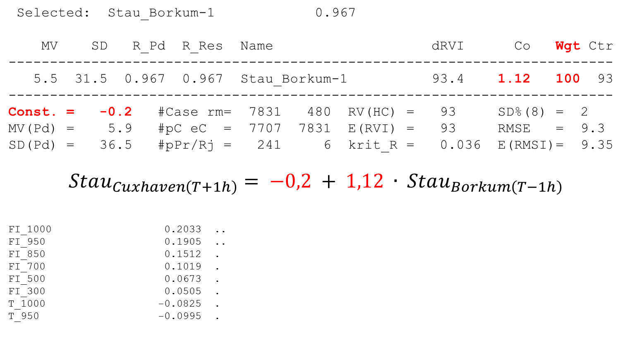
Selected: Stau_Borkum-1 0.967
MV SD R_Pd R_Res Name dRVI Co Wgt Ctr
-------------------------------------------------------------------------
5.5 31.5 0.967 0.967 Stau_Borkum-1 93.4 1.12 100 93
-------------------------------------------------------------------------
Const. = -0.2 #Case rm= 7831 480 RV(HC) = 93 SD%(8) = 2
MV(Pd) = 5.9 #pC eC = 7707 7831 E(RVI) = 93 RMSE = 9.3
SD(Pd) = 36.5 #pPr/Rj = 241 6 krit_R = 0.036 E(RMSI)= 9.35
$$Stau_{Cuxhaven\left(T+1h\right)}= −0,2 + 1,12 ∙ Stau_{Borkum\left(T−1h\right)}$$
FI_1000 0.2033 ..
FI_950 0.1905 ..
FI_850 0.1512 .
FI_700 0.1019 .
FI_500 0.0673 .
FI_300 0.0505 .
T_1000 -0.0825 .
T_950 -0.0995 .

Slide 19
T_850 -0.0939 .
T_700 -0.0217
T_500 0.0162
T_300 -0.0095
O_1000 -0.3410 ....
O_950 -0.2358 ..
O_850 -0.0851 .
O_700 0.0151
O_500 0.0453 .
O_300 0.0338
RH_1000 0.0014
RH_950 0.0323
RH_850 -0.0258
RH_700 -0.0931 .
RH_500 -0.0803 .
RH_300 0.0124
CW_1000 -0.0106
CW_950 0.0181
CW_850 0.1509 .
CW_700 0.0225
CW_500 -0.0664 .
CW_300 -0.0562 .
DMO_U_1000 0.5075 ........
DMO_U_950 0.4745 .......
DMO_U_850 0.3785 .....
DMO_V_1000 -0.0805 .
DMO_V_950 -0.1545 .
DMO_V_850 -0.2302 ..
PSsurface 0.2060 ..
Prec_Water -0.0897 .
RH_column -0.0004
Lift_Index 0.1626 .
CAPE -0.0531 .
Con_Inhib 0.0648 .
4Lev_Lift_Ix 0.2090 ..
CloudWater 0.0007
FI_0Cisotherm -0.0572 .
RH_0Cisotherm 0.0048
DMO_T_sfc -0.0709 .
DownLongFlx3(+2) -0.0302
UpLongFlx3(+2) -0.0755 .
UpLongFlxTp3(+2) 0.0111
UpShortFlxTp3(+2) -0.0263
UpShortFlx3(+2) -0.0718 .
DownShortFlx3(+2) -0.0686 .
DownLongFlx6(+3) -0.0307
UpLongFlx6(+3) -0.0731 .
UpLongFlxTp6(+3) 0.0118
UpShortFlxTp6(+3) -0.0117
UpShortFlx6(+3) -0.0609 .
DownShortFlx6(+3) -0.0581 .
DMO_C_High3(+2) -0.0275
DMO_C_Mid3(+2) -0.0789 .
DMO_C_LOW3(+2) 0.0938 .
DMO_C_High6(+3) -0.0241
DMO_C_Mid6(+3) -0.0831 .
DMO_C_LOW6(+3) 0.0962 .
PrecRate3(+2) -0.0081
ConPrecRate3(+2) -0.0215
PrecRate6(+3) -0.0055
ConPrecRate6(+3) -0.0190
DMO_T2M -0.0681 .
DMO_Tx2M_3(+2) -0.0722 .
DMO_Tn2M_3(+2) -0.0672 .
DMO_Tx2M_6(+3) -0.0726 .
DMO_Tn2M_6(+3) -0.0637 .
CldWorkFct3(+2) -0.0217
CldWorkFct6(+3) -0.0217
Bound_Layer 0.1823 .
Albedo3(+2) -0.0215
Albedo6(+3) -0.0666 .
DMO_C_con -0.0023
DMO_C_tot3(+2) 0.0162
DMO_C_bound3(+2) 0.0216
DMO_C_tot6(+3) 0.0164
DMO_C_bound6(+3) 0.0235

Slide 20
CategRain3(+2) 0.0869 .
CategSnow3(+2) -0.1273 .
CategRain6(+3) 0.0759 .
CategSnow6(+3) -0.1278 .
DMO_RH2M -0.0006
DMO_U_10m 0.5458 ..........
DMO_V_10m -0.0377 .
U_1000 0.4580 .......
V_1000 -0.2682 ...
U_950 0.4457 .......
V_950 -0.2652 ...
U_850 0.3898 .....
V_850 -0.2505 ..
U_700 0.3054 ...
V_700 -0.2266 ..
U_500 0.2365 ..
V_500 -0.1827 .
U_300 0.1765 .
V_300 -0.1581 .
Tv_5_10 -0.0414 .
ThW_850 -0.0986 .
ThW_950 -0.0888 .
Grad_ThW_850_U -0.0483 .
Grad_ThW_850_V -0.2023 ..
Rot_1000 -0.2998 ...
Rot_500 -0.1519 .
Rot_1000_LS -0.2980 ...
Rot_500_LS -0.1734 .
Grad_Tv_5_10_U 0.0404 .
Grad_Tv_5_10_V -0.0820 .
Grad_Rot_500_U -0.0862 .
Grad_Rot_500_V -0.1684 .
Grad_DMO_T2m_U 0.0311
Grad_DMO_T2m_V -0.1698 .
D_U_MS 0.5381 .........
D_U_LS 0.5307 .........
D_U_XLS 0.5177 .........
D_V_MS -0.0381 .
D_V_LS -0.0411 .
D_V_XLS -0.0437 .
DMO_T2m_MS -0.0754 .
DMO_T2m_LS -0.0767 .
PrecRate6_MS(+3) -0.0254
PrecRate6_LS(+3) -0.0319
Grad_RR6_MS_U(+3) -0.0986 .
Grad_RR6_MS_V(+3) -0.1283 .
Grad_RR6_LS_U(+3) -0.1121 .
Grad_RR6_LS_V(+3) -0.1489 .
Sin_Dag 0.0218
Cos_Dag 0.1056 .
Sin_2*Dag -0.0011
Cos_2*Dag 0.0474 .
Sin_3*Dag -0.0186
Cos_3*Dag 0.0466 .
Sin_4*Dag -0.0107
Cos_4*Dag 0.0035
Bin_1/04 0.0331
Bin_7/04 0.0220
Bin_1/05 0.0000
Bin_7/05 0.0000
Bin_1/06 0.0000
Bin_7/06 0.0000
Bin_1/07 0.0736 .
Bin_7/07 0.0779 .
Bin_1/08 0.0469 .
Sun_Alt_Degree -0.0480 .
Sun_Alt_Sinus100 -0.0459 .
Sun_Alt_Sin/1h(+1) -0.0572 .
Sun_Minutes/1h(+1) -0.0351
FFCos 0.5662 ..........
FFCos**1.5 0.6230 ............
FFCos**2-285 0.5871 ...........
FFCos**2 0.6138 ............
FFCos-285 0.5363 .........
FFCos-305 0.5734 ...........
PersStau 0.1048 .

Slide 21

MV SD R_Pd R_Res Name dRVI Co Wgt Ctr
-------------------------------------------------------------------------
5.5 31.5 0.967 0.967 Stau_Borkum-1 93.4 0.94 78 78
36.1 90.6 0.789 0.446 FFCos**1.5 38.7 0.09 22 18
-------------------------------------------------------------------------
Const. = -2.5 #Case rm= 7831 480 RV(HC) = 96 SD%(8) = 2
MV(Pd) = 5.9 #pC eC = 7707 7831 E(RVI) = 96 RMSE = 7.3
SD(Pd) = 36.5 #pPr/Rj = 241 6 krit_R = 0.036 E(RMSI)= 7.32
$$Stau_{Cuxhaven\left(T+1h\right)}= −2,5 + 0,94 ∙ Stau_{Borkum\left(T−1h\right)}+ 0,09 ∙{FFCos}^{1,5}$$
FI_1000 0.1433 .
FI_950 0.1450 .
FI_850 0.1386 .
FI_700 0.1192 .
FI_500 0.0941 .
FI_300 0.0754 .
T_1000 0.0206
T_950 0.0187
T_850 0.0143
T_700 0.0352
T_500 0.0406 .
T_300 0.0169
O_1000 0.0206
O_950 0.0927 .
O_850 0.0972 .
O_700 0.0632 .
O_500 0.0497 .
O_300 0.0396 .
RH_1000 -0.1225 .
RH_950 -0.1154 .
RH_850 -0.1213 .

Slide 22
RH_700 -0.1294 .
RH_500 -0.1038 .
RH_300 -0.0219
CW_1000 -0.0237
CW_950 -0.0702 .
CW_850 -0.0531 .
CW_700 -0.0386 .
CW_500 -0.0683 .
CW_300 -0.0409 .
DMO_U_1000 -0.0072
DMO_U_950 -0.0501 .
DMO_U_850 -0.0741 .
DMO_V_1000 -0.1099 .
DMO_V_950 -0.0962 .
DMO_V_850 -0.0684 .
PSsurface 0.1403 .
Prec_Water -0.0541 .
RH_column -0.0718 .
Lift_Index 0.0589 .
CAPE -0.0119
Con_Inhib 0.0055
4Lev_Lift_Ix 0.0870 .
CloudWater -0.0913 .
FI_0Cisotherm 0.0245
RH_0Cisotherm -0.0988 .
DMO_T_sfc 0.0144
DownLongFlx3(+2) -0.0612 .
UpLongFlx3(+2) 0.0094
UpLongFlxTp3(+2) 0.0943 .
UpShortFlxTp3(+2) -0.0302
UpShortFlx3(+2) 0.0505 .
DownShortFlx3(+2) 0.0502 .
DownLongFlx6(+3) -0.0611 .
UpLongFlx6(+3) 0.0127
UpLongFlxTp6(+3) 0.0999 .
UpShortFlxTp6(+3) -0.0093
UpShortFlx6(+3) 0.0774 .
DownShortFlx6(+3) 0.0759 .
DMO_C_High3(+2) -0.0597 .
DMO_C_Mid3(+2) -0.1053 .
DMO_C_LOW3(+2) -0.1052 .
DMO_C_High6(+3) -0.0590 .
DMO_C_Mid6(+3) -0.1113 .
DMO_C_LOW6(+3) -0.1078 .
PrecRate3(+2) -0.1024 .
ConPrecRate3(+2) -0.0791 .
PrecRate6(+3) -0.1075 .
ConPrecRate6(+3) -0.0828 .
DMO_T2M 0.0250
DMO_Tx2M_3(+2) 0.0279
DMO_Tn2M_3(+2) 0.0176
DMO_Tx2M_6(+3) 0.0356
DMO_Tn2M_6(+3) 0.0128
CldWorkFct3(+2) -0.0456 .
CldWorkFct6(+3) -0.0489 .
Bound_Layer 0.0035
Albedo3(+2) 0.0424 .
Albedo6(+3) 0.0356
DMO_C_con -0.0787 .
DMO_C_tot3(+2) -0.1188 .
DMO_C_bound3(+2) -0.1219 .
DMO_C_tot6(+3) -0.1230 .
DMO_C_bound6(+3) -0.1231 .
CategRain3(+2) -0.0913 .
CategSnow3(+2) -0.0829 .
CategRain6(+3) -0.0992 .
CategSnow6(+3) -0.0765 .
DMO_RH2M -0.1246 .
DMO_U_10m 0.0134
DMO_V_10m -0.1121 .
U_1000 -0.0846 .
V_1000 -0.1028 .
U_950 -0.0833 .
V_950 -0.0835 .
U_850 -0.0790 .
V_850 -0.0639 .

Slide 23
U_700 -0.0598 .
V_700 -0.0530 .
U_500 -0.0204
V_500 -0.0319
U_300 -0.0203
V_300 -0.0270
Tv_5_10 0.0274
ThW_850 -0.0219
ThW_950 -0.0092
Grad_ThW_850_U -0.0459 .
Grad_ThW_850_V 0.0005
Rot_1000 -0.2017 ..
Rot_500 -0.0995 .
Rot_1000_LS -0.1985 ..
Rot_500_LS -0.1110 .
Grad_Tv_5_10_U -0.0336
Grad_Tv_5_10_V 0.0360 .
Grad_Rot_500_U -0.0125
Grad_Rot_500_V -0.0361 .
Grad_DMO_T2m_U -0.0896 .
Grad_DMO_T2m_V 0.0351
D_U_MS 0.0090
D_U_LS 0.0083
D_U_XLS 0.0095
D_V_MS -0.1077 .
D_V_LS -0.1045 .
D_V_XLS -0.1003 .
DMO_T2m_MS 0.0261
DMO_T2m_LS 0.0261
PrecRate6_MS(+3) -0.1183 .
PrecRate6_LS(+3) -0.1227 .
Grad_RR6_MS_U(+3) -0.0434 .
Grad_RR6_MS_V(+3) 0.0433 .
Grad_RR6_LS_U(+3) -0.0442 .
Grad_RR6_LS_V(+3) 0.0421 .
Sin_Dag 0.0851 .
Cos_Dag -0.0352
Sin_2*Dag -0.0680 .
Cos_2*Dag -0.0547 .
Sin_3*Dag -0.0181
Cos_3*Dag 0.0351
Sin_4*Dag 0.0010
Cos_4*Dag -0.0225
Bin_1/04 0.0000
Bin_7/04 0.0000
Bin_1/05 0.0150
Bin_7/05 0.0338
Bin_1/06 0.0864 .
Bin_7/06 0.0848 .
Bin_1/07 0.1205 .
Bin_7/07 0.0893 .
Bin_1/08 0.0626 .
Sun_Alt_Degree 0.0402 .
Sun_Alt_Sinus100 0.0412 .
Sun_Alt_Sin/1h(+1) 0.0069
Sun_Minutes/1h(+1) 0.0148
FFCos -0.0292
FFCos**2-285 0.0100
FFCos**2 0.0306
FFCos-285 -0.0549 .
FFCos-305 -0.0011
PersStau -0.0640 .
PersStau-6 0.0014
PersStau-12 0.0114
2D-Model 0.1964 ..
Pers2D-Mod-6 -0.0737 .
Pers2D-Mod-12 -0.0862 .
Stau_Aberd 0.0043
Stau_Aberd-3 0.0044
Stau_Aberd-6 -0.0135
Stau_Aberd-9 -0.0135
Stau_Aberd-12 -0.0525 .
Stau_Borkum-6 -0.1459 .
Stau_Borkum-9 -0.1001 .
Stau_Borkum-h -0.1002 .
RR3_Strat(+2) -0.0730 .

Slide 24
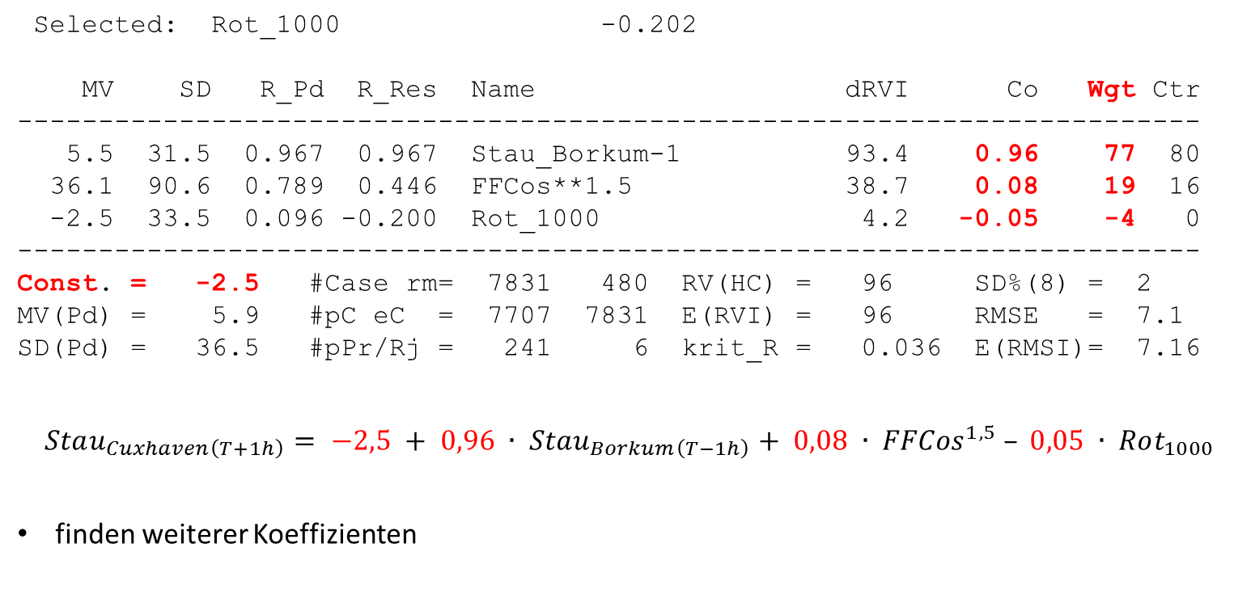
Selected: Rot_1000 -0.202
MV SD R_Pd R_Res Name dRVI Co Wgt Ctr
-------------------------------------------------------------------------
5.5 31.5 0.967 0.967 Stau_Borkum-1 93.4 0.96 77 80
36.1 90.6 0.789 0.446 FFCos**1.5 38.7 0.08 19 16
-2.5 33.5 0.096 -0.200 Rot_1000 4.2 -0.05 -4 0
-------------------------------------------------------------------------
Const. = -2.5 #Case rm= 7831 480 RV(HC) = 96 SD%(8) = 2
MV(Pd) = 5.9 #pC eC = 7707 7831 E(RVI) = 96 RMSE = 7.1
SD(Pd) = 36.5 #pPr/Rj = 241 6 krit_R = 0.036 E(RMSI)= 7.16
$$Stau_{Cuxhaven\left(T+1h\right)}= −2,5 + 0,96 ∙ Stau_{Borkum\left(T−1h\right)}+ 0,08 ∙ {FFCos}^{1,5} – 0,05 ∙ Rot_{1000}$$
finden weiterer Koeffizienten

Slide 25
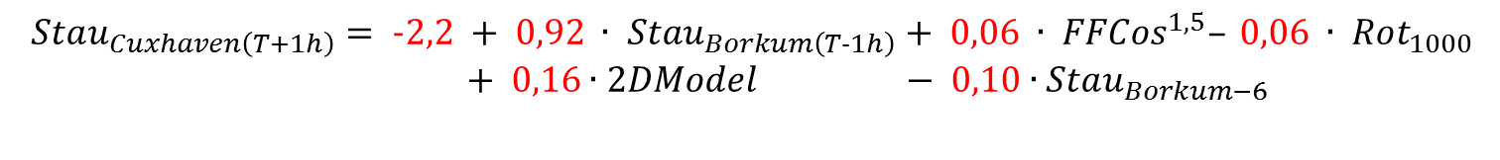
endgültige Regressionstabelle
Selected: Stau_Borkum-6 -0.229
MV SD R_Pd R_Res Name dRVI Co Wgt Ctr
-------------------------------------------------------------------------
5.5 31.5 0.967 0.967 Stau_Borkum-1 93.4 0.92 64 77
36.1 90.6 0.789 0.446 FFCos**1.5 38.7 0.06 13 12
-2.5 33.5 0.096 -0.200 Rot_1000 4.2 -0.06 -4 0
7.3 35.5 0.921 0.085 2D-Model 5.1 0.16 13 14
5.5 31.5 0.785 -0.129 Stau_Borkum-6 5.5 -0.10 -7 -7
-------------------------------------------------------------------------
Const. = -2.2 #Case rm= 7831 480 RV(HC) = 97 SD%(8) = 2
MV(Pd) = 5.9 #pC eC = 7707 7831 E(RVI) = 97 RMSE = 6.8
SD(Pd) = 36.5 #pPr/Rj = 241 6 krit_R = 0.036 E(RMSI)= 6.78
$$Stau_{Cuxhaven\left(T+1h\right)}= −2,2 + 0,92 ∙ Stau_{Borkum\left(T−1h\right)}+ 0,06 ∙ {FFCos}^{1,5}– 0,06 ∙ Rot_{1000}$$
$+ 0,16∙2DModel − 0,10∙Stau_{Borkum−6}$

Slide 26
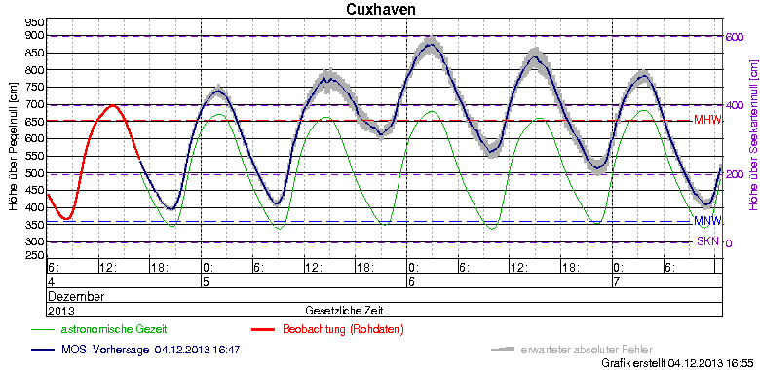
Eingetretene Scheitelwasserstände
18h-Vorhersage, man.

Slide 27
2000 bis Gegenwart
  wetterturnier.de
  MSwr-MOS – Vorhersagen
  MOS als NowCast-Warnsystem

Slide 28
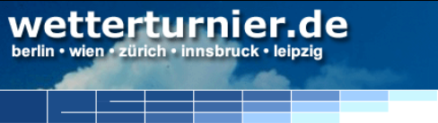
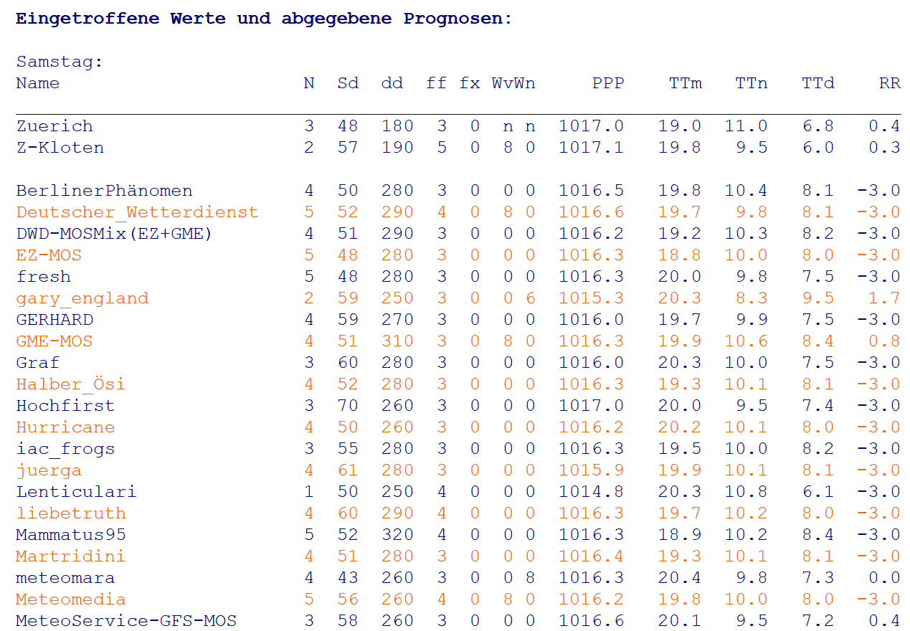
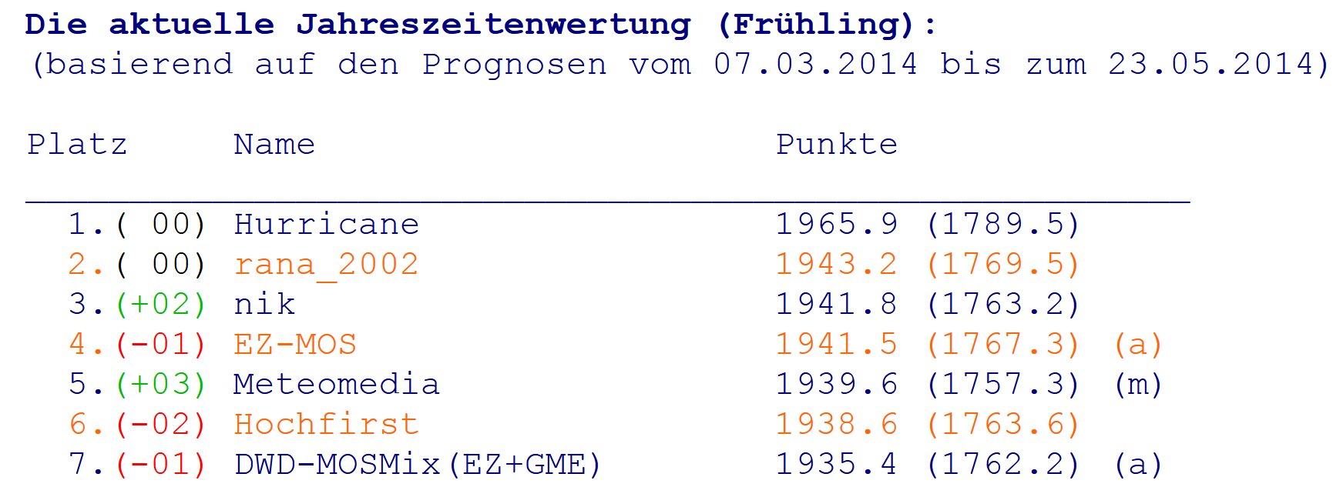
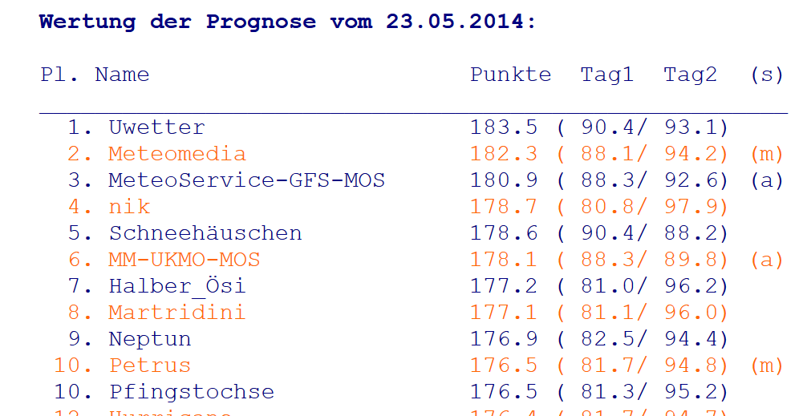
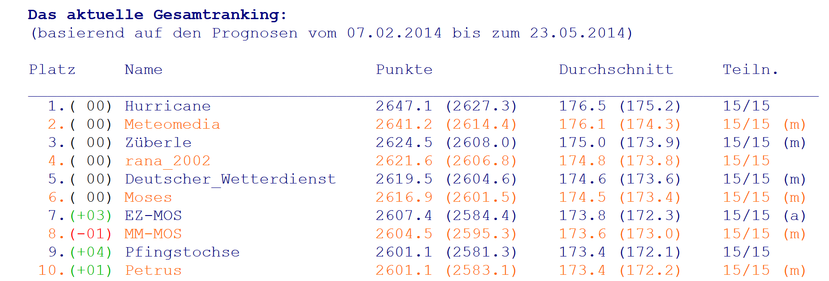

Slide 29
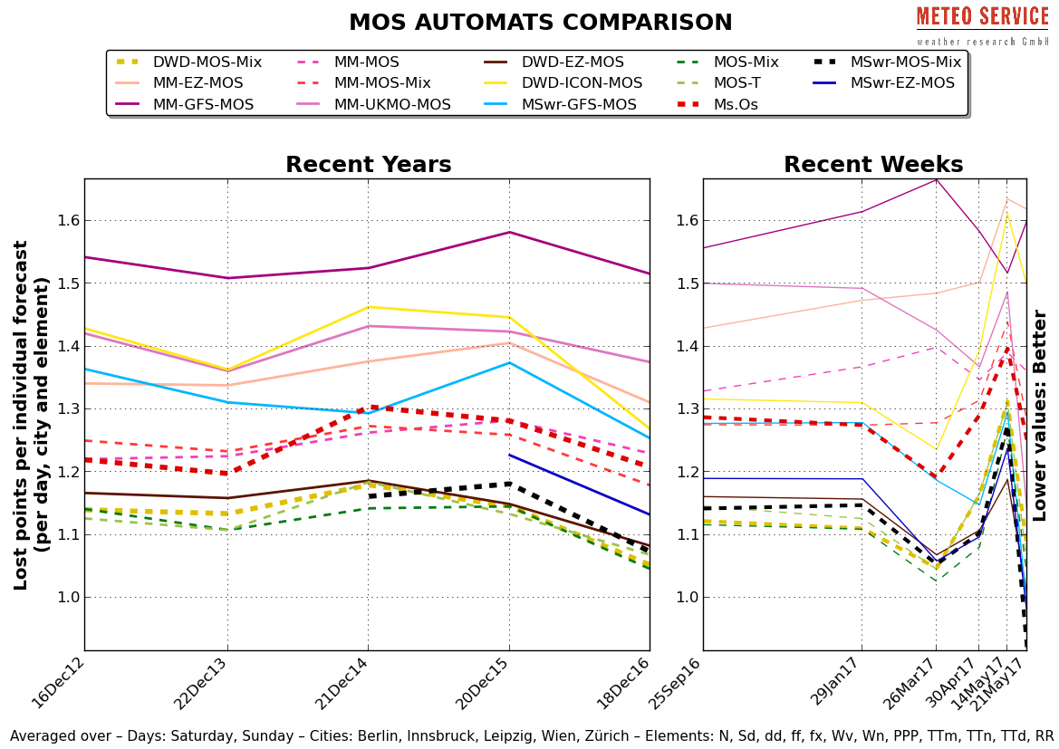

Slide 30
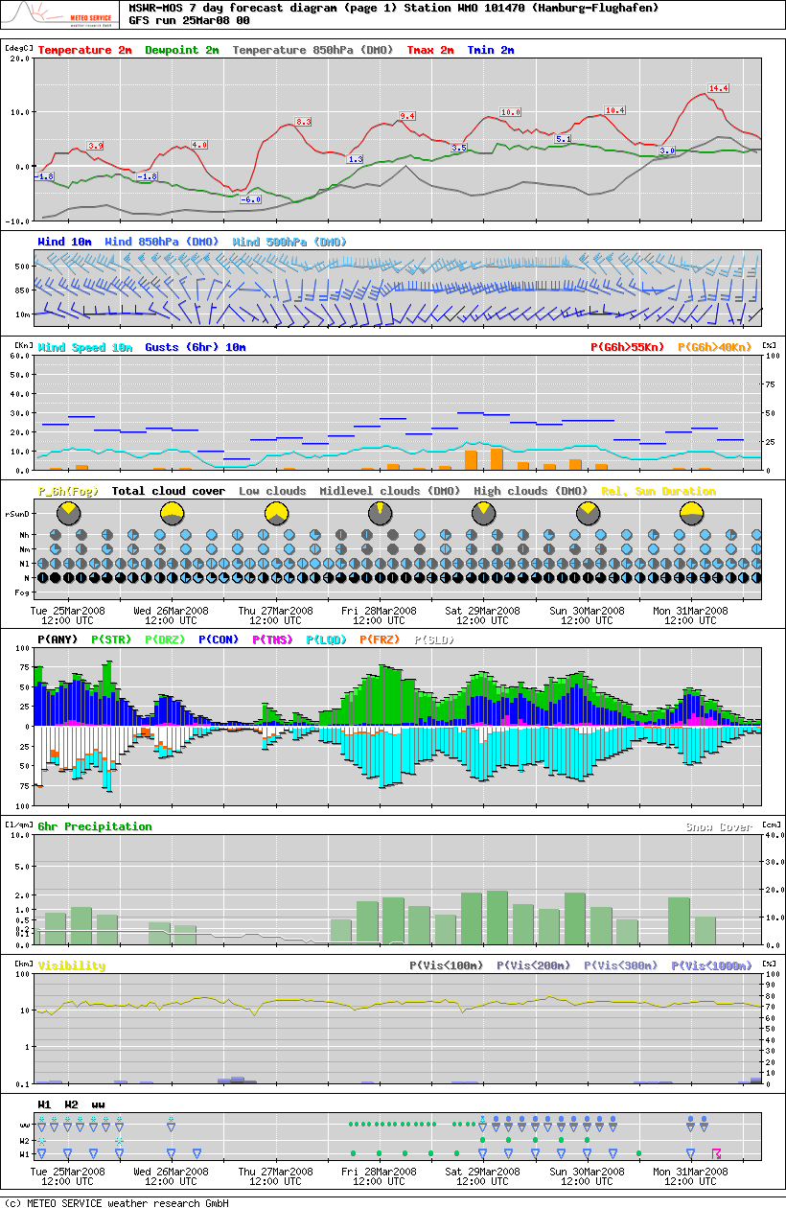
MSwr-MOS Vorhersage
für Hamburg, ausgegeben
am 25. März 2008

Slide 31
MSwr-MOS Vorhersage
für Hamburg, ausgegeben
am 25. März 2008

Slide 32
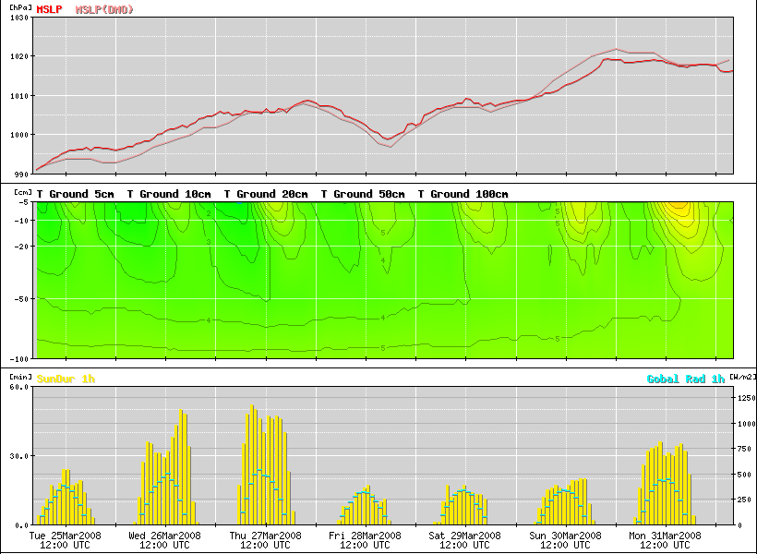
MSwr-MOS Vorhersage
für Hamburg, ausgegeben
am 25. März 2008

Slide 33
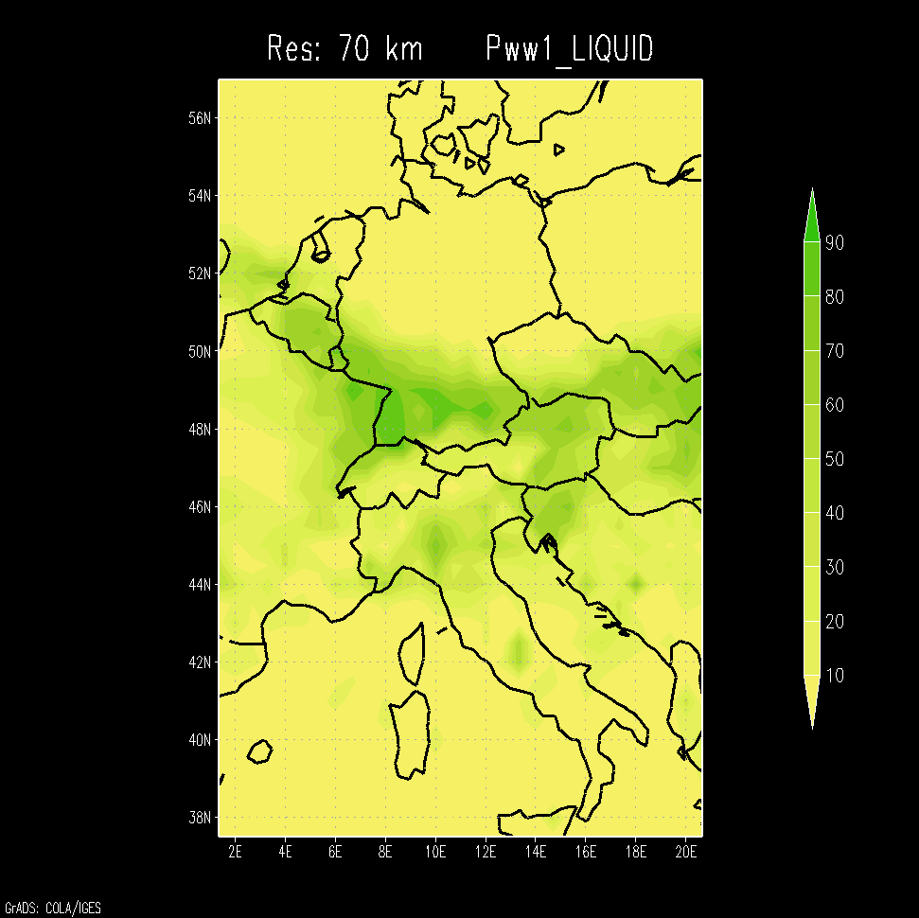
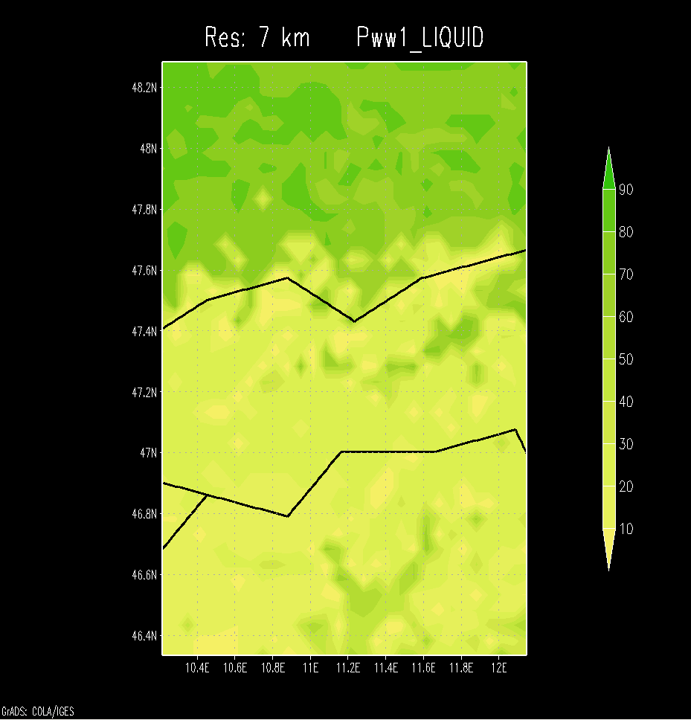
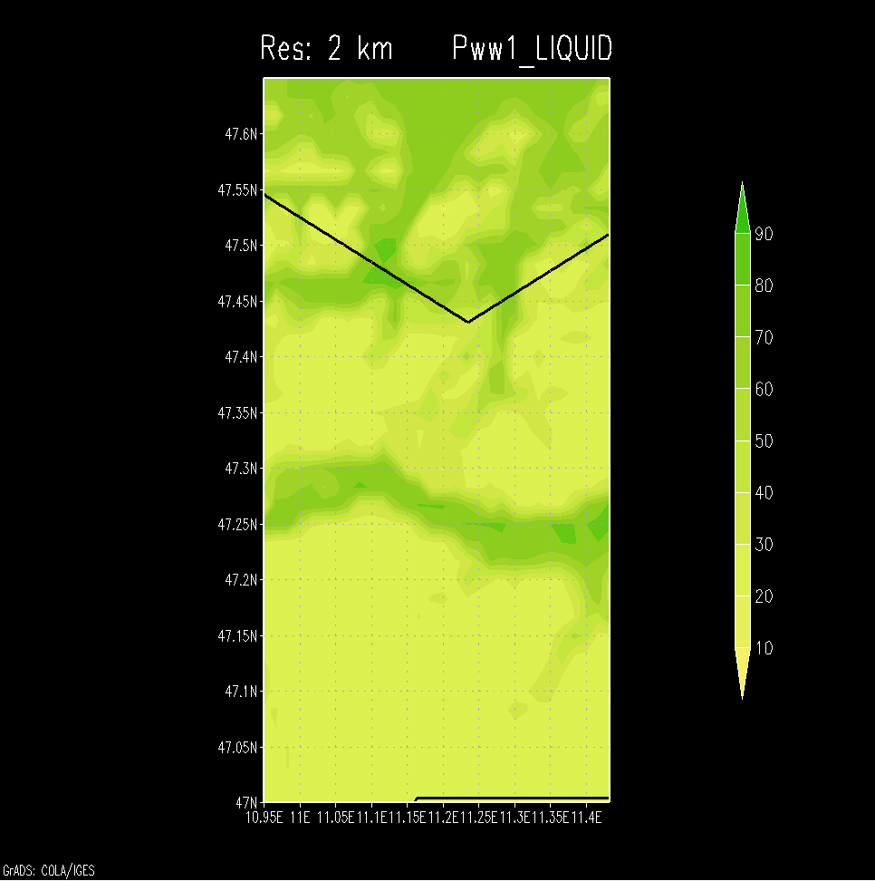
Interpolations-MOS für den 20.04.2005 13 UTC

Slide 34
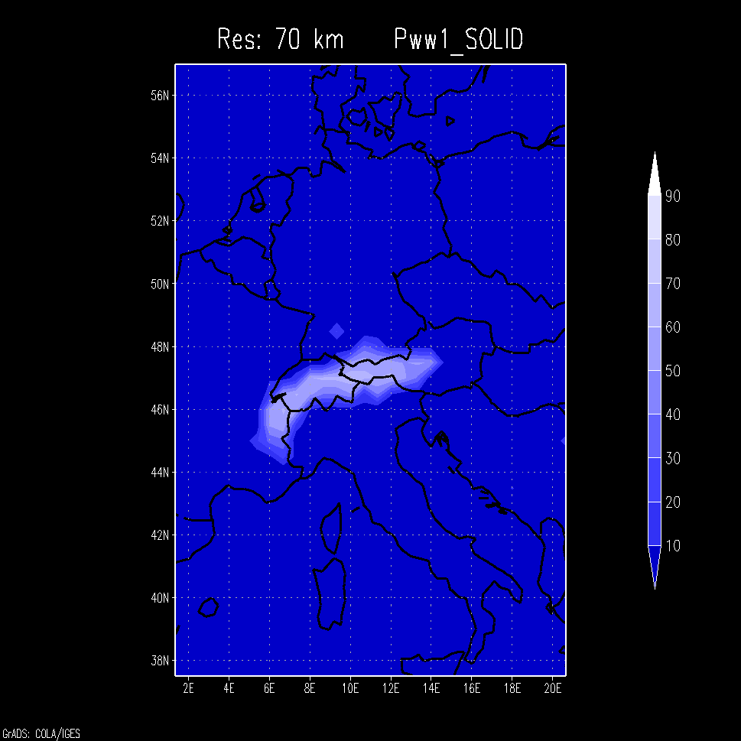
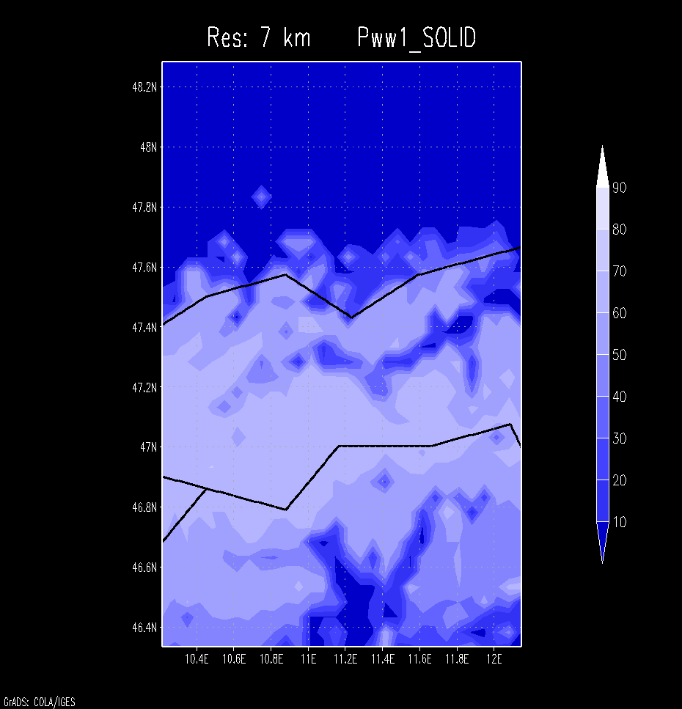
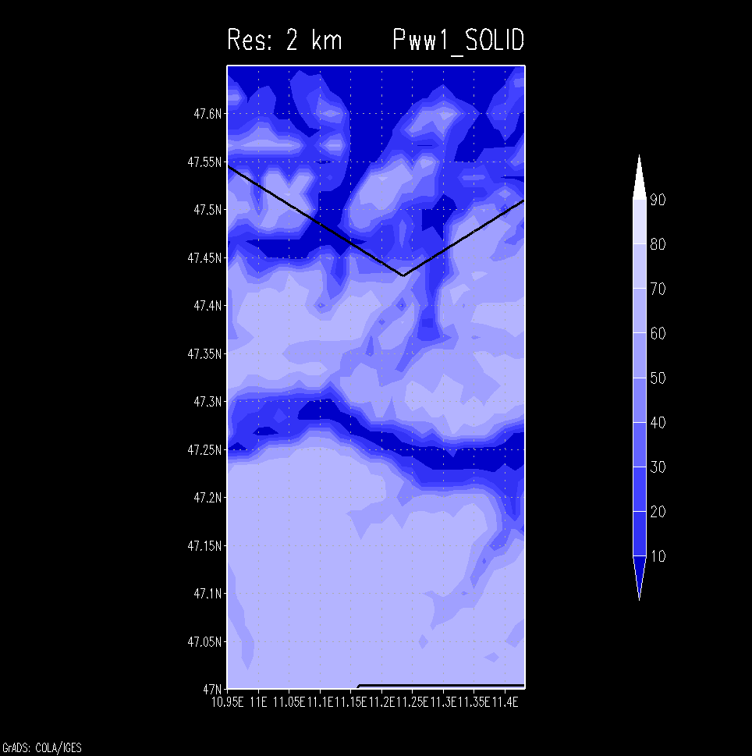
Interpolations-MOS für den 20.04.2005 13 UTC

Slide 35
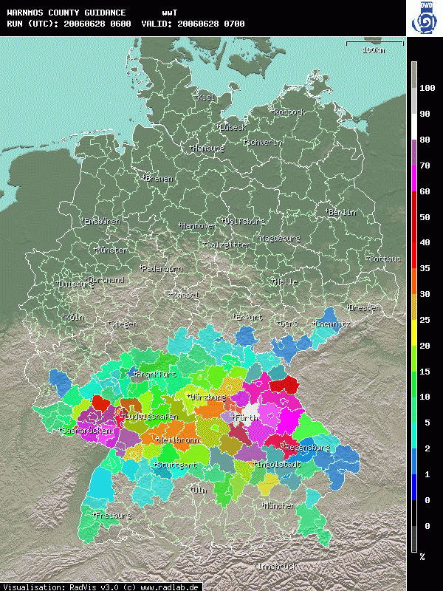
WarnMOS
Stündliche Gewitterwahrscheinlichkeit
28. Juni 2006
12h-Vorhersage

Slide 36
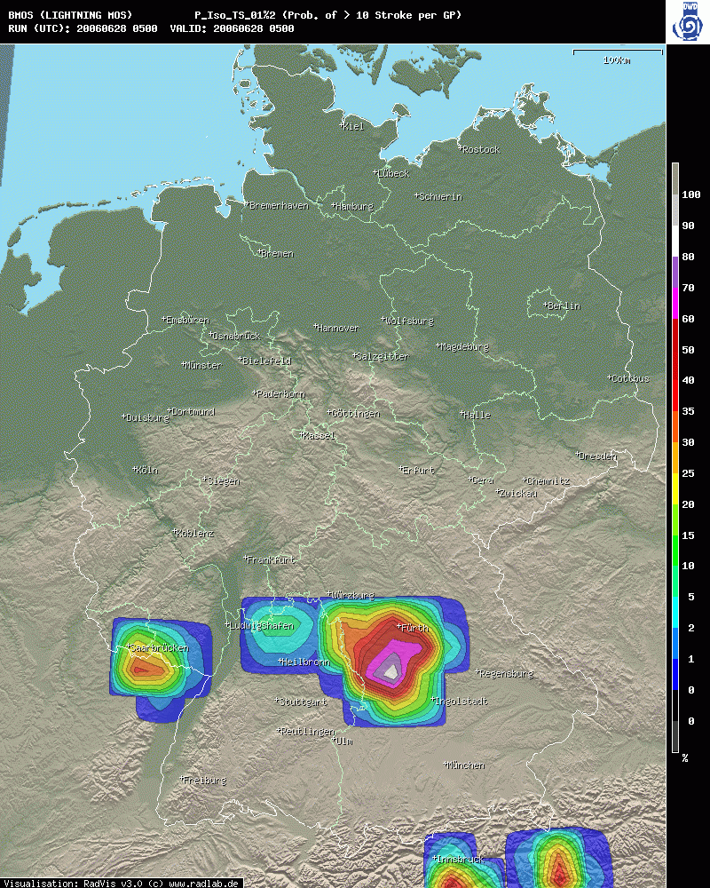
BlitzMOS
Wahrscheinlichkeit isolierter Gewitter mit mehr als 10 Blitze pro 15 min im 27x27 Gitter
28. Juni 2006
3h-Vorhersage

Slide 37
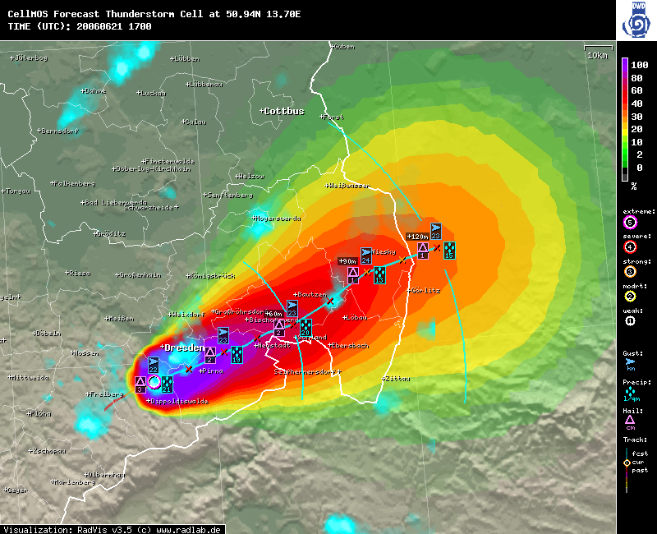
ZellMOS
21. Juni 2006
17 UTC

Slide 38
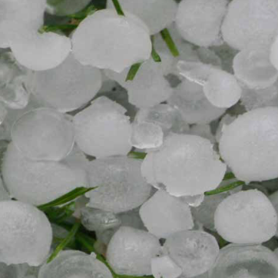
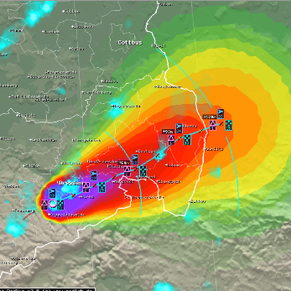
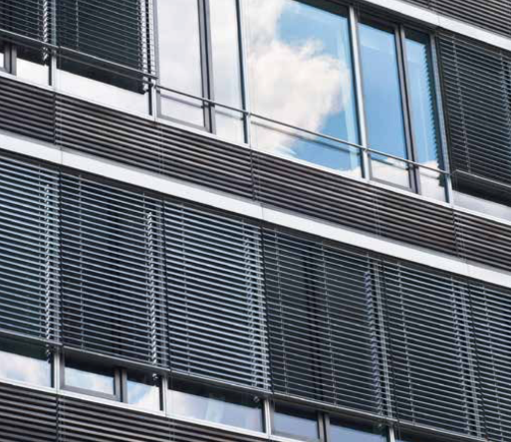
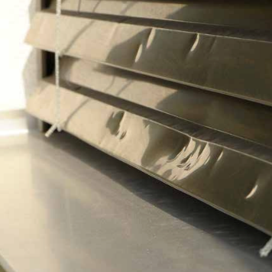
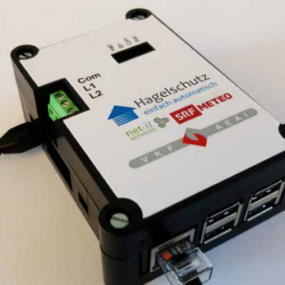






0 Introduction
Adoption of MSwr-CellMOS for Hail Alarm in Switzerland
Hail… Protection... Simply
automatic!
Contributors

Slide 39
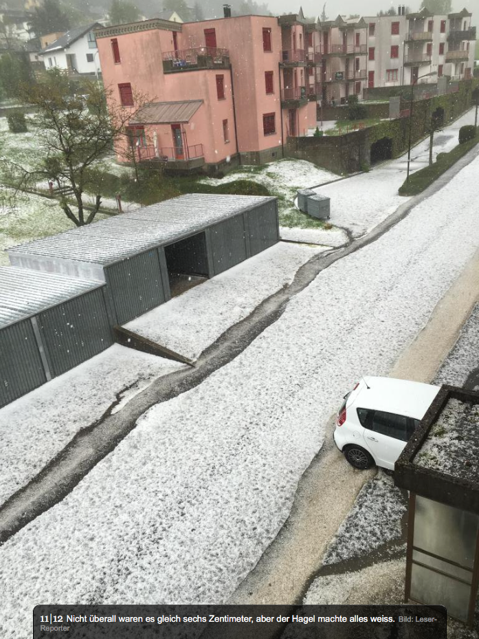
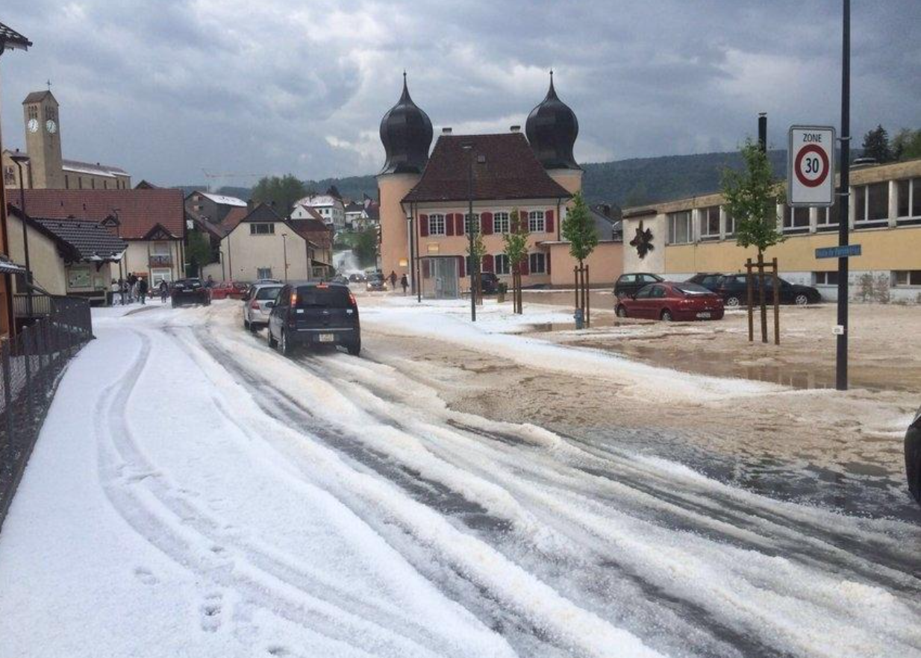
1.3.2 MSwr-CellMOS (SRF/VKF)
Adoption of MSwr-CellMOS for Hail Alarm in Switzerland
Case example
May 10th 2016, Canton: Jura
Image source: www.20min.ch

Slide 40
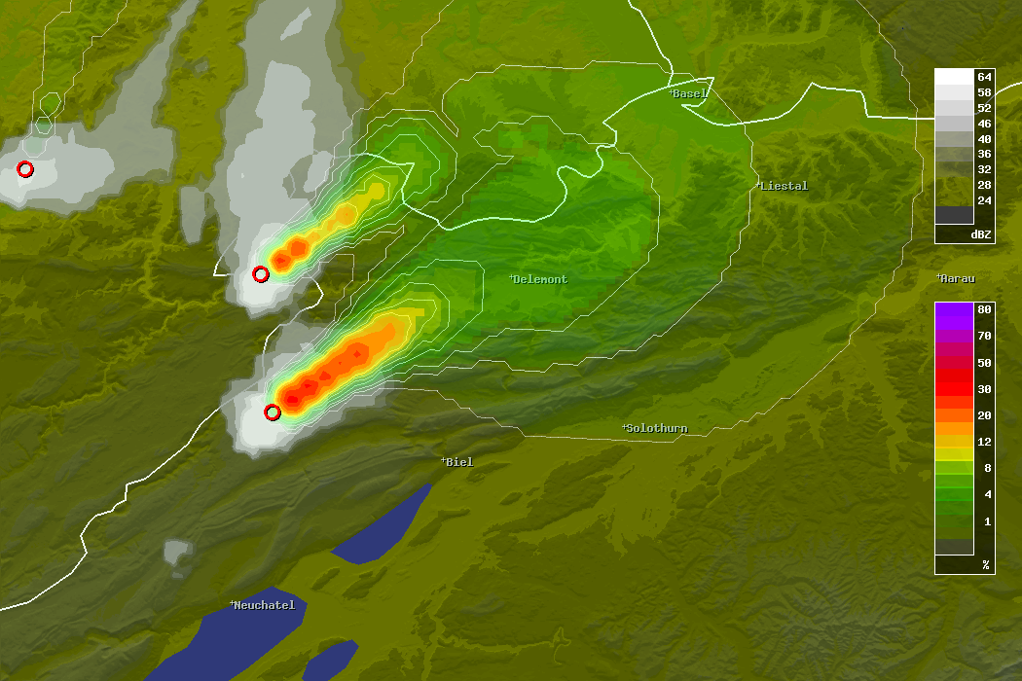
1.3.2 MSwr-CellMOS (SRF/VKF)
Radar Refl. 16:20 UTC
16:45 UTC, 1.5 cm
Prob Hail > 15mm / 120min
17:10 UTC, 3 cm
MSwr-CellMOS Hail Forecast
Full Run 16:20 UTC (0 – 120 min)
ESWD Hail Reports

Slide 41
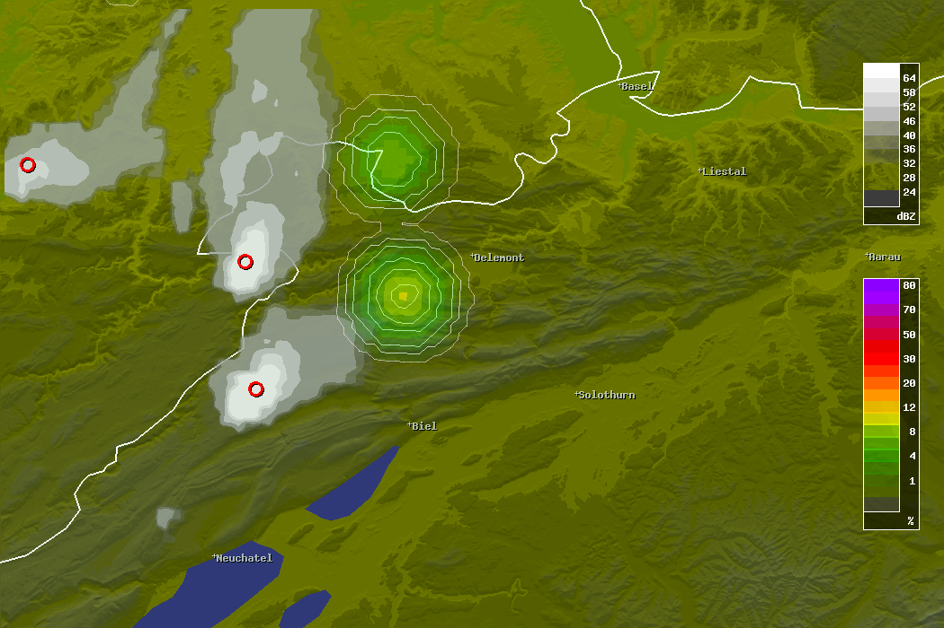

1.3.2 MSwr-CellMOS (SRF/VKF)
Radar Refl. 16:20 UTC
Prob Hail > 15mm / 5min
17:10 UTC, 3 cm
MSwr-CellMOS Hail Forecast
Run 16:20 UTC + 45 min / 17:05 UTC
ESWD Hail Reports

Slide 42
Zusammenfassung und Ausblick

Slide 43
Zusammenfassung und Ausblick
MOS reduziert seit ca. 20 Jahren ca. 50% der Fehlervarianz der numerischen Vorhersagemodelle
  Modelle werden besser
  MOS-Verfahren werden besser
  die 50% bleiben...(?)

