Slide 1

Weather forecasting contests
with emphasis on comparison of the performance of different MOS technologies based on different numerical models
NOAA, MDL
29.08.2014

Slide 2
Outline
0
History
1
Motivation
2
The Tournament: Participants and Rules
3
Results
4
Conclusions

Slide 3
0
History

Slide 4
Weather forecasting contests
Meteo Service: History
Pre-History
Jul 1990 Klaus Knüpffer visits Bob Glahn and others at TDL
1991 ECMWF-MOS at Meteo Consult Wageningen (now: MeteoGroup)
1993 Kalman Filtering of EM (Europa-Modell) at DWD
Coefficient (not forecast) interpolation in space.
1993 K. Knüpffer makes a proposal for a European Centre for Statistical
Postprocessing
Jan 1994 METEO SERVICE weather research GmbH founded by Klaus Knüpffer and Diederik Haalman
1995 Auto-TAF: MOS-guidance + encoded TAF and GAFOR
1996 Kalman-Filtering of ECMWF Ensembles: RV=10…20%
1998 GME-MOS for standard weather elements for DWD: MOS coefficient
interpolation in space (old scheme)
2000 Start of weather forecasting tournaments
2001-05 MOS NowCasting systems: Radar-MOS, Lightning-MOS
Integration into WarnMOS and Auto-TAF
2005 MSwr-GFS-MOS operational
http://prognose.met.fu-berlin.de/index_en.php

Slide 5
Weather forecasting contests
Meteo Service: History
http://prognose.met.fu-berlin.de/index_en.php
Transition from big projects for big clients to operational provision of MSwr-GFS-MOS for smaller weather forecasting companies.
2009 Water level forecasts: North Sea and rivers.
2010 New MOS coefficient interpolation scheme in space operational:
Complete MOS forecasts (without NIL values).
2014/15 GFS-ECMWF-HIRLAM-MOS-Mix
2014/15 Transition of the new spatial interpolation system to DWD.

Slide 6
Weather forecasting contests
Meteo Service: Strength and weaknesses
Strength
Intuitive approach with high success rate
Classical, timeless set-up of the FORTRAN-bash-system with database-like structure,
controlled by configuration files
- No structural changes during the last 20 years and
- fit for the coming 20 years
One solution for all elements
Strictly RMSE optimized (other optimizations possible)
Simple algorithms with high transparency (important for system development and debugging)
Strictly linear regression. All non-linear aspects are dealed with by transformations:
- analytical transformations
- empirical transformations
http://prognose.met.fu-berlin.de/index_en.php

Slide 7
Weather forecasting contests
Meteo Service: Strength and weaknesses
Weaknesses
We are too small:
We cannot afford all good observation and model data
Internal reasons:
- PR insufficient
Why don‘t we have one global MOS manufacture which blends the MOS forecasts of all the good models into one – seamless from NowCast until extended Medium range?
http://prognose.met.fu-berlin.de/index_en.php

Slide 8
1
Motivation

Slide 9

Weather forecasting contests
Motivation
http://prognose.met.fu-berlin.de/index_en.php
It is a unique verification tool which tells us:
How good are (MOS forecasts based on) the different numerical models?
How good are the MOS forecasts of different MOS developers?
How much can the forecasters improve the machine forecast?
It is a forecasting game, but moreover
29.08.2014

Slide 10
2
The Tournament: Participants and Rules

Slide 11
Weather forecasting contests
weather forecasting for 5 locations
participants: human forecaster and machine forecasts
What?
http://prognose.met.fu-berlin.de/index_en.php
create a forecast in which you predict the weather of the following weekend as accurate as possible (deadline: each Friday 15UTC)
evaluation by a sophisticated point system
How?
scoring of the week
ranking for each season
continuous ranking: 15 weeks running means
Scoring?
29.08.2014

Slide 12
Weather forecasting contests
Participants
http://prognose.met.fu-berlin.de/index_en.php
Forecasters from amateur, students to professionals
(a): machine forecasts (details next slide)
(m): averages, e.g. Deutscher Wetterdienst
→Petrus: arithmetic average of all participants
→Moses: MOS-regression-weighted average of
the best and/or independent participants
29.08.2014

Slide 13
Weather forecasting contests
Machine forecasts, developed by Meteo Service
DWD-MOS:
- GME-MOS – since 2000
- EZ-MOS – since 2004:
- based on Thu 12z-run until summer 2011
- based on Fr 00z-run from summer 2011
- DWD-MOS-Mix(EZ+GME) – since 2003
MeteoService-MOS:
MeteoService-GFS-MOS – since 2004
MSwr-HIR-MOS – since 2014
MSwr-MOS-Mix(GFS+HIR) – since 2014
DWD- and Meteoservice-MOS combined:
MOS-Mix (=2/3 DWD-MOS-Mix + 1/3 GFS-MOS) – since 2004
http://prognose.met.fu-berlin.de/index_en.php
29.08.2014

Slide 14
Weather forecasting contests
Machine forecasts, developed by others
Meteomedia-MOSs:
- MM-EZ-MOS – since 2009
- MM-GFS-MOS – since 2009
- MM-UKMO-MOS – since 2009
MM-MOS-Mix – since 2009
MM-MOS – since 2006
MeteoGroup-MOS: Ms.Os – since 2000
http://prognose.met.fu-berlin.de/index_en.php
29.08.2014

Slide 15
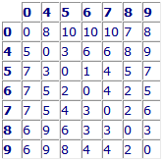
Scoring
The scoring operates on a demerit principle based on a system of rules where points are deducted from an ideal score for every error as follows:
Example: weather conditions Wv and Wn:
perfect score: 10 pts.
observed
forecasted

Slide 16
3
Results

Slide 17
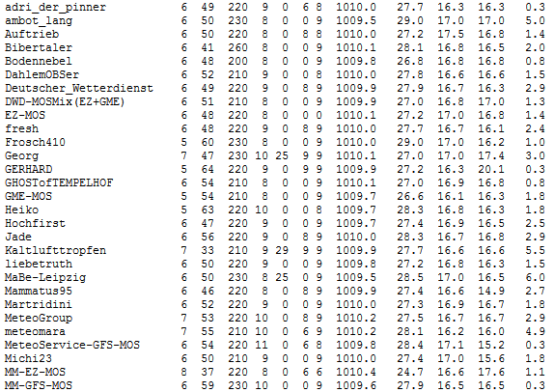
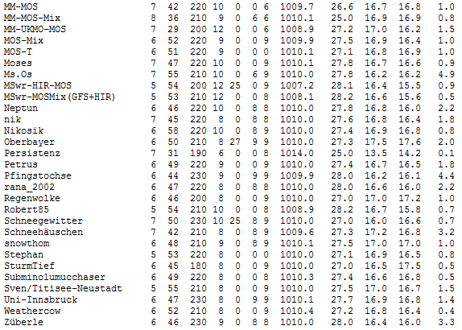
Weather forecasting contests
obs-stations
all participants
MeteoService-GFS-MOS
Petrus
29.08.2014

Slide 18
Weather forecasting contests
Weather observations and forecasts Berlin - Saturday, Aug 9
Scoring Saturday
day1
day2
MeteoService-GFS-MOS 85.9 /
Petrus 74.0 /
29.08.2014

Slide 19
Weather forecasting contests
Weather observations and forecasts Berlin - Sunday, Aug 10
Scoring Sunday
day1
day2
1.)MeteoService-GFS-MOS 85.9 / 84.8
34.)Petrus 74.0 / 79.6
57.)GME-MOS 70.4 / 58.2
29.08.2014

Slide 20
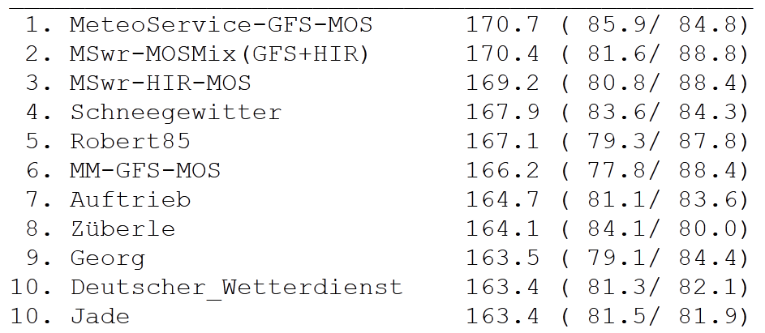
Weather forecasting contests
Scoring weekend (09./10. Aug14) - Berlin
pos
name
points
day1
day2
29.08.2014

Slide 21
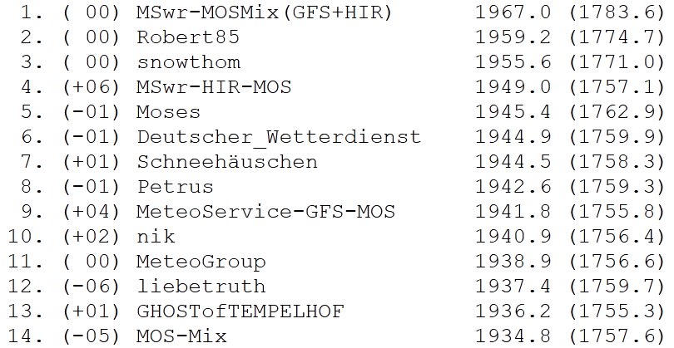
Weather forecasting contests
Seasons ranking – Berlin (based on the weekends from June 6, 2014 till August 15, 2014)
29.08.2014

Slide 22
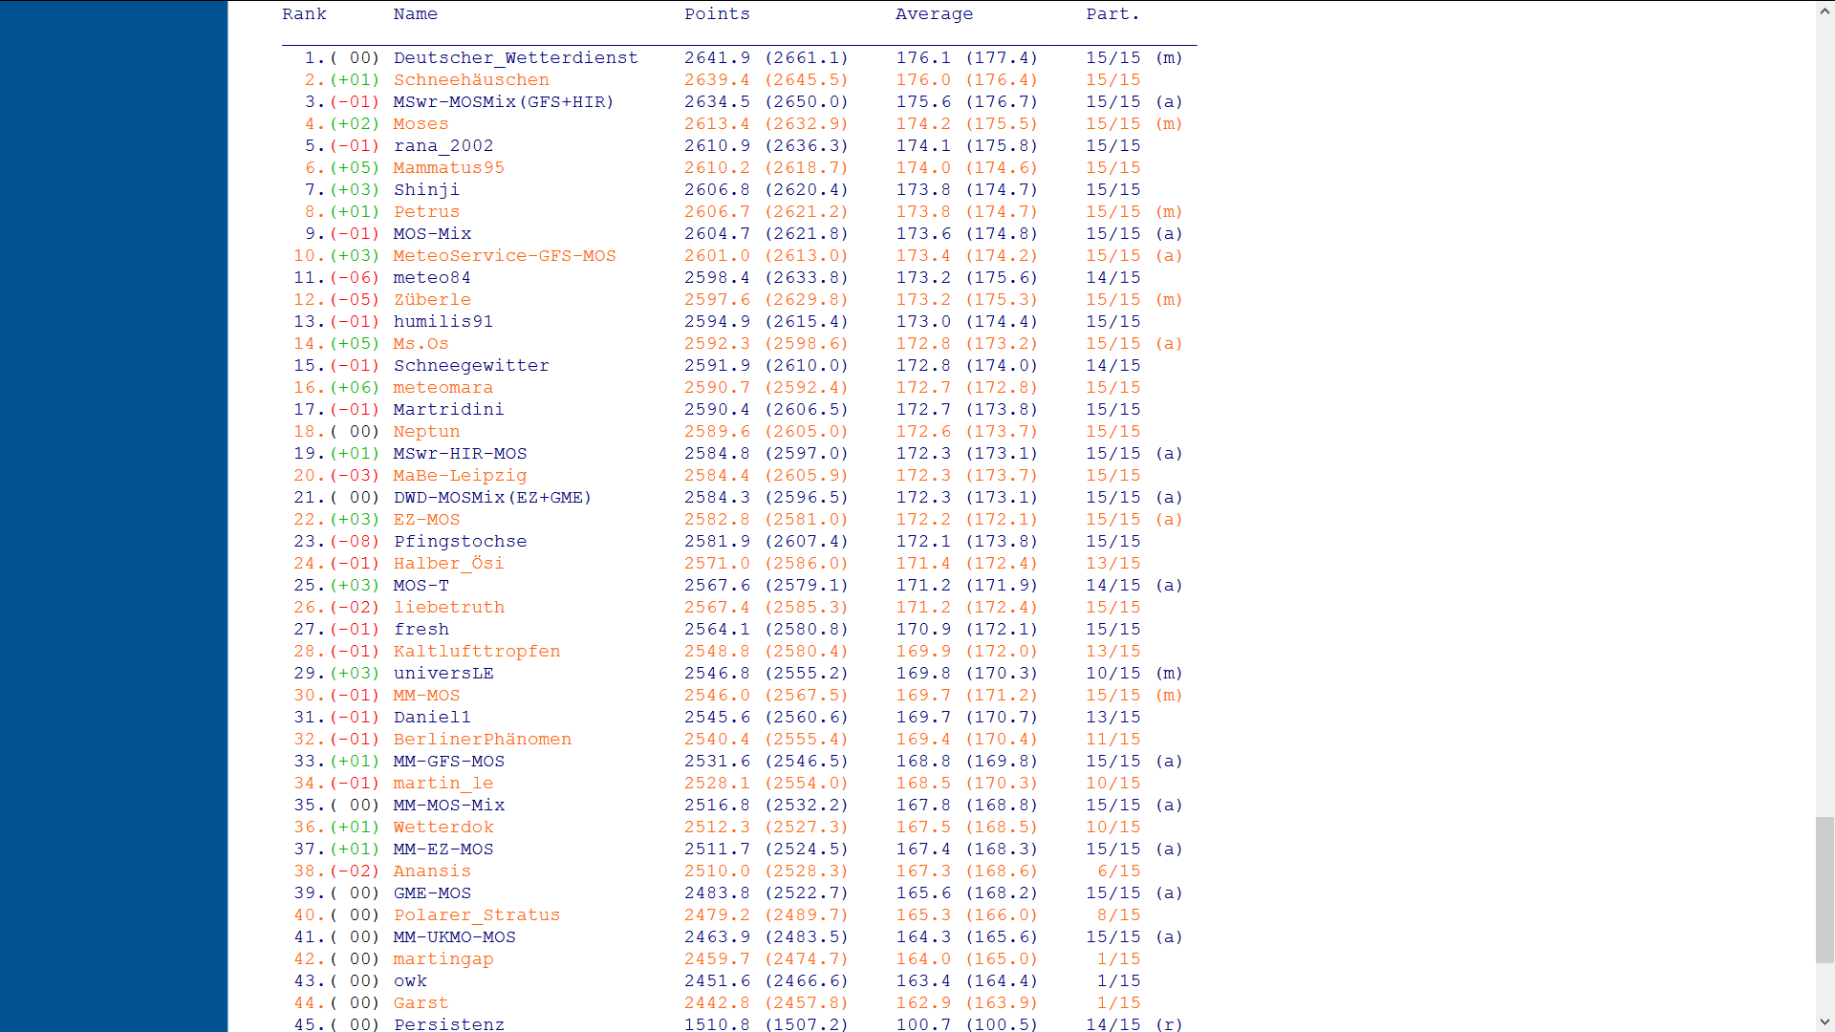
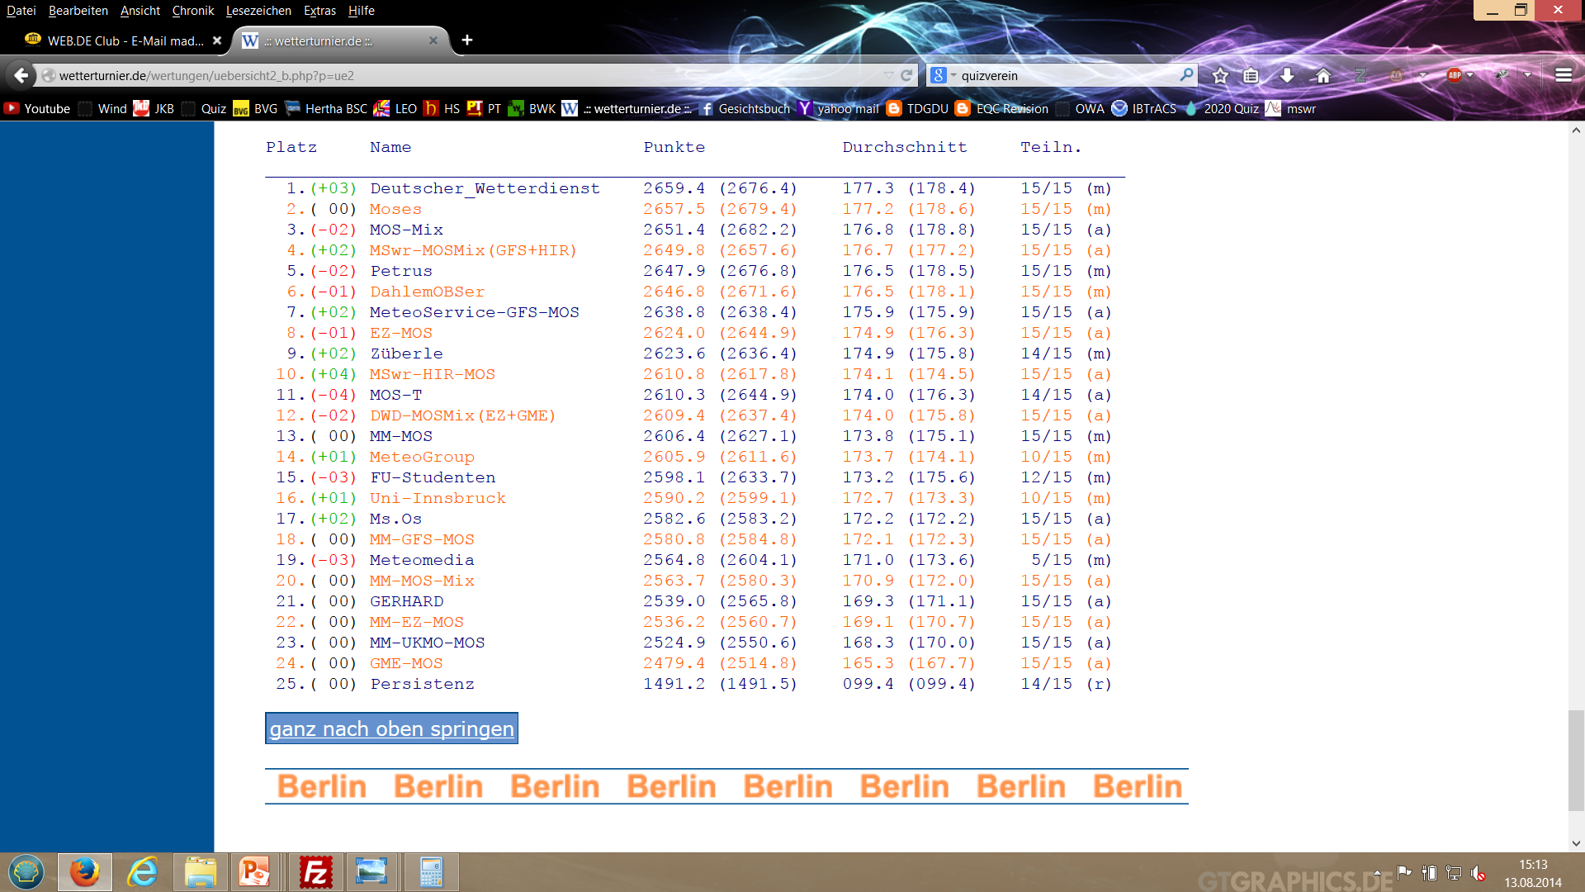
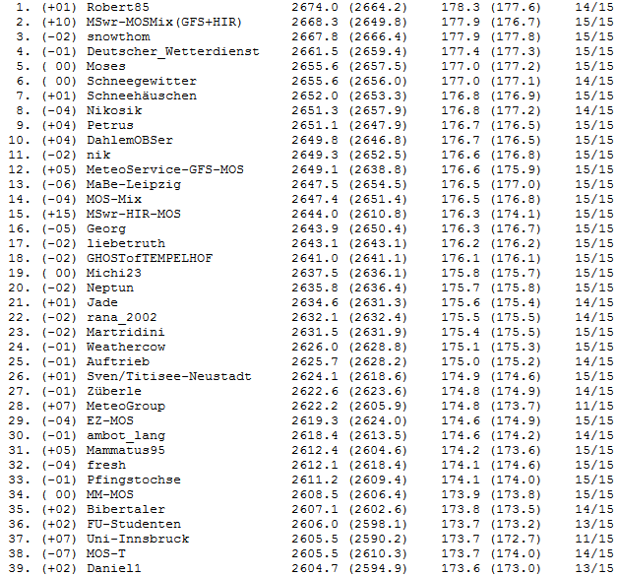
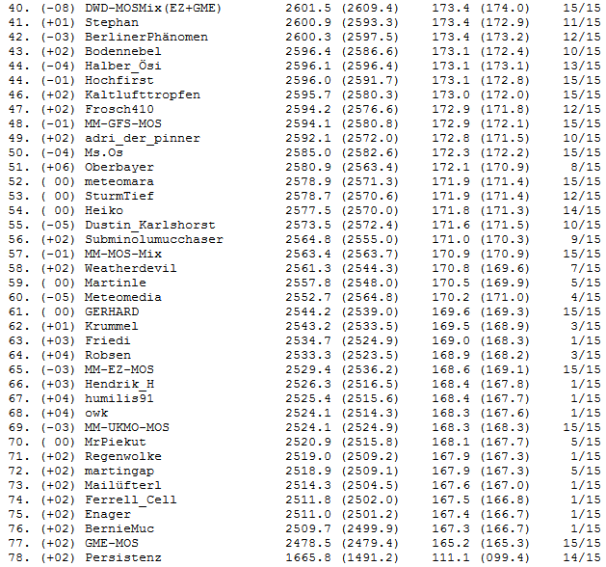
Weather forecasting contests
Continuous ranking – Berlin (based on the weekends from 09.05.2014 till 15.08.2014)
29.08.2014

Slide 23
Weather forecasting contests
Continuous ranking – Berlin (based on the weekends from 09.05.2014 till 15.08.2014)
29.08.2014

Slide 24
Tournament metrics
→ Weakest MOS: 0% - average points: about 165
→ Strongest MOS: 100% - average points: about 175 (out of 200)
All other MOSs between 0 and 100% accordingly.
A very rough and averaged translation of the tournament metrics (TM) percentages into RV is possible with RV = 3/8 * TM,
e.g. 40% difference in TM is about equal to 15% RV.

Slide 25
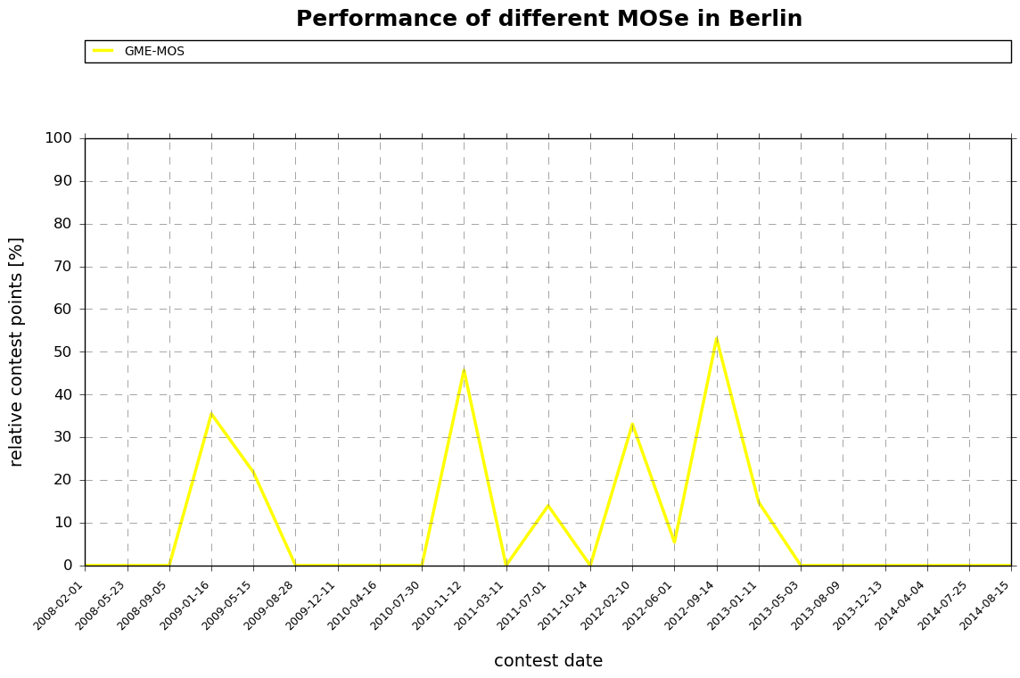
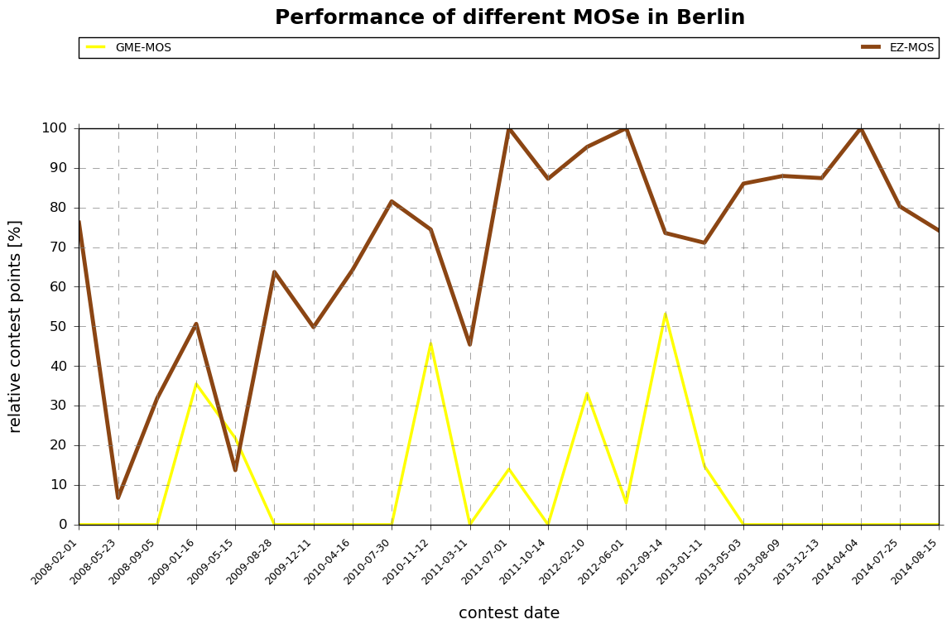
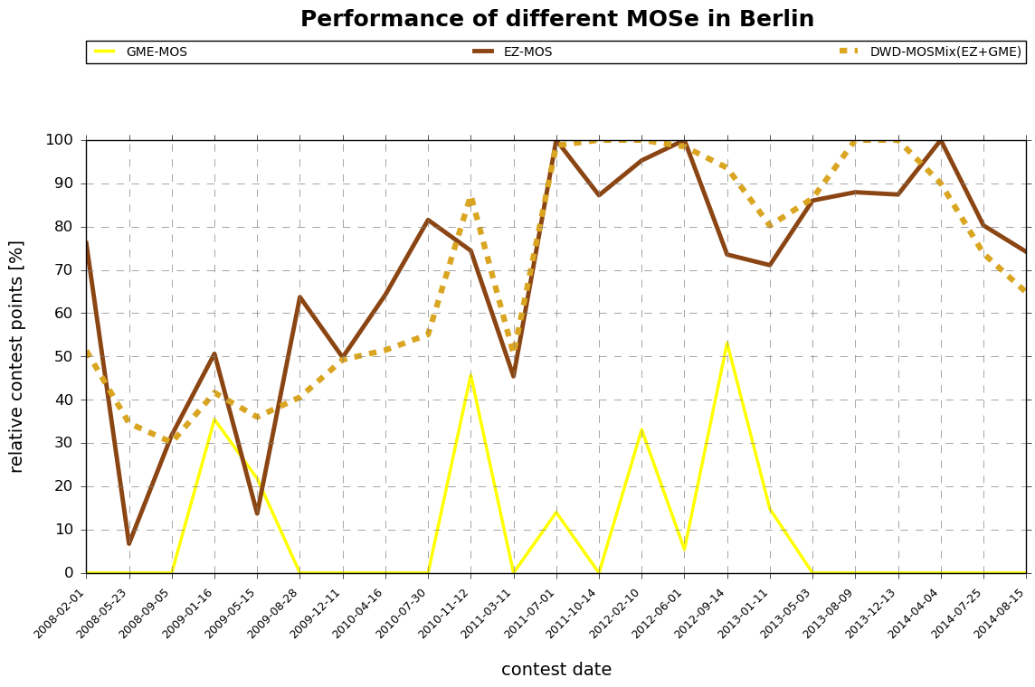
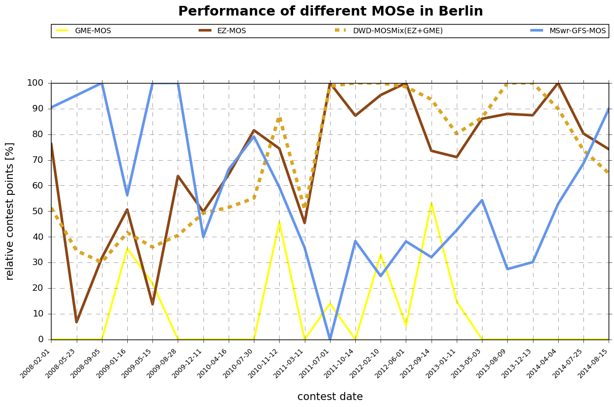
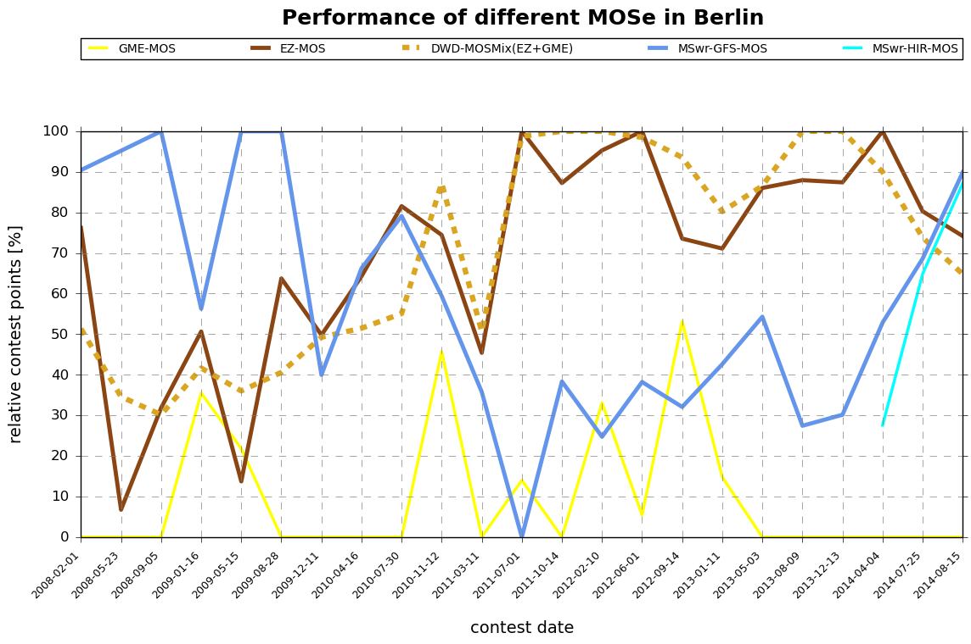
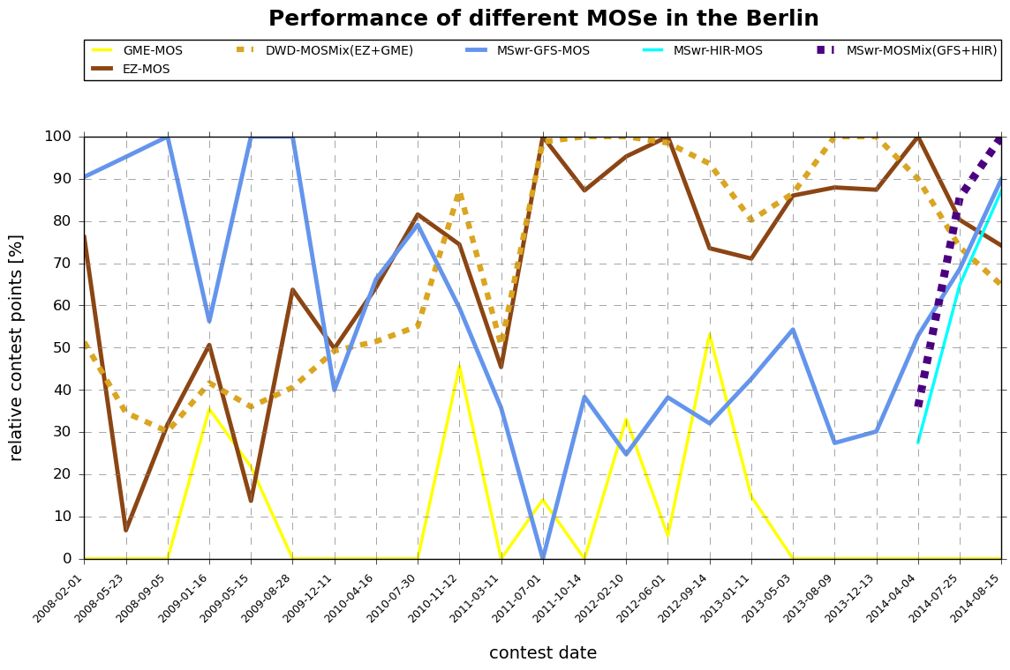
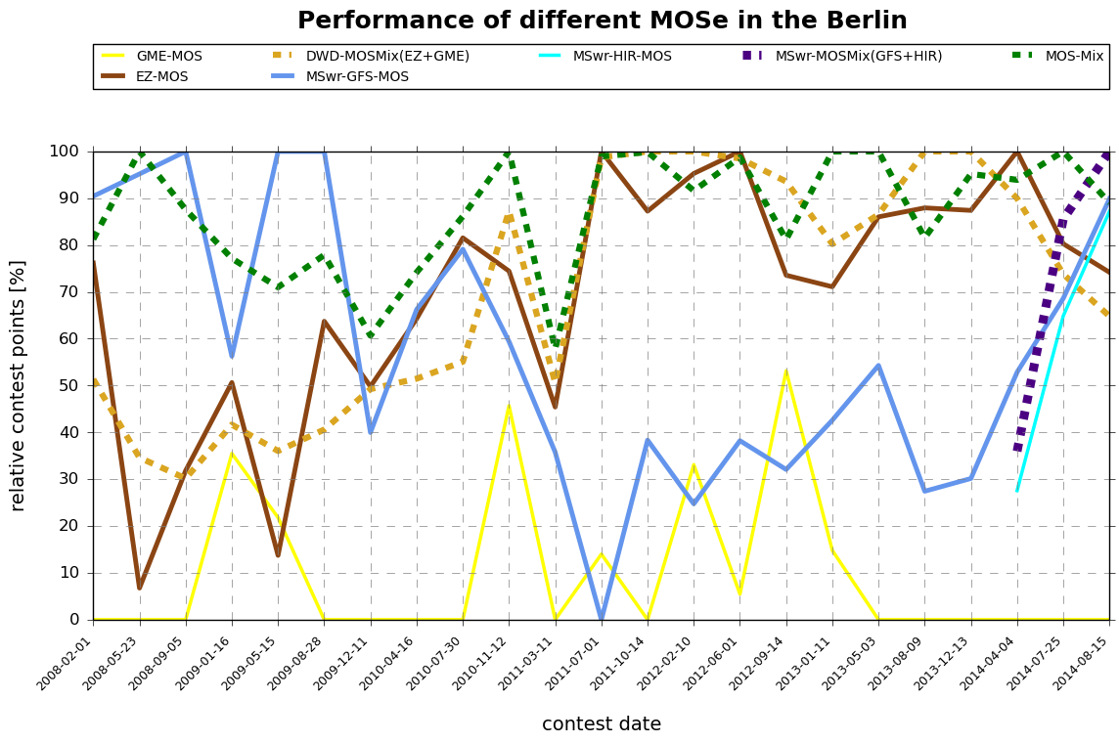
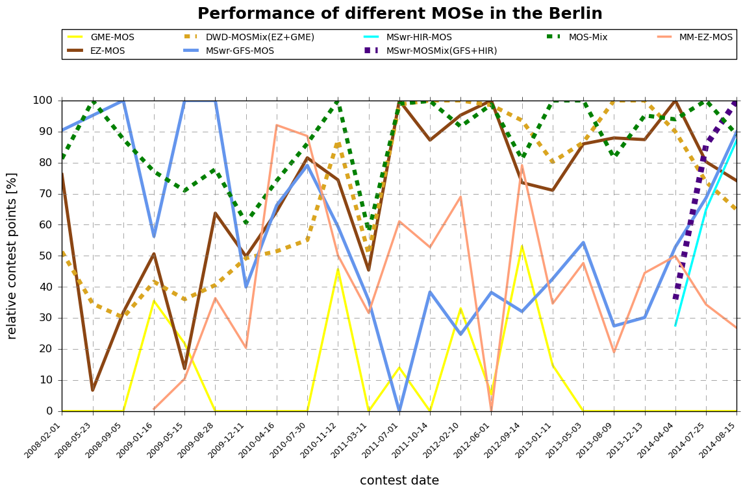
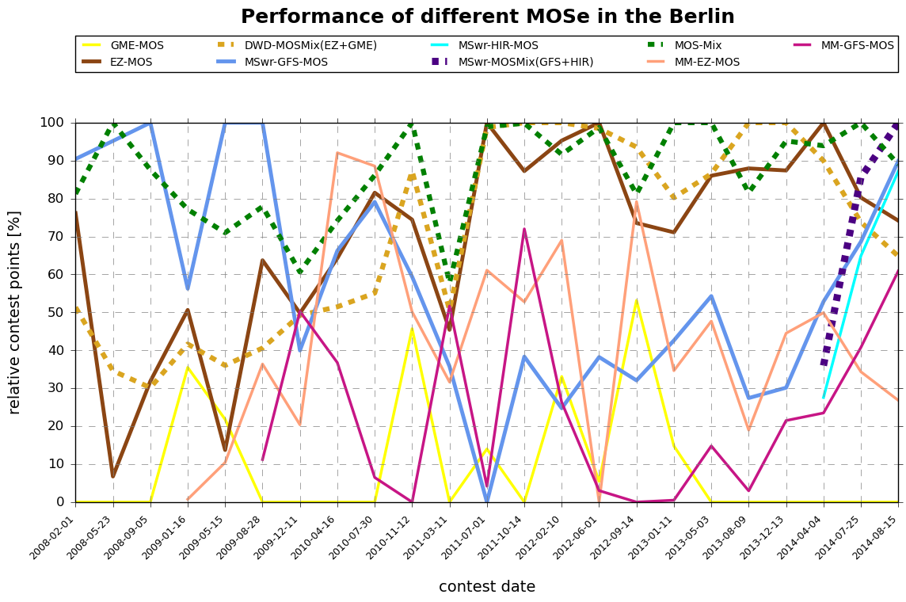
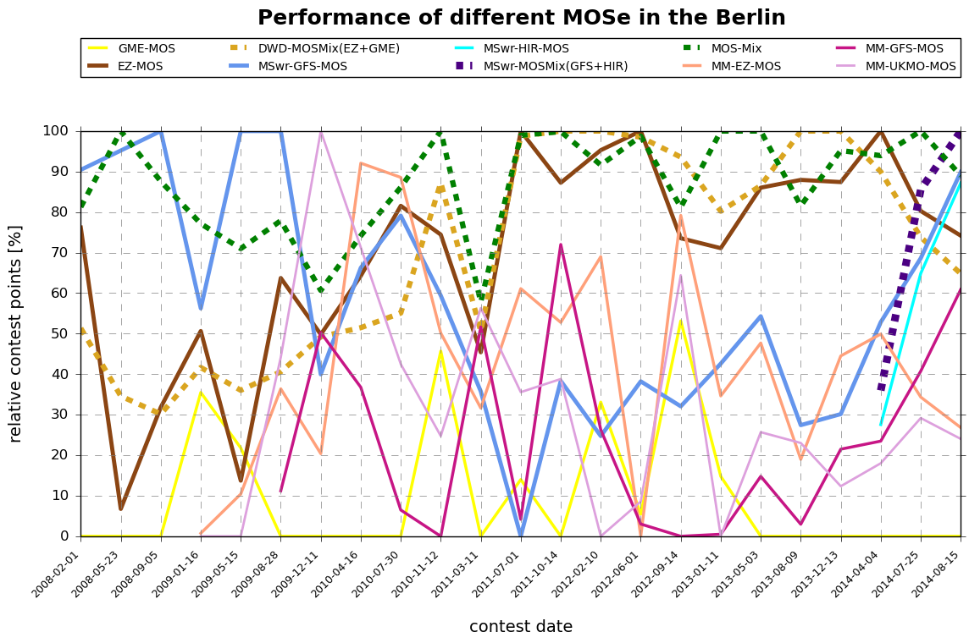
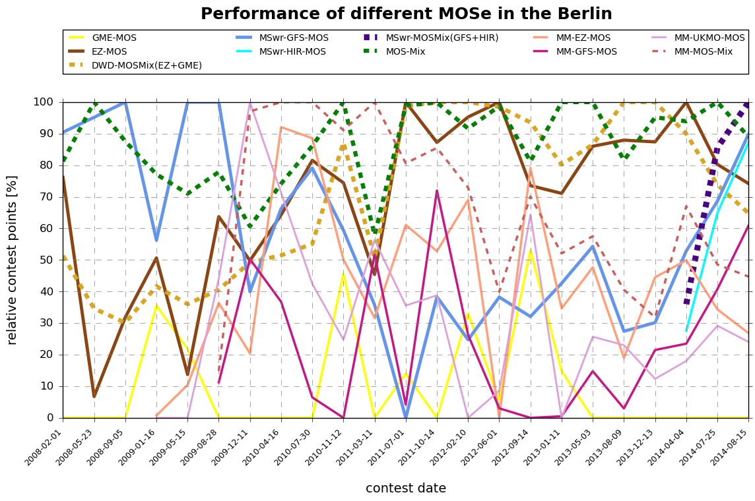
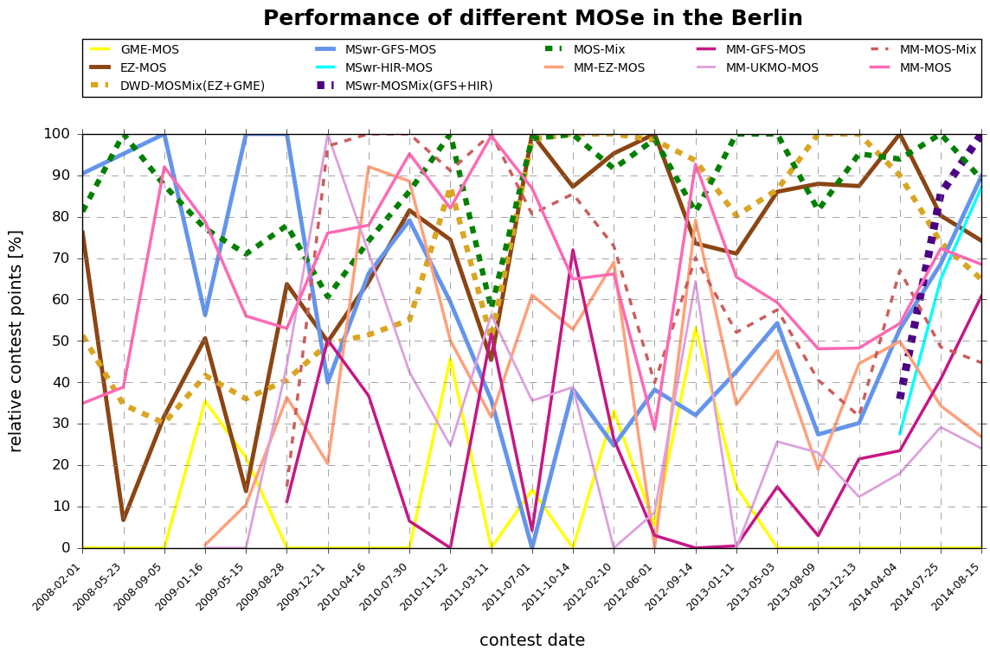
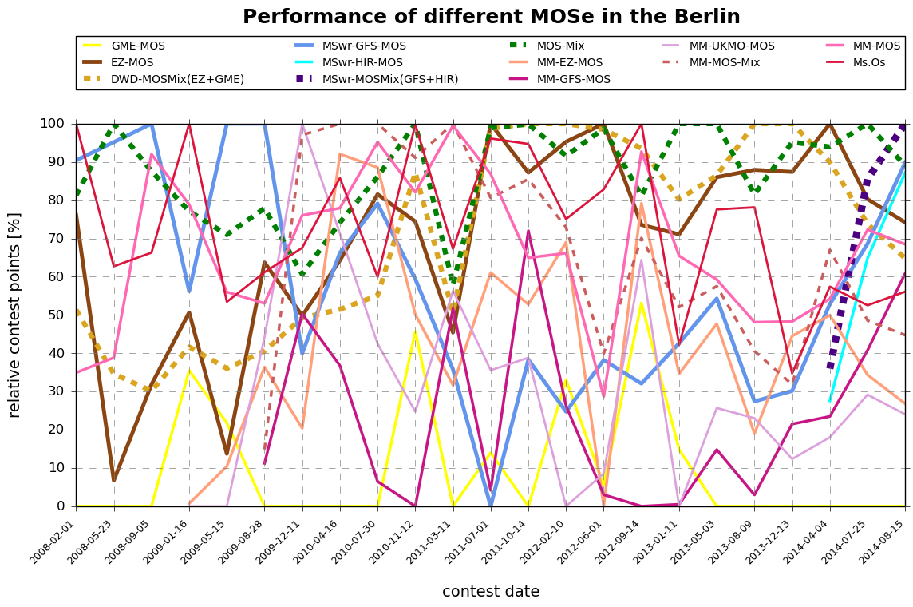
Weather forecasting contests
Berlin
Performance of different MOSs in the Berlin weather forecasting contest
MSwr-HIR-MOS
MSwr-MOSMix(GFS+HIR)
29.08.2014

Slide 26
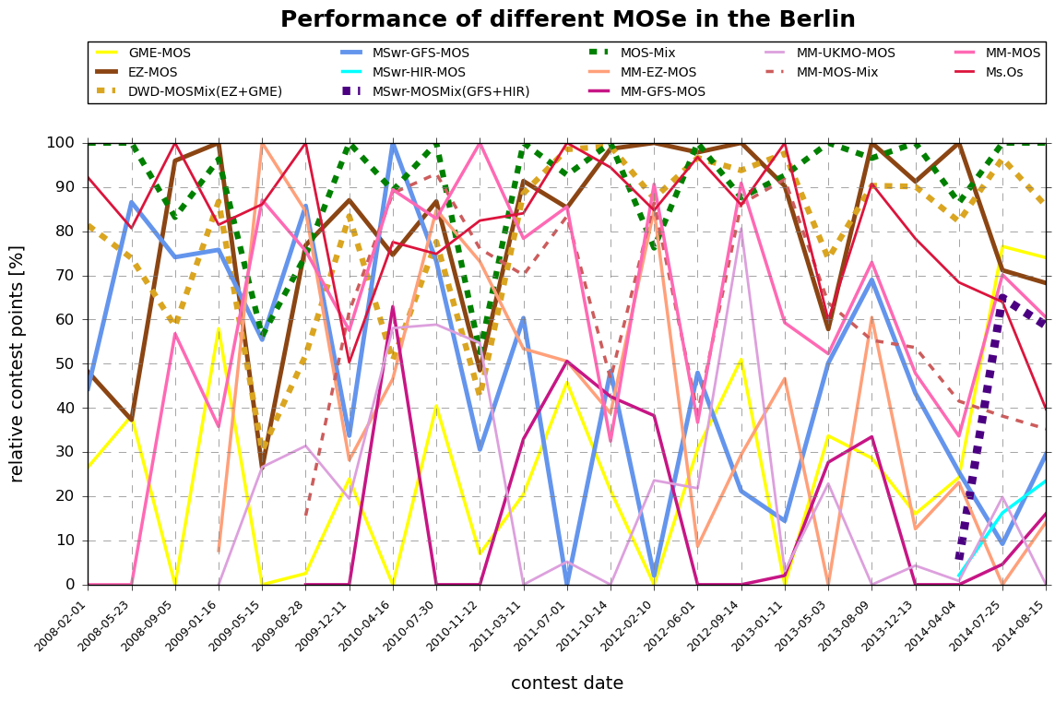
Weather forecasting contests
Wien
Performance of different MOSs automats
29.08.2014

Slide 27
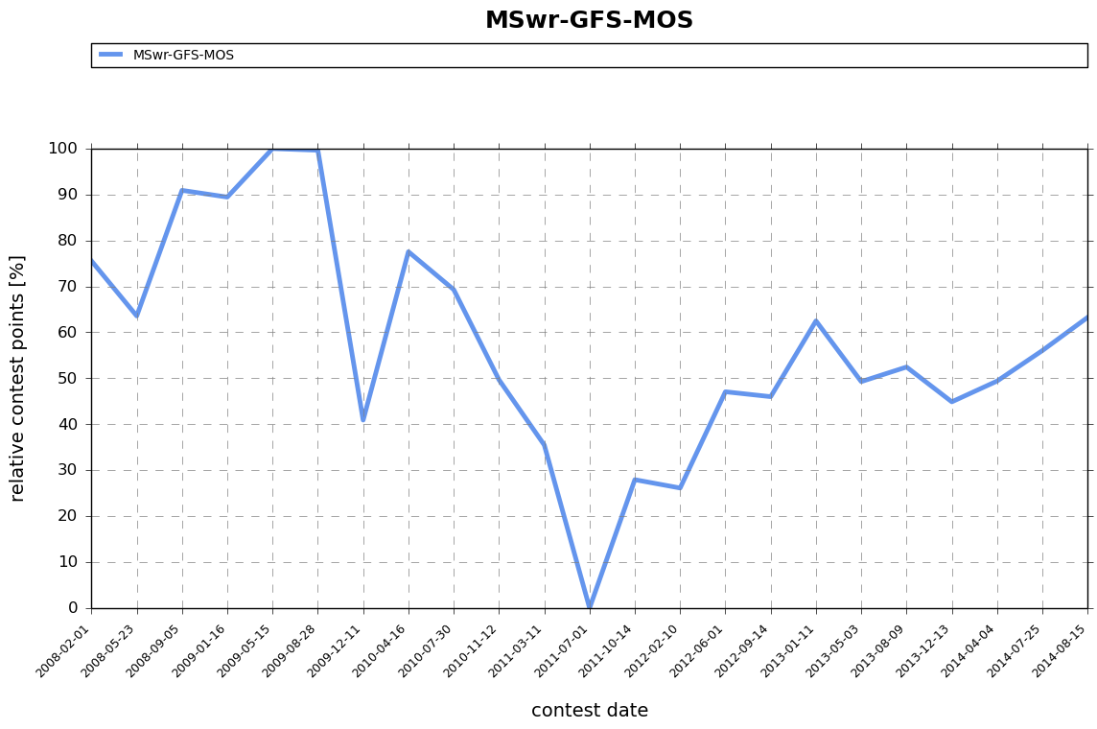
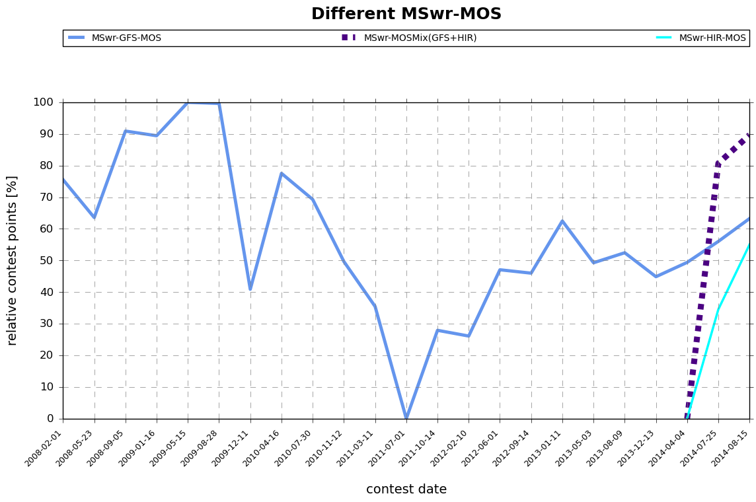
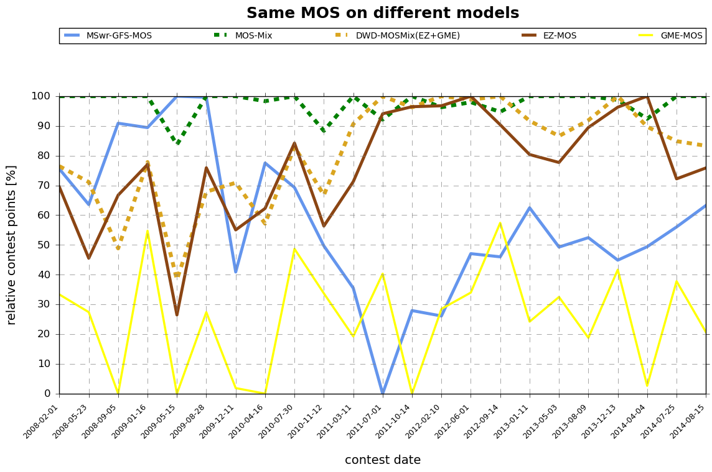
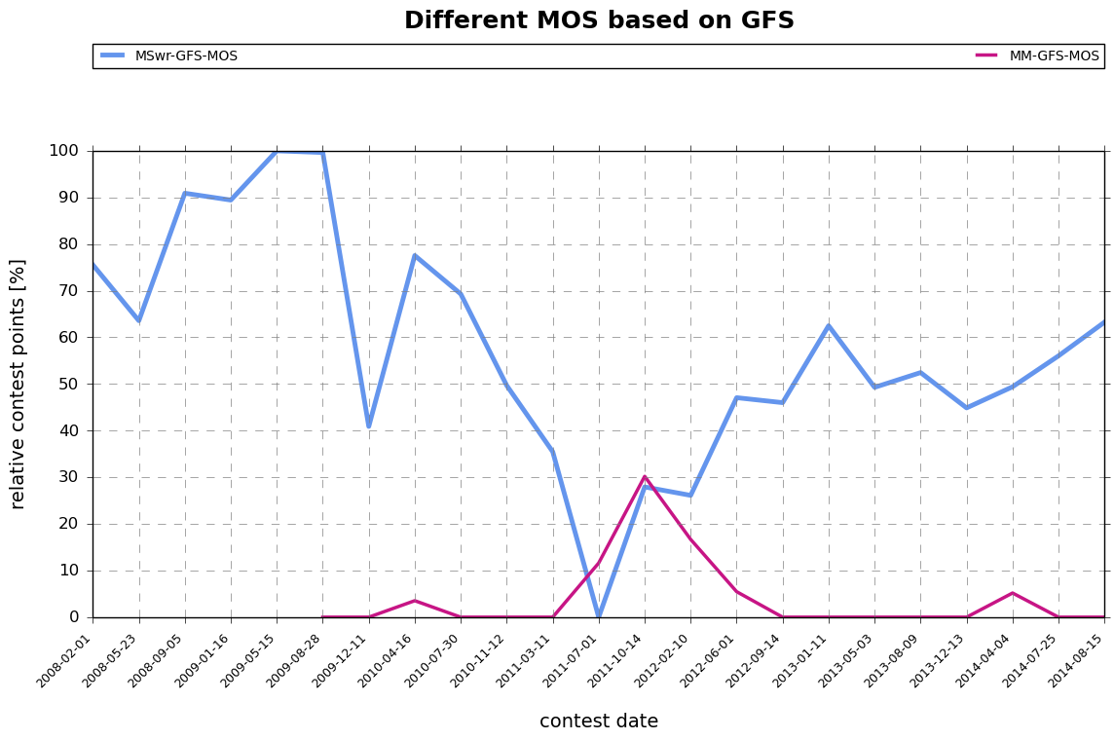
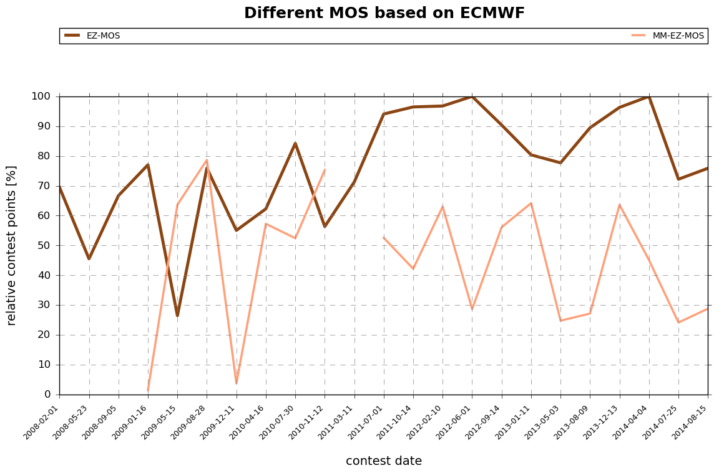
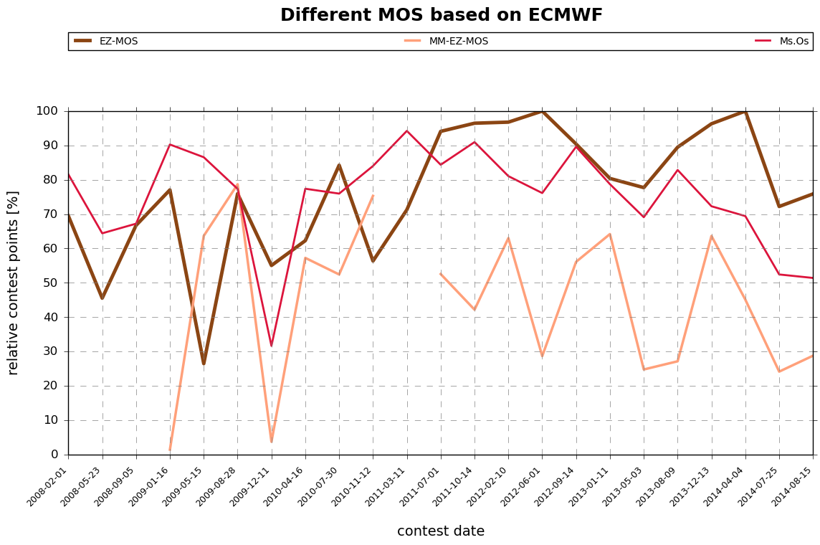
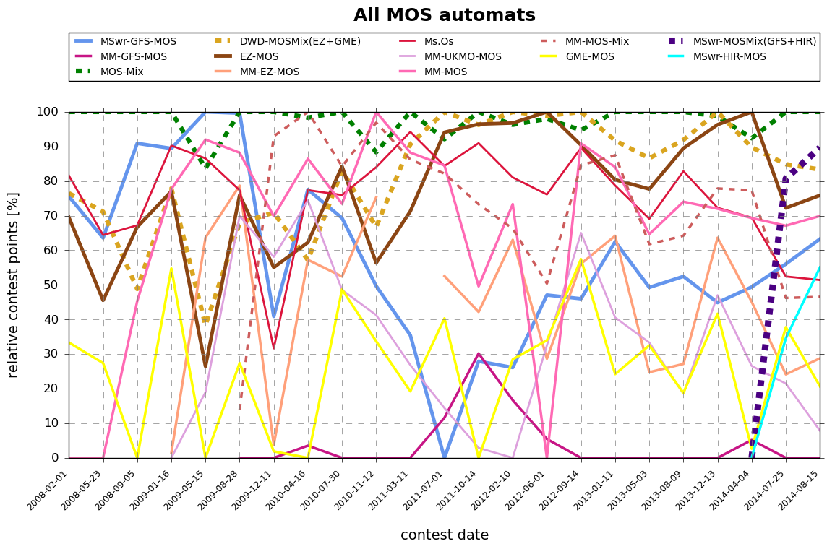
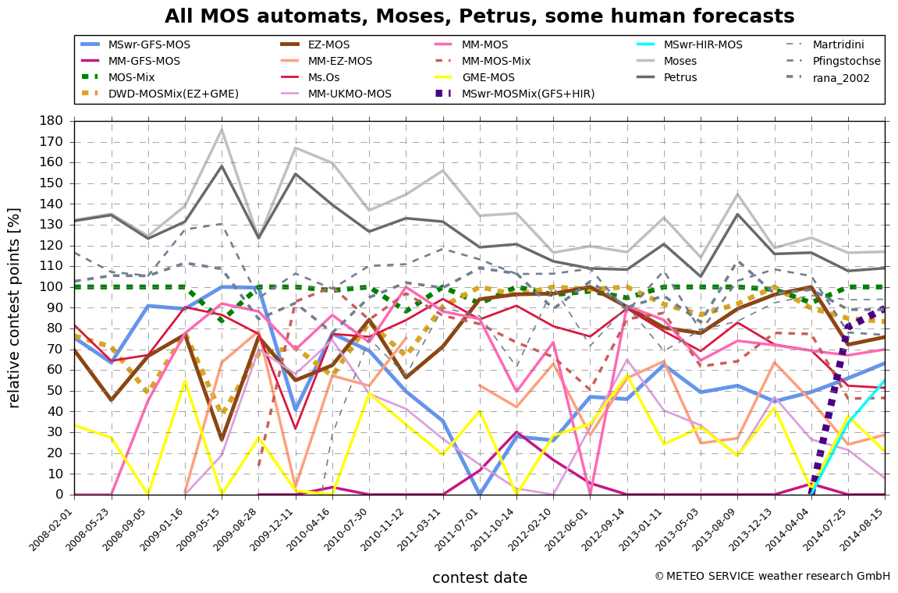
Weather forecasting contests
5 cities
(each point represents 1.800 individual forecasts: 15 weeks * 12 Elements * 2 days * 5 cities)
why?
MOS-Mix(EZ+GME+GFS)
MSwr-MOSMix(GFS+HIR)
MSwr-GFS-MOS
DWD-MOSMix(EZ+GME
MSwr-HIR-MOS
why?
29.08.2014

Slide 28
4
Conclusions

Slide 29
Weather forecasting contests
Conclusions
There is evidence that MSwr-MOS performs about 40% better than MOS of other developers (based on the same numerical model as input). These 40% in tournament metrics are equal to about 15% Reduction of error variance (RV).
29.08.2014

Slide 30


Thank you for your attention
We welcome your questions, suggestions, comments!
info@mswr.de
www.mswr.de
29.08.2014

