Slide 1
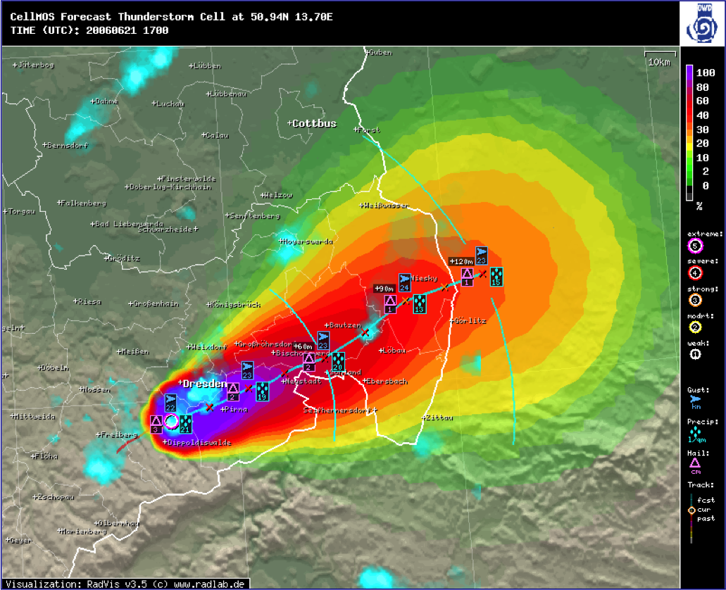
Hail protection – simply automatic
Automatic Hail Detection and Forecasting with MSwr-CellMOS
Klaus Knüpffer, Jan Hoffmann

Slide 2
Content
0. Introduction
History of the project
„Automatic Hail Detection and Forecasting“
Verification
Outlook

Slide 3
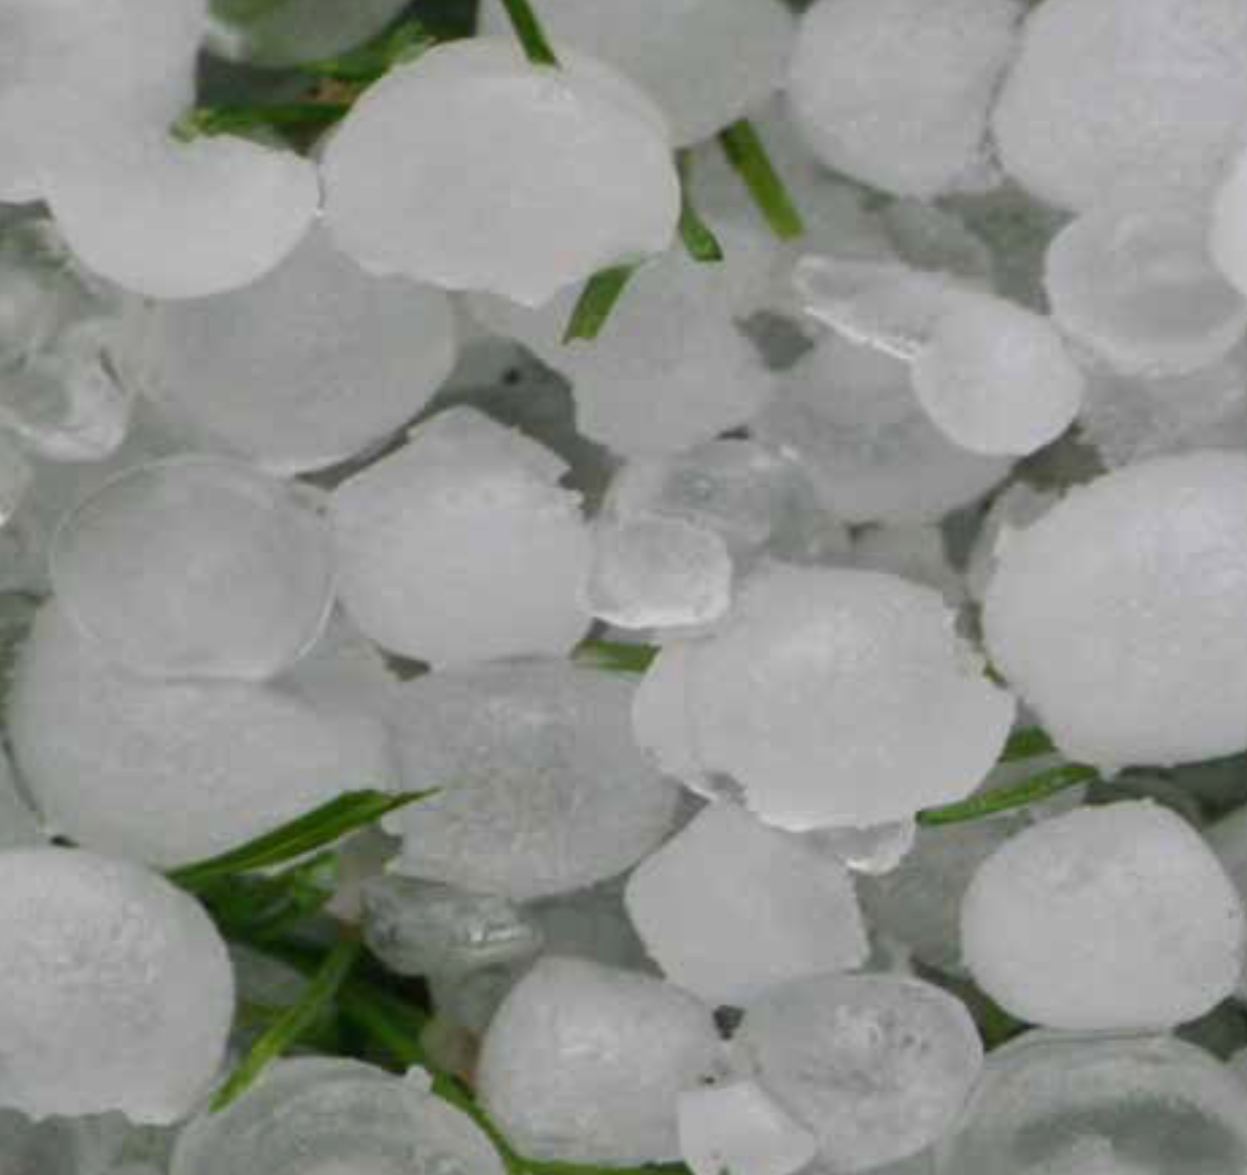

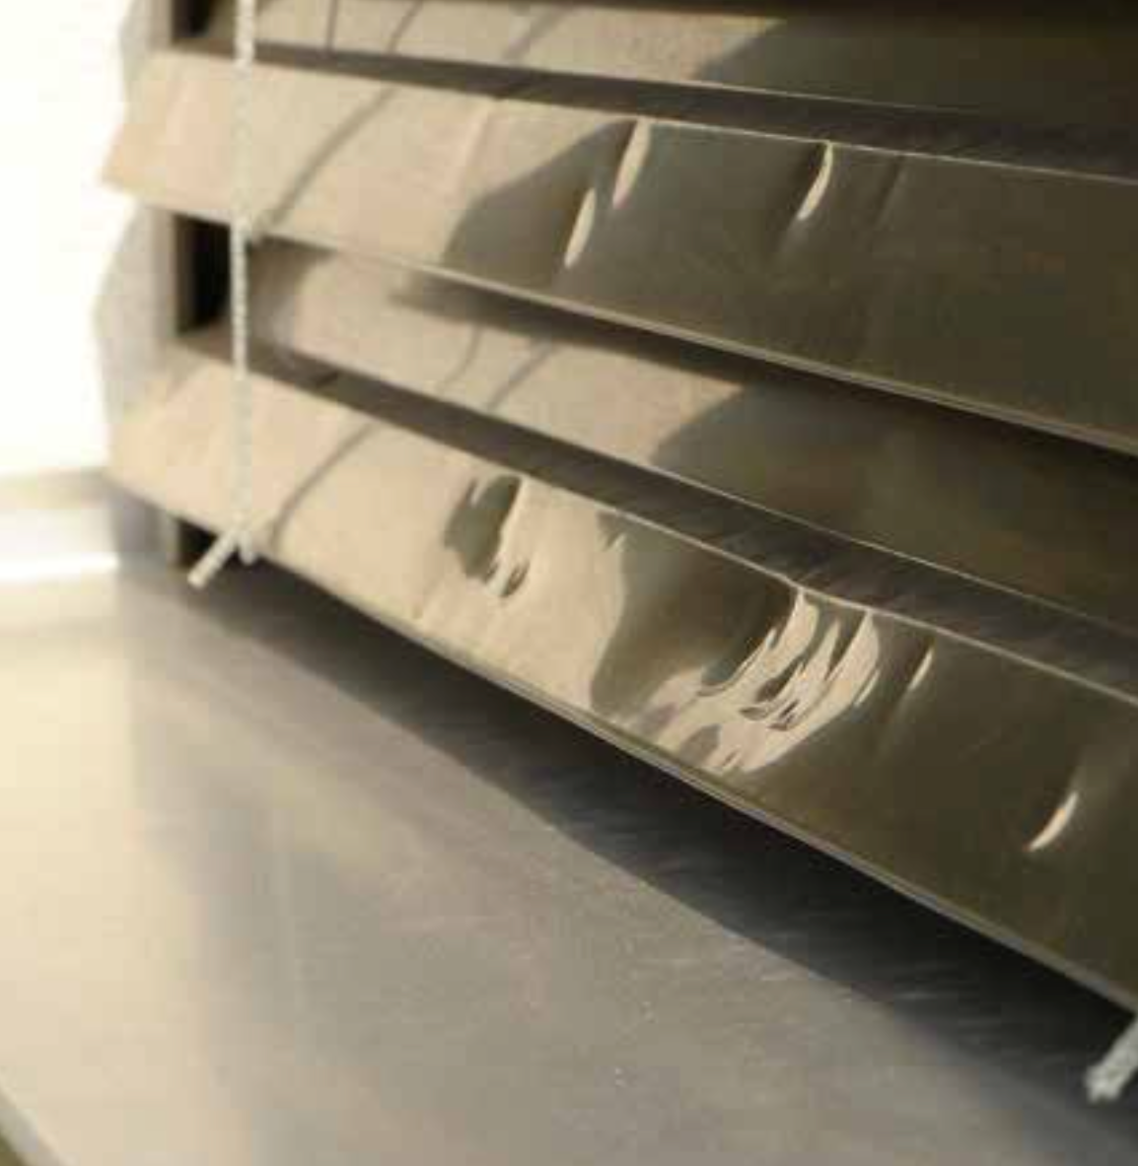
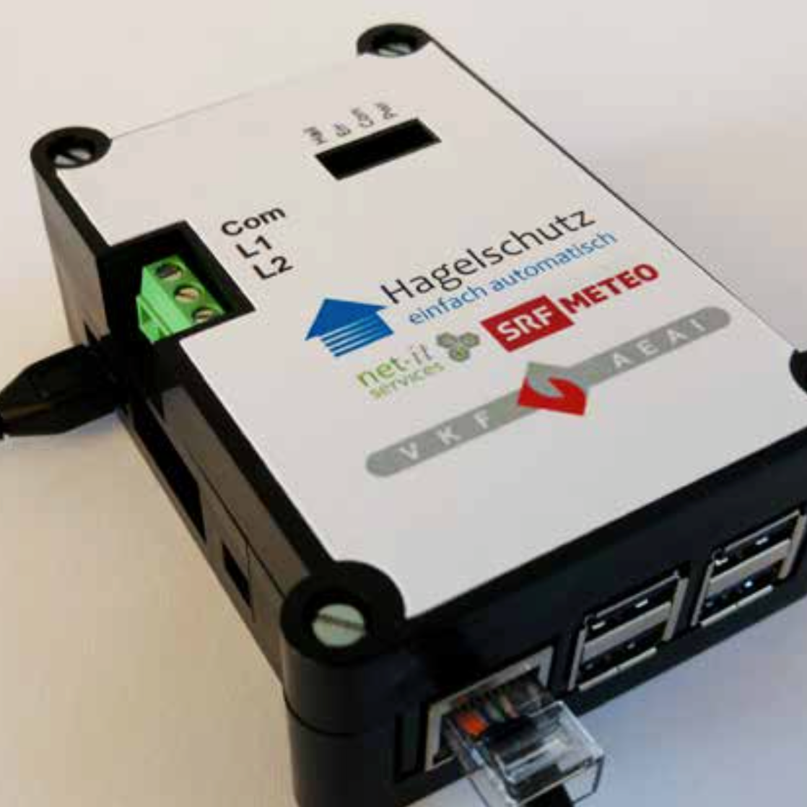






0 Introduction
Adoption of MSwr-CellMOS for Hail Alarm in Switzerland
Hail… Protection... Simply
automatic!
Contributors

Slide 4
1. History „Automatic Hail Detection and Forecasting“
1.1 The 90‘s: MOS (Model Output Statistics) for Standard weather elements
1.2 The 00‘s: NowCast-MOS
1.3 Recently: MSwr-CellMOS – the basis for automatic hail detection and forecasting
1.3.1 MSwr-CellMOS (DWD)
1.3.2 MSwr-CellMOS (SRF/VKF)

Slide 5
1.1 MOS from the 90's on
1.1 MOS from the 90's on: Verification results
• Man(+Machine) versus Machine forecasts
• Introduction of MOS at DWD
• RV (MOS, DMO) = 50%

Slide 6

1.1 MOS from the 90's on
Man(+Machine) versus Machine forecast

Slide 7
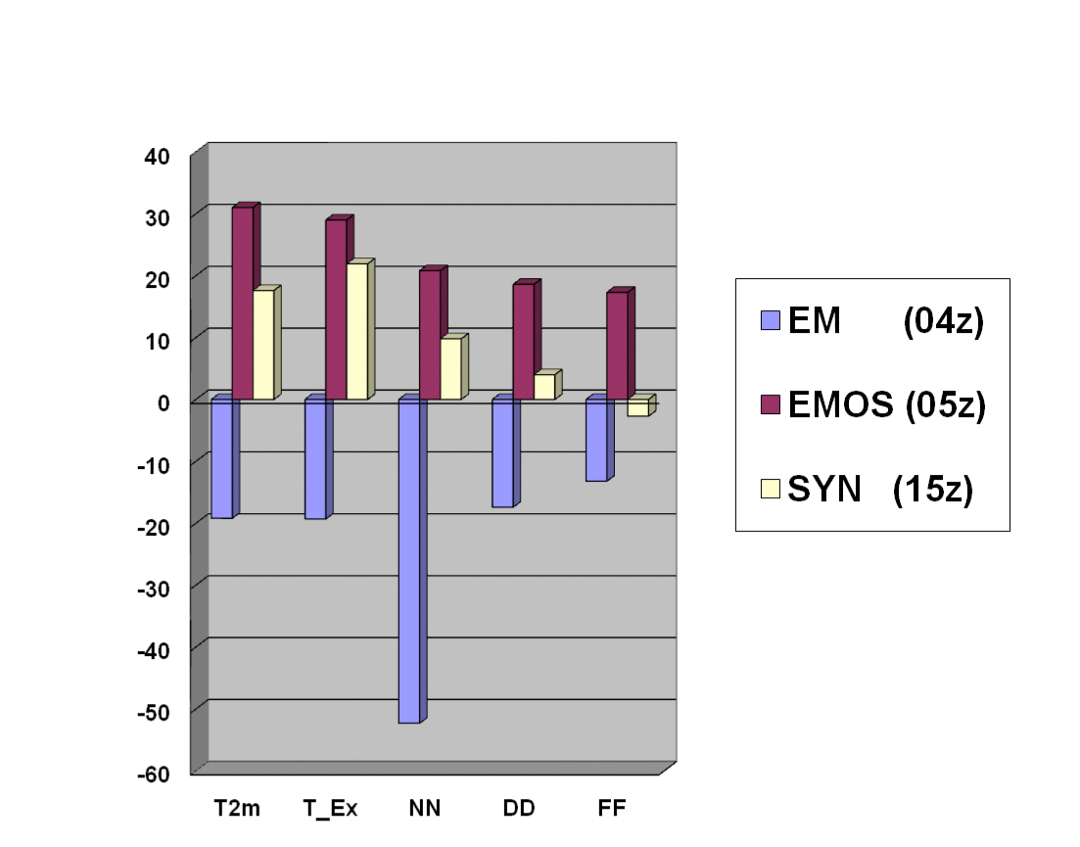
1.1 MOS from the 90's on
Introduction of MOS at DWD
RV of different methods vs. reference Kalman filter (neutral axis) in %
Source: DWD short term
verification 1998/1999

Slide 8
1.1 MOS from the 90's on
RV(MOS,DMO) = 50% - What does it mean?
• The sum of squared forecasts errors of MOS forecasts is half the sum of squared forecast errors of Direct Model Output (DMO) forecasts
• A MOS forecast of the year 1997 had the same accuracy as a model forecast of the year 2017
• A 3-day-ahead MOS forecast has the same accuracy as a 1-day-ahead DMO forecast - no matter what the resolution is

Slide 9
1.1 MOS from the 90's on
„Probability is the language of the forecaster“
(Chuck Doswell)
MOS produces Probabilities in two ways:
• Explicitly: By pre-defining probabilistic predictands like probability of Hail
• Implicitly: By predicting a non-probabilistic element (e.g. T2m but also wind vector components) and its absolute forecasting error. From these two all probabilities can be calculated with normal (or other) distribution assumption.

Slide 10
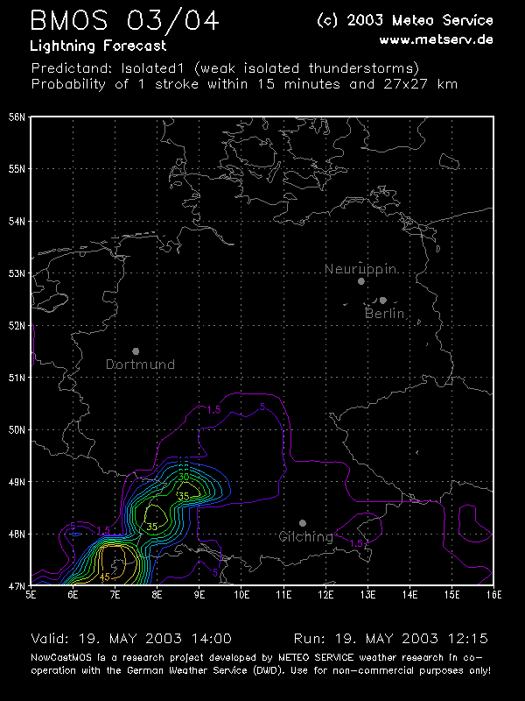
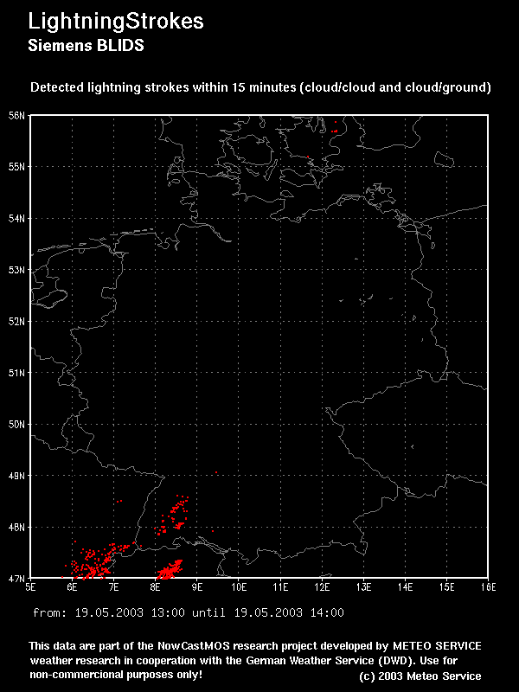
1.2 The 00's: NowCast-MOS

Slide 11
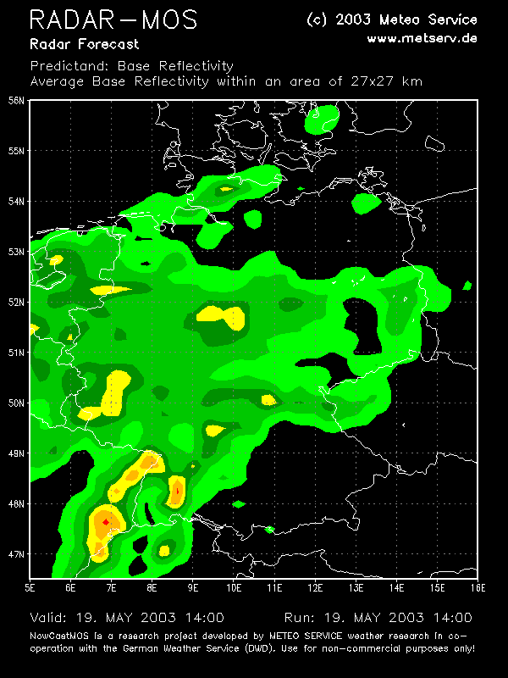
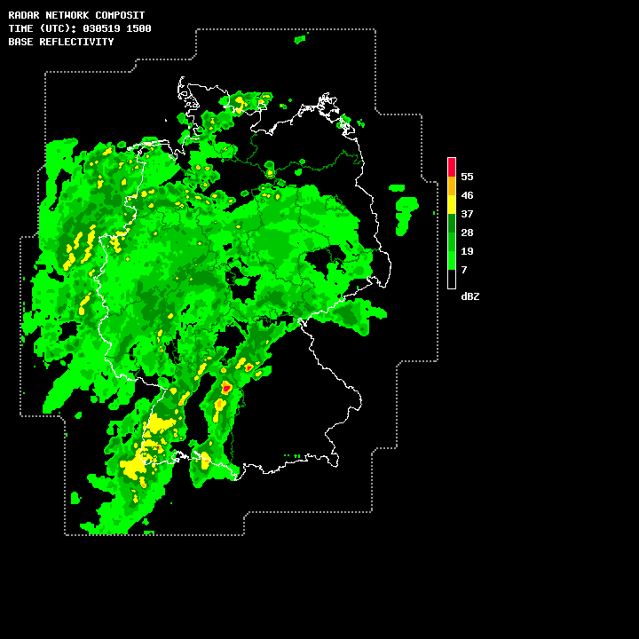
1.2 The 00's: NowCast-MOS

Slide 12
1.3 CellMOS
Derived Predictands from radar and lightning
• Movement (U, V, derived from cell detection)
• Hail Size / Probabilities
- “classic”: DWD MSwr-CellMOS
- Waldvogel
- SHI / MEHS / POSH
• Total precipitation
- for a single location and single cell, assuming the cell hits that location with constant speed and strength
• Maximum estimated wind gust
• Lightning stroke rate
Forecasting
• Statistical forecasts are made for all individual detected cells
• Second step is calculation of field data derived from the cell forecasts using a Gaussian approach (assumption: cell properties and forecast location errors behave nearly like Gaussian distributions over space)

Slide 13
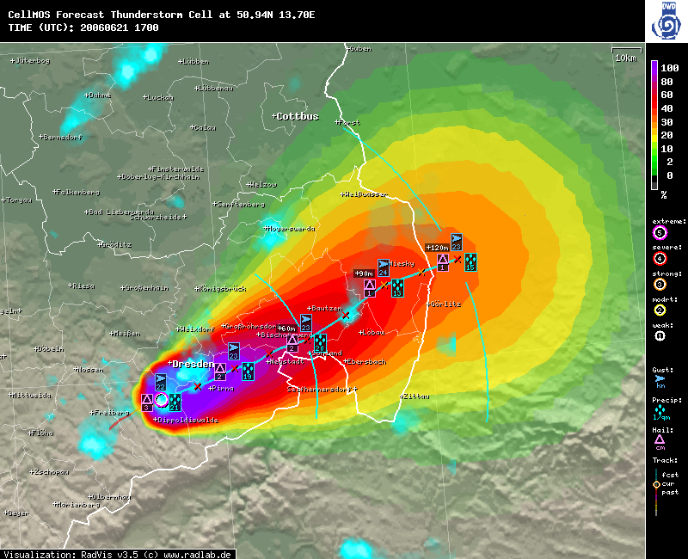
1.3.1 MSwr-CellMOS (DWD)
DWD MSwr-CellMOS Convectice Cell Forecast
June 21th 2006, 17:00 UTC

Slide 14

1.3 CellMOS
Gaussian field distribution derived from cell forecasts
• σ_shape (Gaussian shape) of the Cell:
expected value = predictand value minus environmental field value
sigma(shape) derived from cell size and
variance = radius of 61% of expected value
• σ_position (forecast error of cell position):
derived from forecast of error of trajectory
Convolution of σ_shape und σ_position:
• σ_total

Slide 15
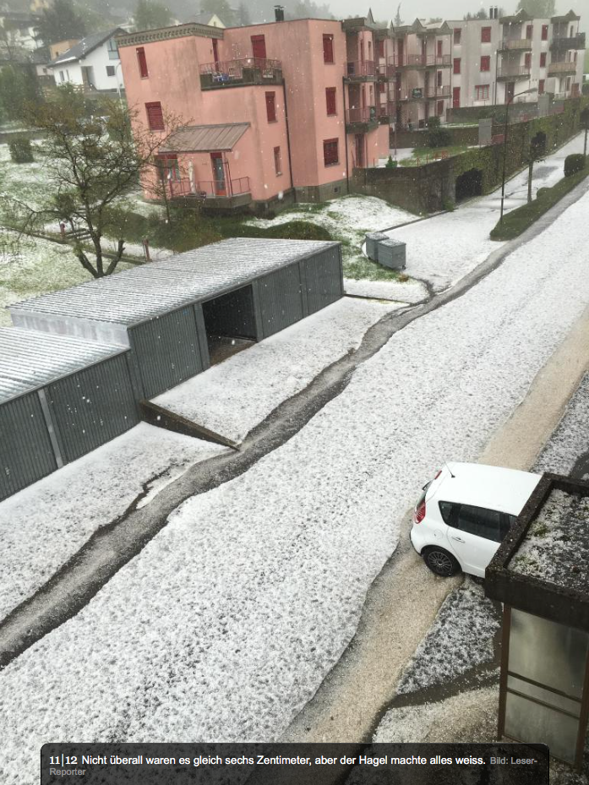
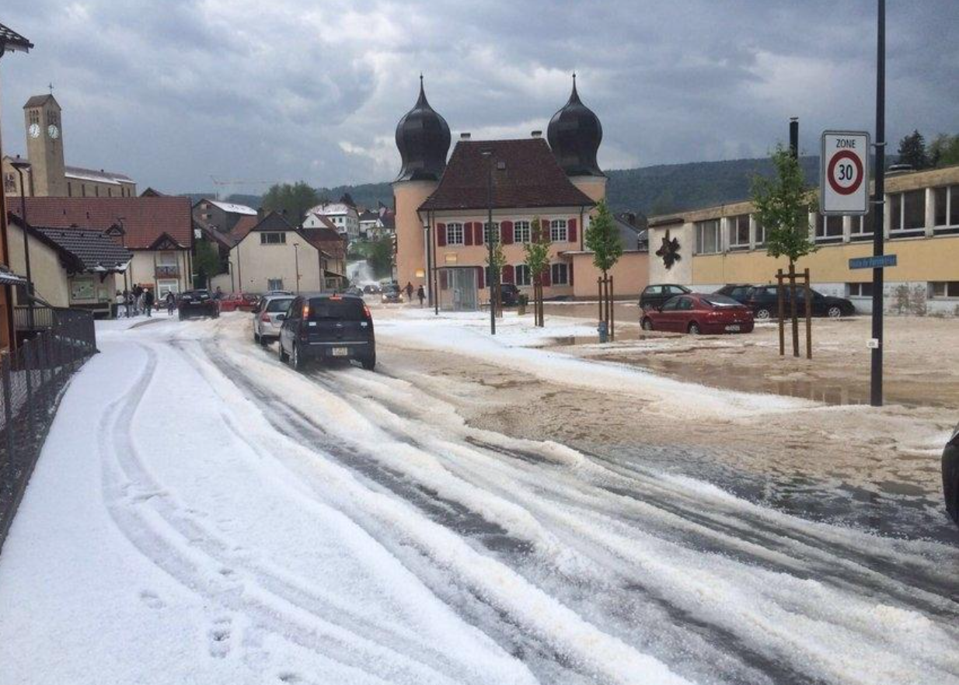
1.3.2 MSwr-CellMOS (SRF/VKF)
Adoption of MSwr-CellMOS for Hail Alarm in Switzerland
Case example
May 10th 2016, Canton: Jura
Image source: www.20min.ch

Slide 16
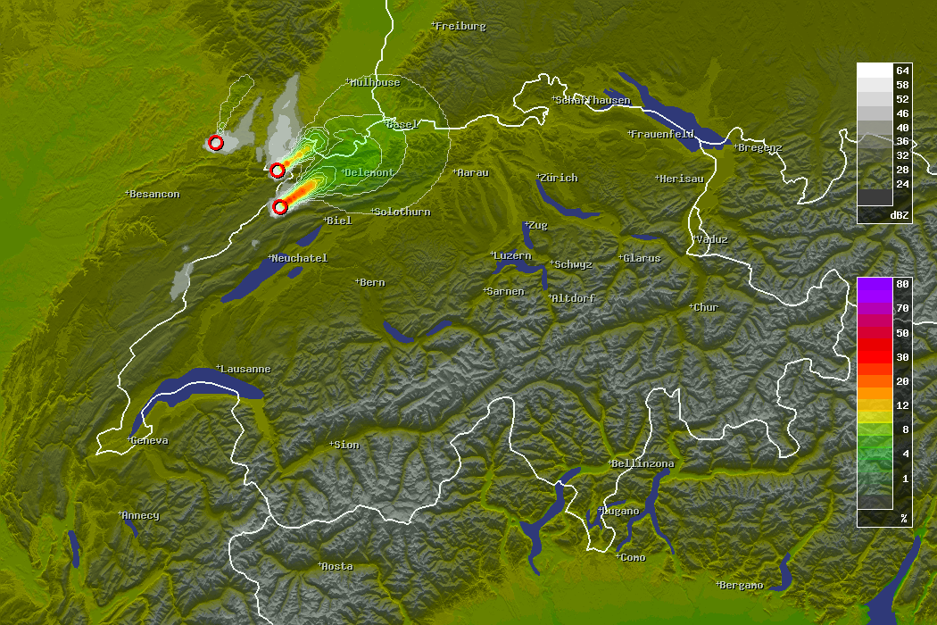
1.3.2 MSwr-CellMOS (SRF/VKF)
Radar Refl. 16:20 UTC
Prob Hail > 15mm / 120min
MSwr-CellMOS Hail Forecast
Full Run 16:20 UTC (0 – 120 min)

Slide 17
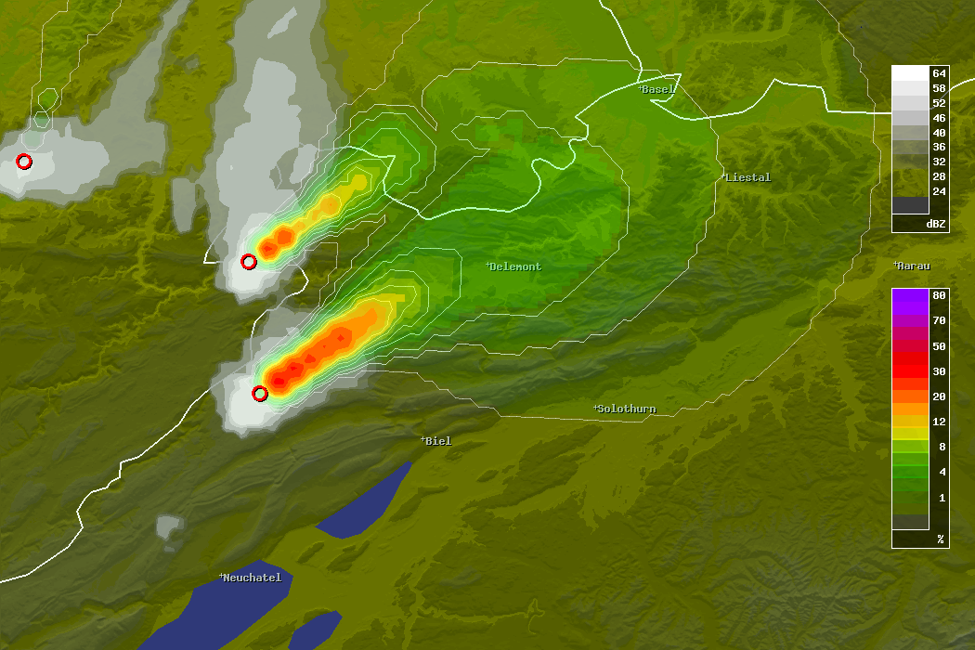
1.3.2 MSwr-CellMOS (SRF/VKF)
Radar Refl. 16:20 UTC
16:45 UTC, 1.5 cm
Prob Hail > 15mm / 120min
17:10 UTC, 3 cm
MSwr-CellMOS Hail Forecast
Full Run 16:20 UTC (0 – 120 min)
ESWD Hail Reports

Slide 18
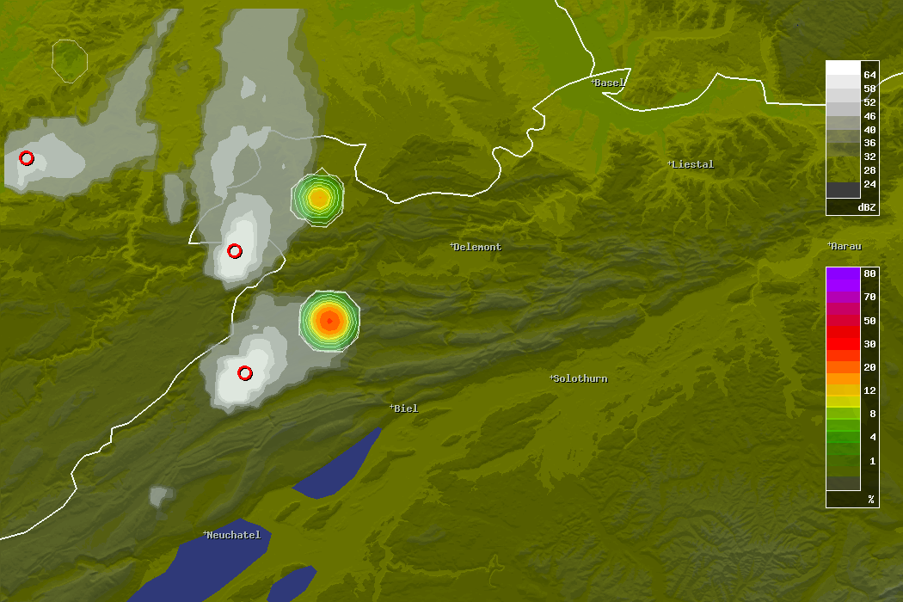
1.3.2 MSwr-CellMOS (SRF/VKF)
Radar Refl. 16:20 UTC
16:45 UTC, 1.5 cm
Prob Hail > 15mm / 5min
MSwr-CellMOS Hail Forecast
Run 16:20 UTC + 25 min / 16:45 UTC
ESWD Hail Reports

Slide 19
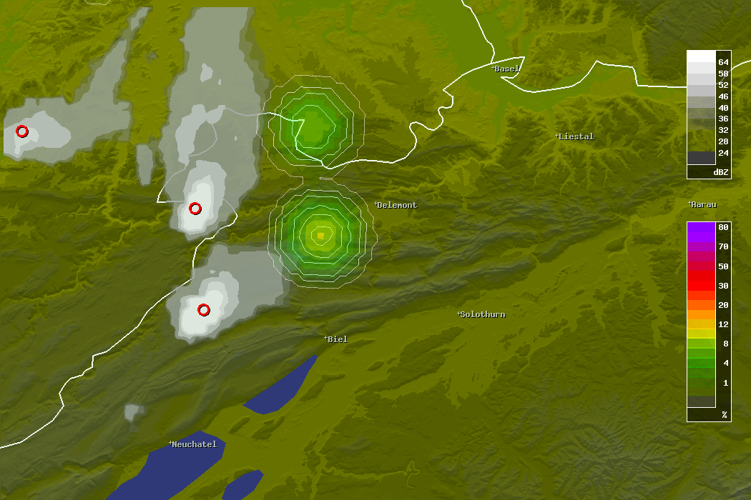
1.3.2 MSwr-CellMOS (SRF/VKF)
Radar Refl. 16:20 UTC
Prob Hail > 15mm / 5min
17:10 UTC, 3 cm
MSwr-CellMOS Hail Forecast
Run 16:20 UTC + 45 min / 17:05 UTC
ESWD Hail Reports

Slide 20
1.3.2 MSwr-CellMOS (SRF/VKF)
Optimized decision making based on Hail probabilities
Rule: If predicted hail probability exceeds the
cost-loss ratio then action has to be taken:
Cost: loss of living quality due to moving external venetian blinds up
Loss: expected damage if Hail occurs.
Formula:
If (Prob_Hail>15mm > Threshold)
move external venetian blinds up
with Threshold = Cost / Loss
Current Threshold is 5% and subject of discussions

Slide 21
2 Verification
Verification is very difficult:
• sparse observation data
• comparative verification with other providers impossible
• comparative verification against persistency of the observation possible
• verification possible for selected single cases with verified observations, e.g. from ESWD

Slide 22
2 Verification
Verification SFCMOS vs. observation persistency
Element: Probability of Hail Size > 15mm
Lead Mean Mean Bias RMSE RV Cases RMSE
Time Obs Fc Fc Fc (Fc,P) /Mio Pers
-------------------------------------------------------
0 10.78 10.78 1.00 0.00 0.00 0.33 0.00
-------------------------------------------------------
5 2.40 2.24 0.93 6.27 35.40 1.50 7.80
10 1.70 1.66 0.98 6.50 34.59 2.12 8.03
15 1.20 1.25 1.04 5.86 32.56 2.99 7.14
20 0.80 0.98 1.22 4.94 30.82 4.49 5.94
25 0.53 0.78 1.47 4.11 29.30 6.76 4.88
30 0.36 0.66 1.84 3.42 28.11 10.00 4.03

Slide 23
3 Outlook
3 Outlook
• Missing conceptual piece in MSwr-CellMOS:
„Life cycle“ of convective cells: Forecast of „birth“ and „death“
• Improvement of hail analysis by using full volumetric radar data and polarimetric precipitation type radar data as predictand input possible

Slide 24
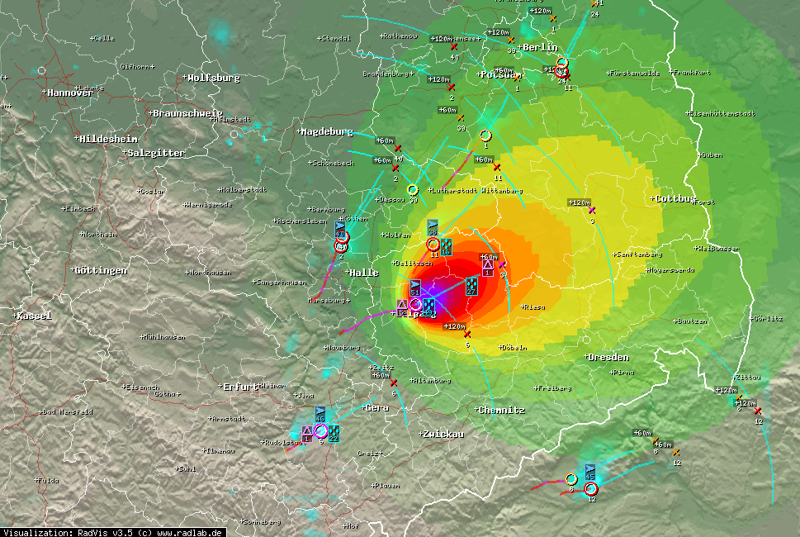
Thank you for your attention!
Contributors

