Slide 1


前書き
Introduction
METEO SERVICE weather research GmbH
Currently, the most efficient way to improve the accuracy of local weather forecasts is the introduction of an advanced statistical interpretation system that operates on the outputs of numerical models.
presented by Klaus Knüpffer, Diederik Haalman, Bernd Richter – 10.07.2018 at

Slide 2
アウトライン
Outline
一
1. What is MOS?
Klaus Knüpffer
2. History and Mission MSwr
Klaus Knüpffer
3. Model Output Statistics vs Direct Model Output
Klaus Knüpffer
4. Product Developments
Klaus Knüpffer
5. MSwr and Aviation: Relationship with Natl. Weather Services
Bernd Richter
6. A Step by Step approach …
Diederik Haalman
7. Future of MSwr
Diederik Haalman
二
三
四
五
六
七

Slide 3
一
What is MOS?
MOS is what the name says: Model Output Statistics.
MOS is statistically optimized feed-back between model forecasts and local observations.
MOS takes into account:
  real physics
  error characteristics of the numerical model
    Bias
    Random error
MSwr-MOS is the MOS application of the company Meteo Service and has according to our knowledge the highest quality as it is based on:
  many handcrafted transformations according to synoptical knowledge
  detailed understanding of the process

Slide 4
一
What is MOS?
What is MOS good for?
It reduces the error variance (= the sum of squared forecast errors) of DMO (Direct Model Output)
by RV=50% for standard weather elements like temperatures, clouds, wind.
Remark: RV(MOS,DMO) = 50% means:
  a MOS forecast for day X+2 days is as accurate as a DMO forecast for Day X
  current DMO forecasts are as accurate as MOS forecasts used to be 20 years ago
  Note: Scientific-technological progress goes with about RV=25% per decade.

Slide 5
一
What is MOS?
What is MOS good for?
It allows for the prediction of elements which the models do not predict:
  Probabilities ('probability is the language of the forecaster' - Chuck Doswell).
  Probabilities are needed for optimum decision making.
  Visibility, Solar and Wind power are elements which are not predicted by the models directly
  but by MOS.
Where a forecaster can handle a few locations, MOS can do so for ten thousands of locations.
Best results (RV=50%) at places with high quality observations for >=3 (rare events: 10) years,
e.g. at airports.

Slide 6
一
What is MOS?
What is MOS good for?
No other method is currently known which produces better forecasts:
Kalman Filter (adaptive correction of DMO): RV(KAL,DMO) is only 25%.
AI, Machine Learning, Neural Network: No successful application known yet.
  That does not mean there is no better method
  but it is recommended to use MSwr-MOS as quality reference for such developments.
No other automatic method is known that allows for automatic dissemination of forecasts to the customers without loss of forecast quality as compared to a human forecaster.
Glossary: Similar expressions:
  Statistical Weather Forecasting
  Statistical Interpretation of the NWP Outputs
  Statistical Post-Processing

Slide 7
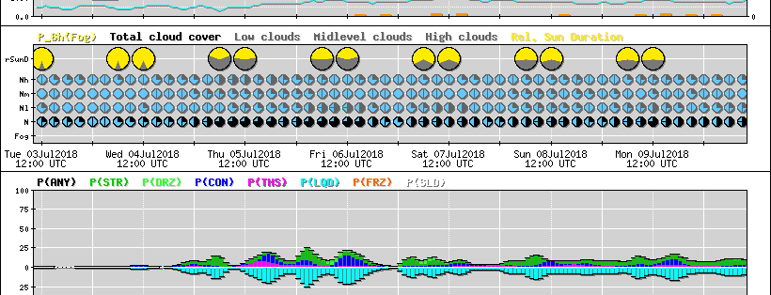
一
1. History and Mission MSwr

Slide 8
History of MOS, MSwr and Mission of MSwr
二
1960s
Statistical Weather forecasting in the USA and Europe (Netherlands, East Germany, ...) began.
As a child, listening to the weather news:
  How can they know in advance?
  Why are they so often wrong?
The most quoted article about MOS appeared in the United States
1972

Slide 9
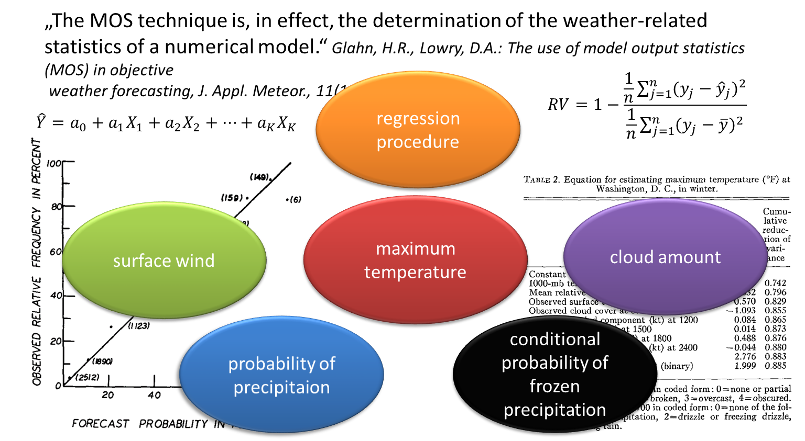
History of MOS, MSwr and Mission of MSwr
二
1972

Slide 10
History of MOS, MSwr and Mission of MSwr
二
1980s
As a student asking my self and mentors:
How in an ideal world an ideal weather forecasting system looks like?
Answer: Combination of Physics and Statistics → MOS
Klaus Knüpffer (operational forecaster East) meets Bernd Richter (operational forecaster West).
DWD introduced a new model chain without MOS
My first MOS program worked at the private company Meteo Consult (Harry Otten) in Wageningen (NL), now called Meteogroup, that was interested in this.
→ Result much better than expected
1989
1990
1991

Slide 11
History of MOS, MSwr and Mission of MSwr
二
1991
MOS was better than the forecasters that used MOS but didn't trust it in the beginning.
I met Phil van Haren there: He was one of them.
This comparative verification result has never changed since then: On the average the following statement is true since 1991:
Accuracy of final weather forecast of human forecaster + MOS = accuracy of pure MOS forecasts
In other words:
The 'average' forecaster cannot add value to the MOS prediction with respect to accuracy. Some can add value, others correct MOS forecasts to the worse on the average.

Slide 12
History of MOS, MSwr and Mission of MSwr
二
1991
until present: Approach of the successful forecasters who add value to the MOS:
Get a basic idea of the strength and weaknesses of MOS method and forecasts
  Teaching of Meteorologists is very important.
Be patient like a fisherman:
  Take MOS as it is in most occasions and
  wait for the fish - the occasion, where you find deficiencies in MOS forecasts and improve
  Be modest: Correct only half the difference between MOS and your opinion.

Slide 13

History of MOS, MSwr and Mission of MSwr
二
I met Diederik, for the first time
at a Go tournament in Utrecht (NL):
Meteo Consult flooded the German Market with high-quality forecasts, generated automatically.
DWD realized it was behind and gave contracts to improve the situation:
First with Kalman Filtering = an adaptive bias correction of DMO.
  much better than doing nothing
  but only half the way to the accuracy that could be achieved with MOS
until 2018: Thanks to Bernd Richter this situation changed dramatically to the better.
1992
1993

Slide 14
History of MOS, MSwr and Mission of MSwr
二
1990s
Summary 1990s:
MOS has much more predictive power than anyone expected.
It allows for completely automated production and dissemination of weather forecasts without loss of forecast quality as compared to human forecasters - a state that could not been reached by using NWP alone.
It makes a weather service much more efficient.

Slide 15
History of MOS, MSwr and Mission of MSwr
二
1993
What can be done to maximize the benefit of statistical post-processing for society?
I made a proposal to append a European Centre for Statistical Weather Forecasting to ECMWF - with negative response.
I took the decision not to work at the Natl. Weather Service but in a private company to provide it to any customer who is interested.

Slide 16
History of MOS, MSwr and Mission of MSwr
二
Most important: Diederik was willing to set up the company with me.
He has all the missing qualifications regarding hard and software management and others.
MSwr was founded.
Diederik set up and improved the system that was so successful in the Netherlands in a way suitable for application for many customers - in a classic timeless good structure
- even after 25 years.
1994

Slide 17
History of MOS, MSwr and Mission of MSwr
二
1995
until 2005: We reported these successes on conferences using the mantra:
Currently, the most efficient way to improve the forecast accuracy is the implementation of a
state-of-the-art statistical post-processing system that operates on the outputs of numerical models.
Contracts from DWD, KNMI and private start-up weather companies:
They gave us their historical model and observation data
MSwr implemented ready-to-run systems at their sites.
Some companies developed own MOS and missed ~15% of accuracy as compared to MSwr-MOS.
How do we know that?
Weather forecasting competition www.wetterturnier.de started
a competition of the forecasts of enthusiastic experts and amateurs and algorithms
a unique verification tool: The only real-time verification platform for different forecast providers.
2000

Slide 18
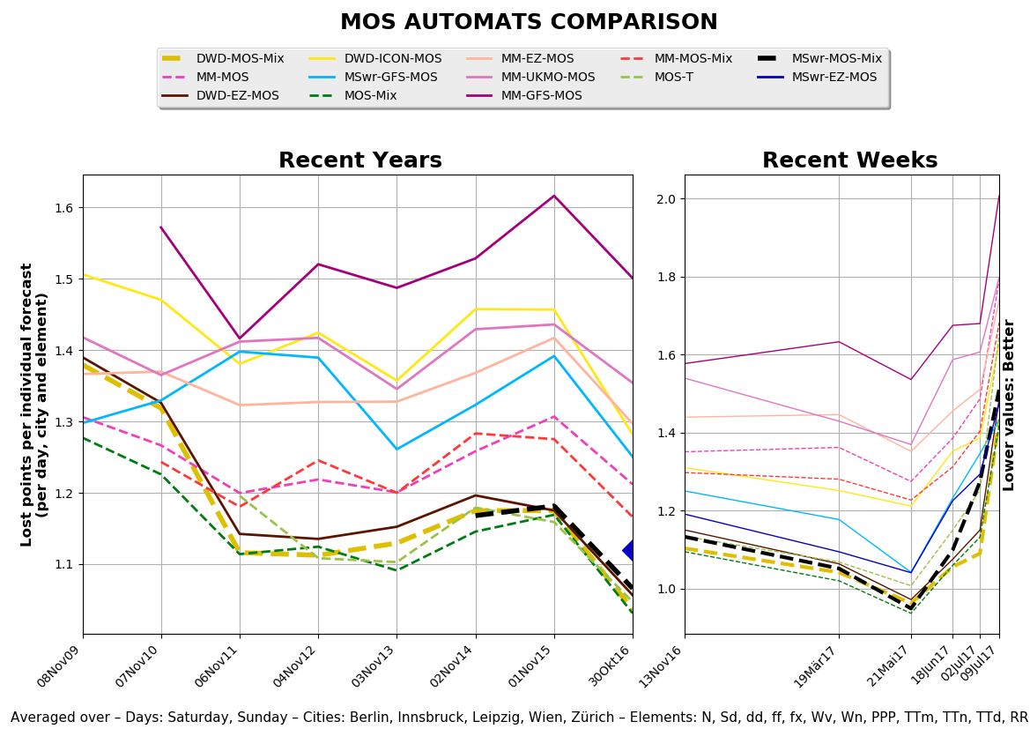
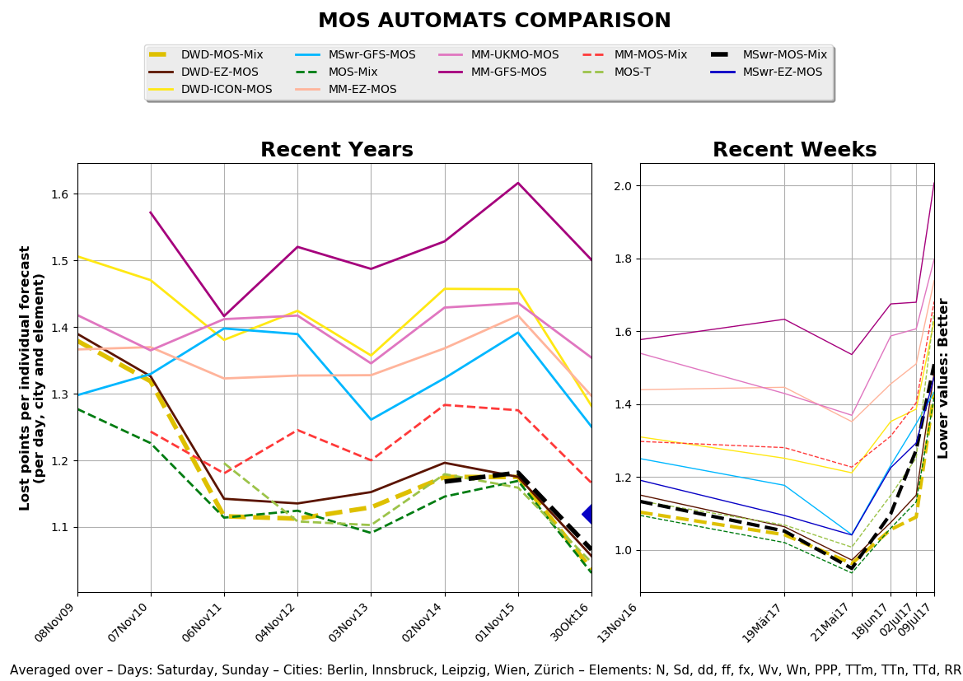
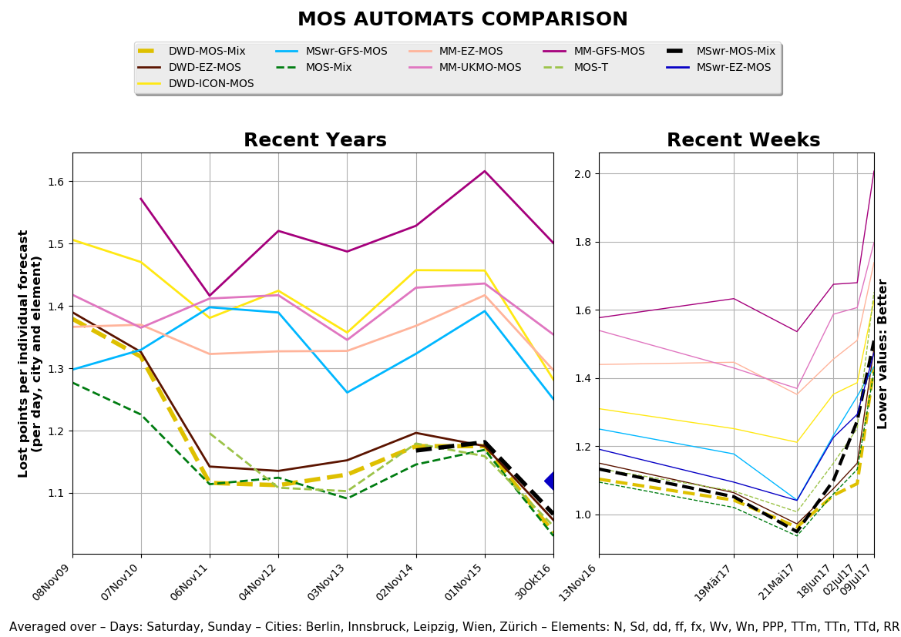
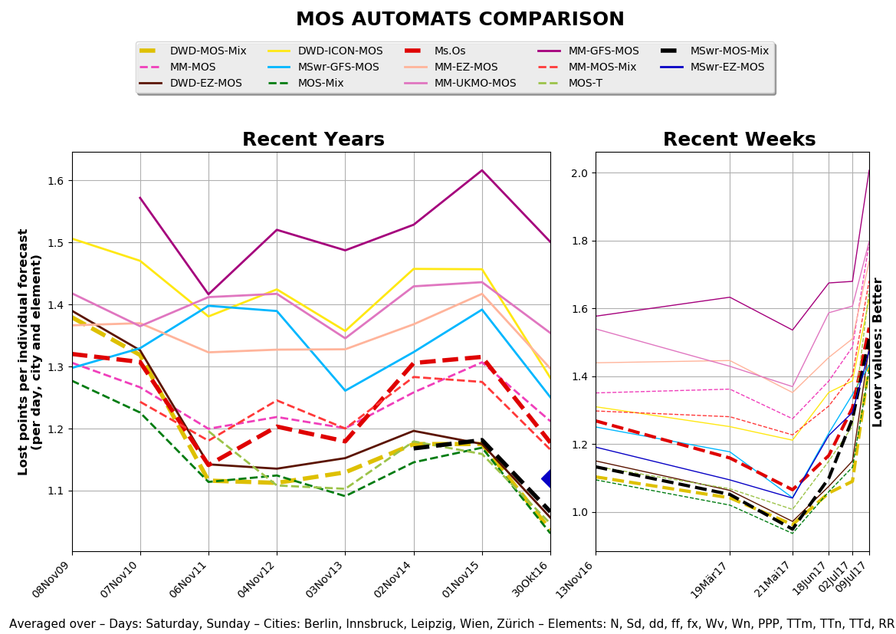
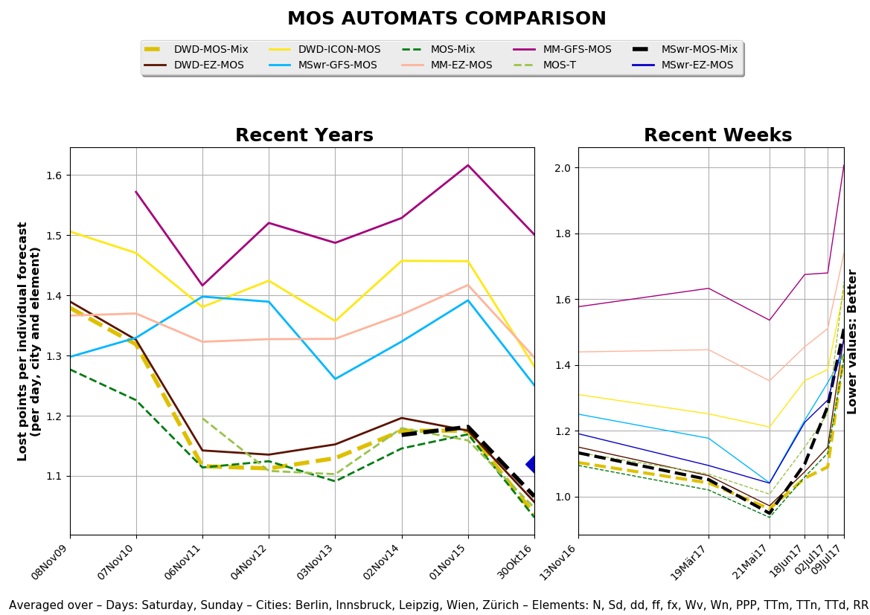
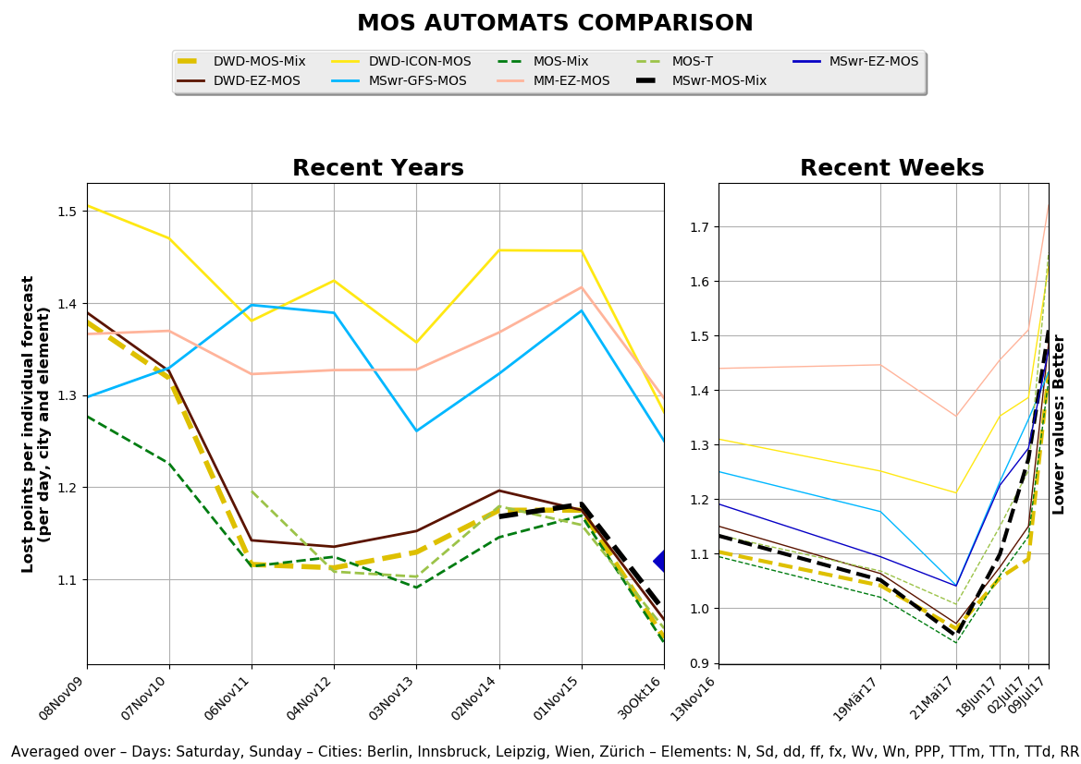
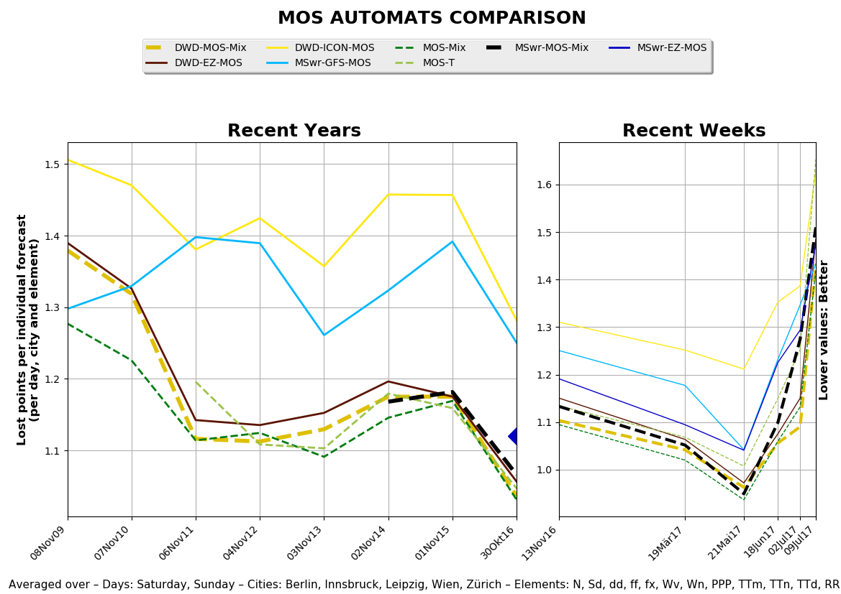
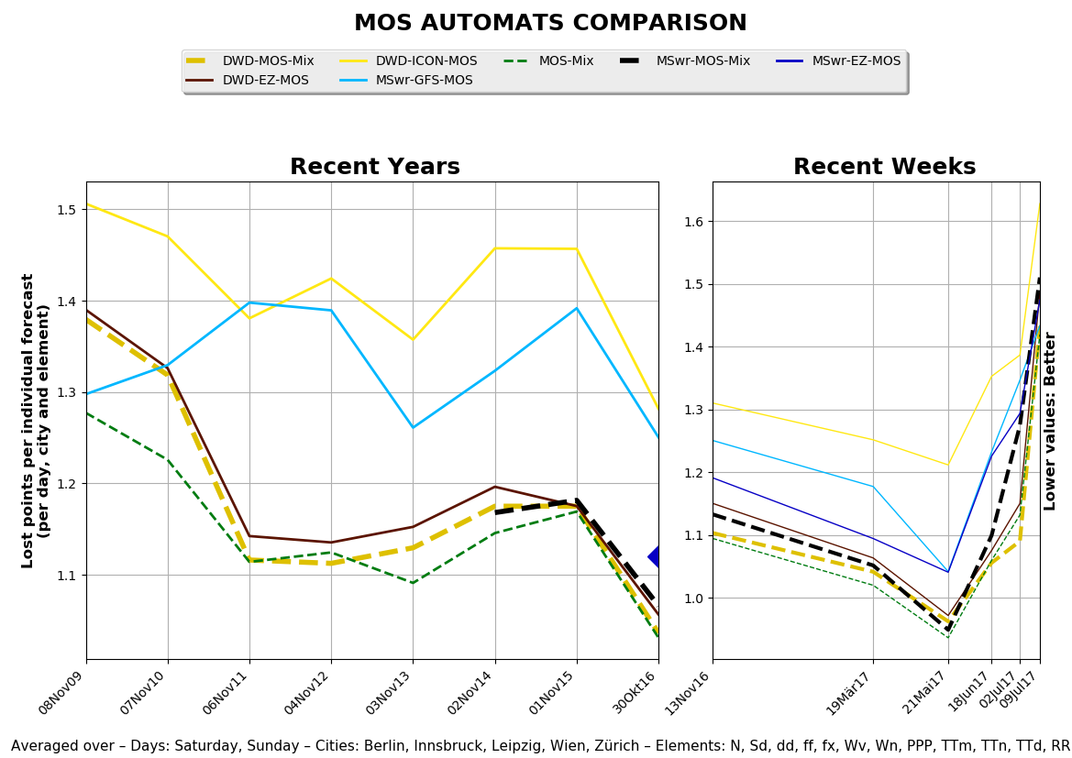
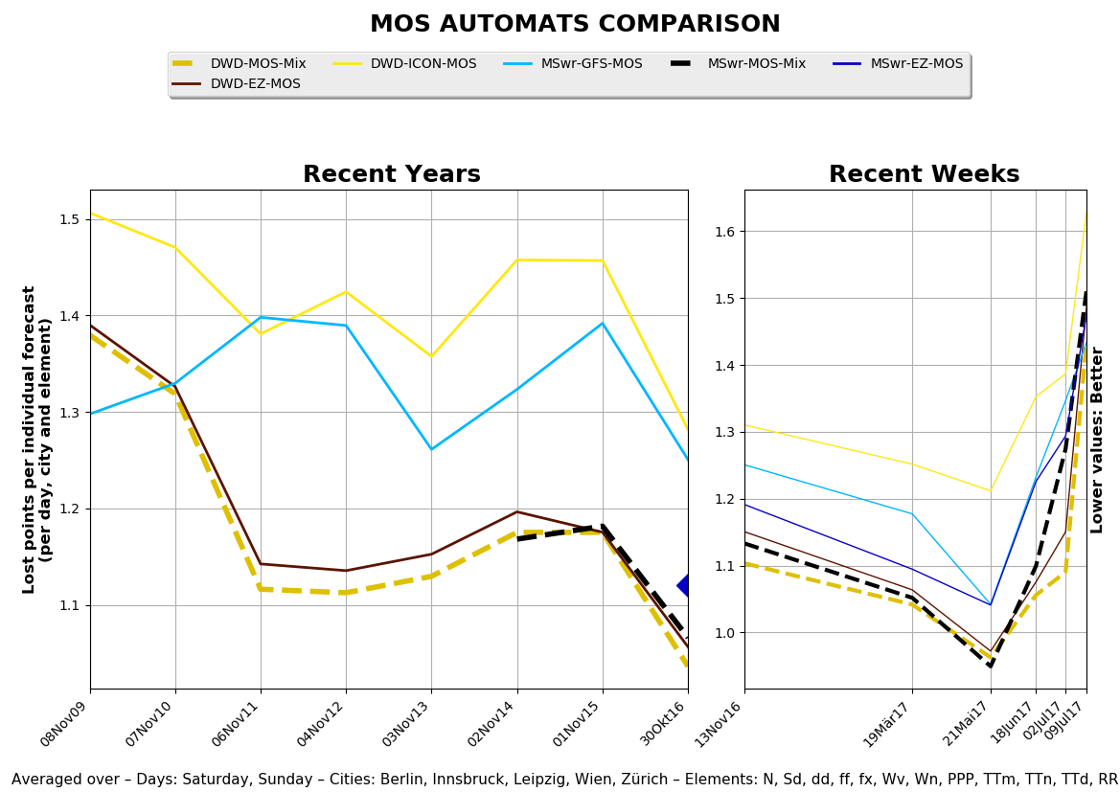
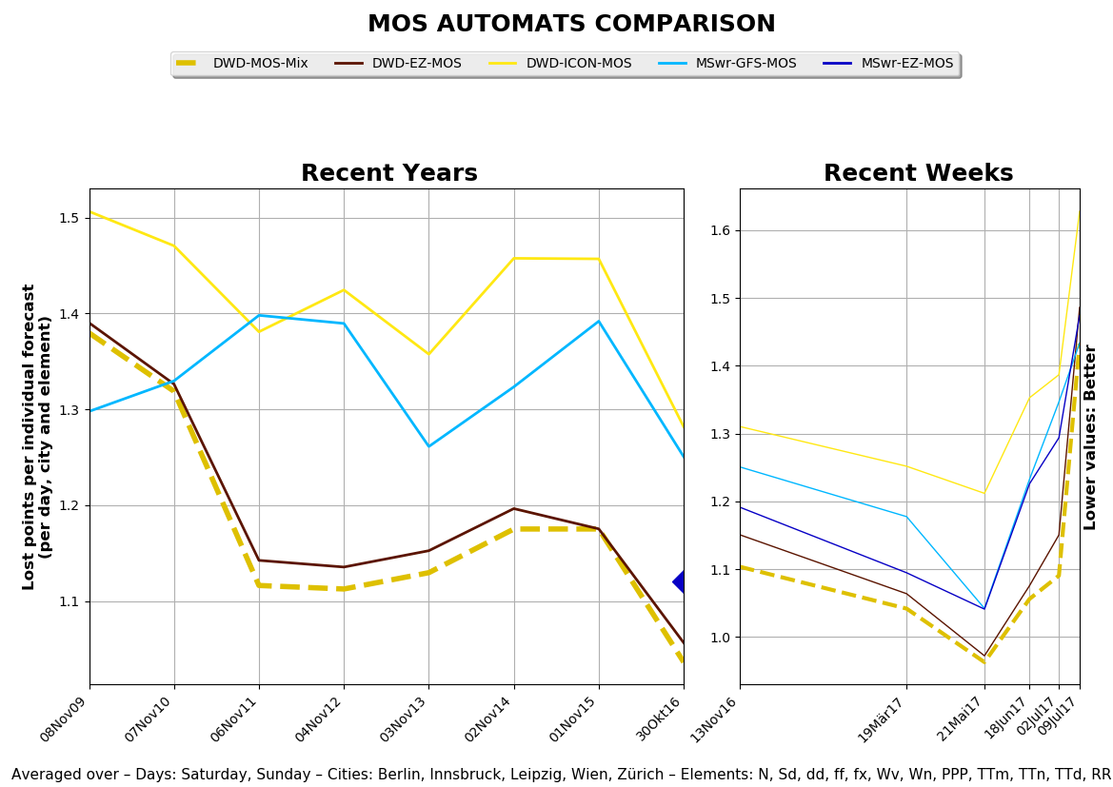
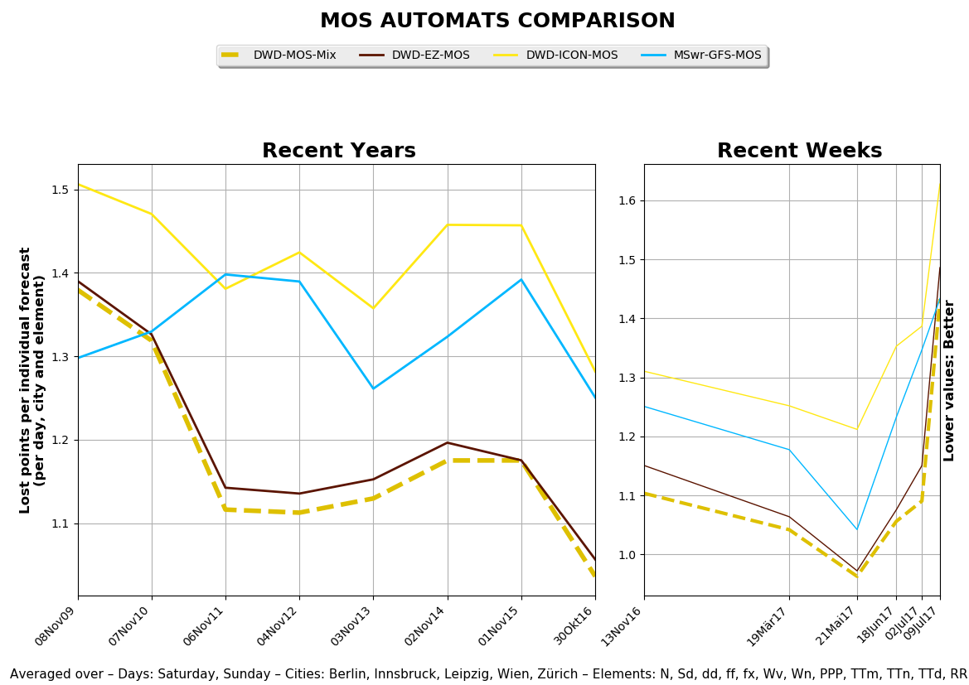
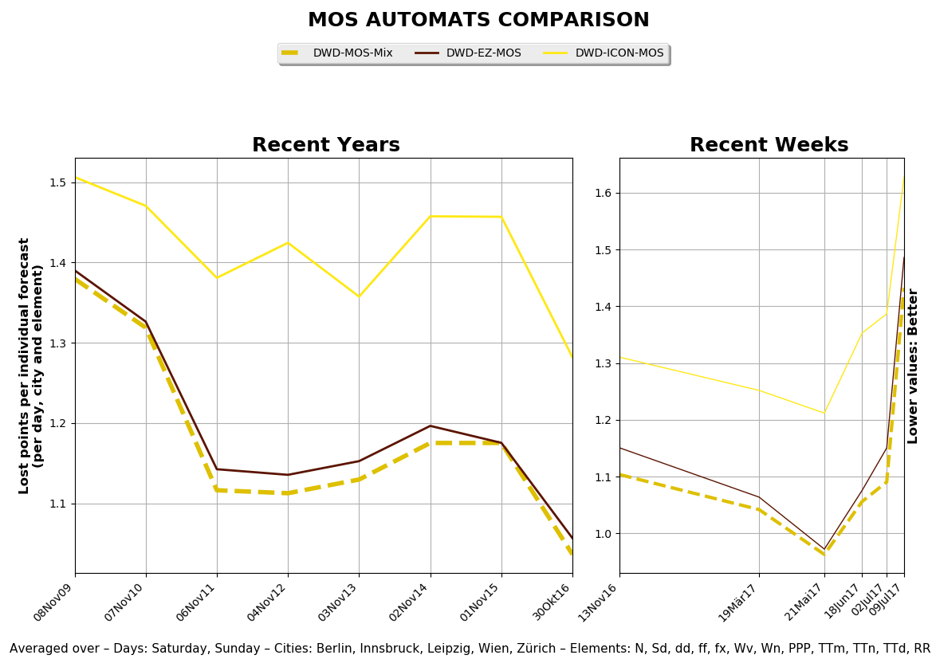
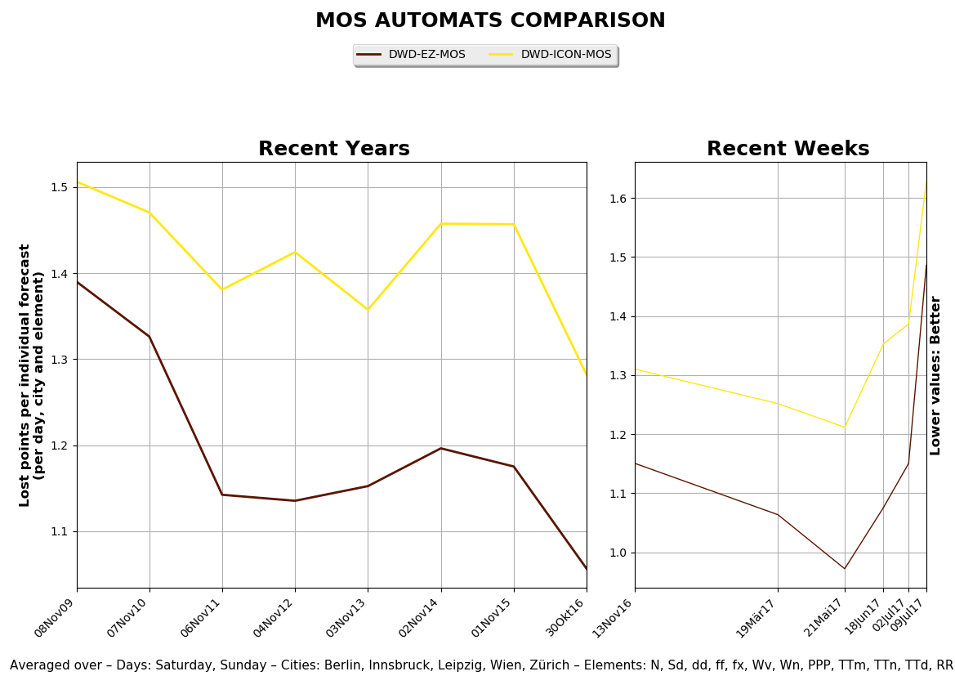
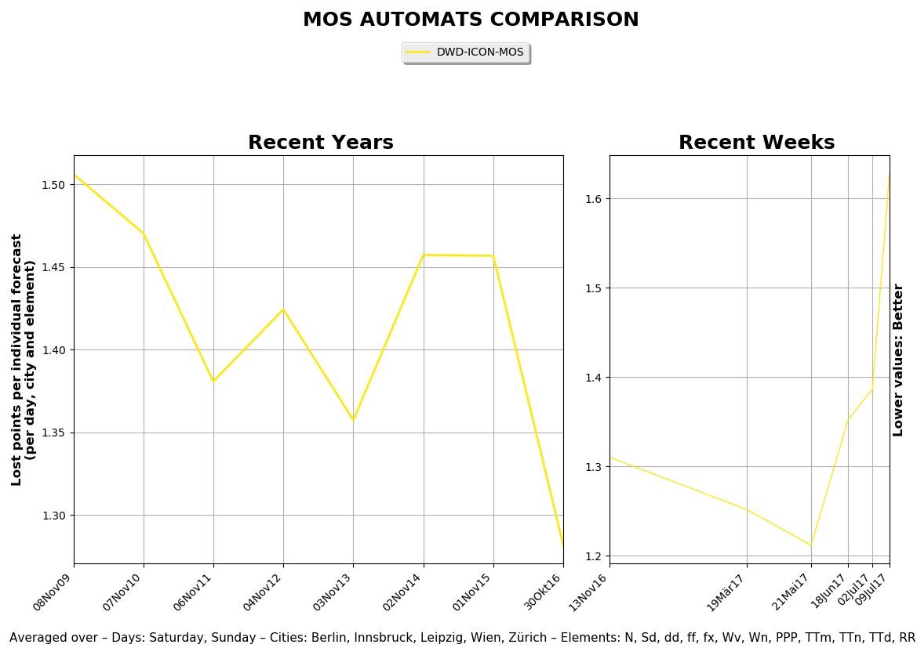
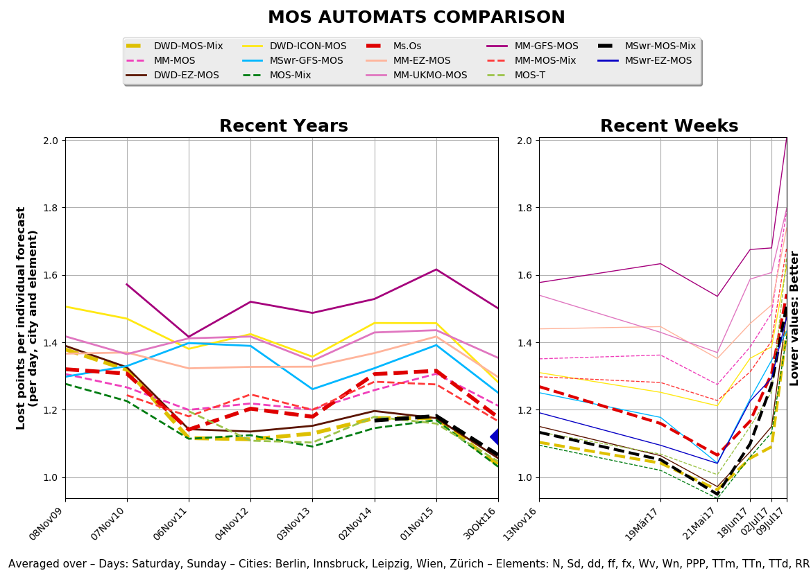
History of MOS, MSwr and Mission of MSwr
二

Slide 19
History of MOS, MSwr and Mission of MSwr
二
2005
MSwr went on the market with 'own' MOS - based on GFS model + SYNOP and METAR Obs.
→ 10 customers: Mainly smaller weather services with small R&D capacities.
Practice: MSwr produces forecasts
for ~60.000 places worldwide
for ~200 elements (predictands)
updated each hour
in forecast steps of 1 hour
up to 15 days ahead.
Each customer gets usually only a small fraction of these forecasts
to be downloaded from our ftp server or
via license to run the system operationally at his site.
until present: MSwr buys ECMWF data (only for Europe) and sells
ECMWF+GFS+(GFS-Ensemble)-MOS-Mix with notable better performance than just GFS-MOS.
2015

Slide 20
History of MOS, MSwr and Mission of MSwr
二
The Mission of MSwr
To make the potential of statistical post-processing
available to a wide range of customers
for the benefit of society and involved companies
with a variety of products to be presented later.

Slide 21
三
Model Output Statistics vs Direct Model Output
Introduction: Inductive and Deductive Modeling – a System Analytic View
MOS without model is about nothing.
A model without statistical post-processing is about 20 years behind w.r.t. accuracy of the forecasts.
Marriage of Physics, Synoptics and Statistics brings the best result.
Modeling type | Deductive | Inductive
Method type | Axiomatic | Empirical
Method | Physics | Statistics
A-priori knowledge | High | Low
Model complexity | High | Low
Model validity | General in space and time | Local and time specific
Example | NWP | MOS, AI, Neural Network, Machine Learning

Slide 22
三
Model Output Statistics vs Direct Model Output
Synoptical rules are incorporated as transformations into the statistics.
How does Statistics work?
Multiple linear forward screening regression
transformations (analytical and empirical) of predictors and predictands handle non-linear relationships in a linear regression equation properly.
This is the Unique Selling Point as compared to other MOS developers:
Idea comes from an operational forecaster who tried to algorithmize the most important considerations when making a specific weather forecast.
With each project more synoptical knowledge introduced into MSwr-MOS. It is continuously improving this way. Perhaps we can deliver better MOS forecasts for fog in Dubai or Thunderstorm in New Delhi this way in future?

Slide 23
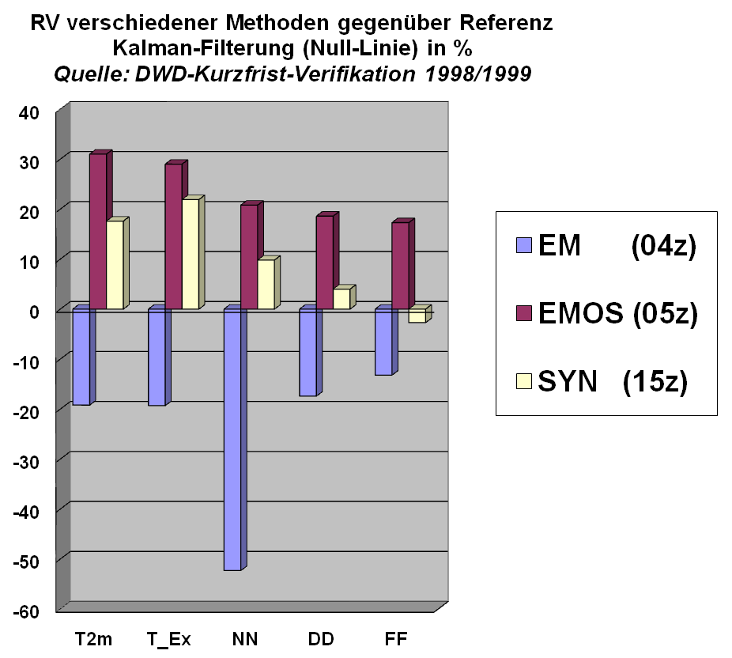
三
Model Output Statistics vs Direct Model Output
‘Screenshot’ of the comparative verification of
DMO
Kalman Filter = Zero Line
MOS
Final (human) Forecast
Negative values: Kalman Filter better
Positive values: Better than Kalman Filter
Weakness of MOS:
Availability and quality of the observational data
→ lots of care needed

Slide 24
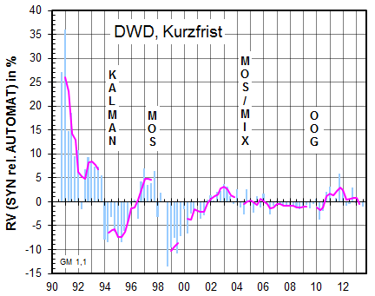
三
Model Output Statistics vs Direct Model Output
Relation between Human and Machine
Chronic of RV of Forecasters in comparison to the respective best available Machine from 1991 to 2013
Average of temperature-, wind-, and cloud-coverage- predictions for tomorrow, all 14 DWD regional weather offices
Positive values: Forecasters better
Source: DWD, Verifikationsbericht zur Güte operationeller Wettervorhersagen Nr. 48 – Sept. 2013
Short Range

Slide 25
三
Model Output Statistics vs Direct Model Output
Summary:
MOS reduces the error variance (e.g. sum of squared forecast errors of the numerical model) by 50%.
This is equivalent to 20 years of scientific-technological progress.
Best results of MOS are obtained when the best NWP gets married with the best MOS.

Slide 26
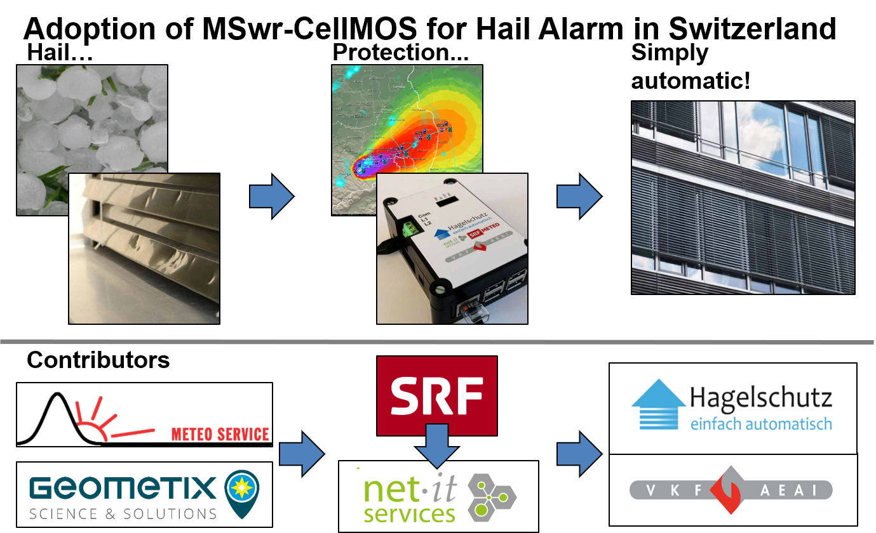
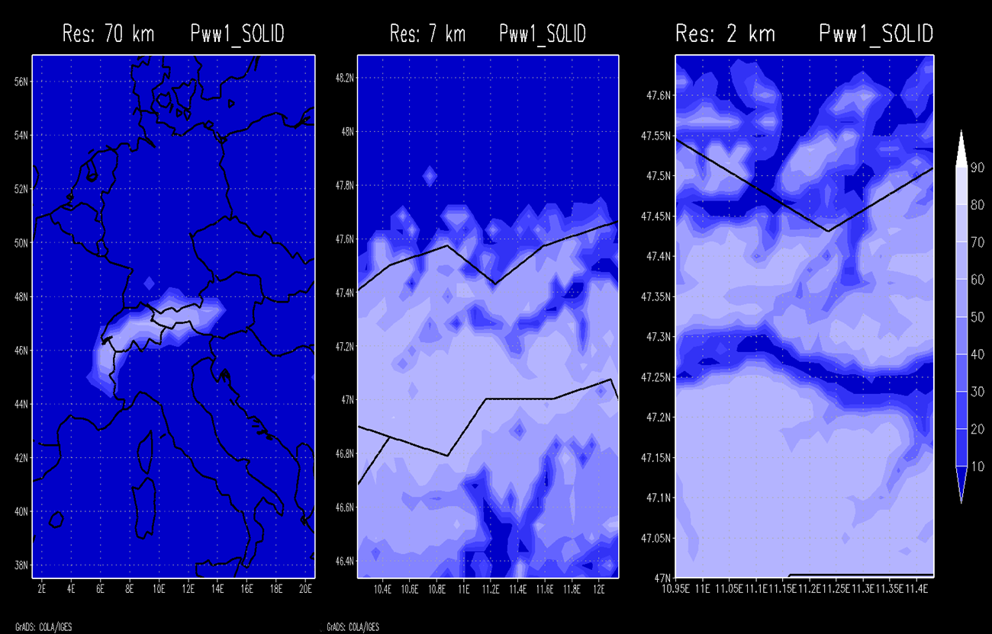
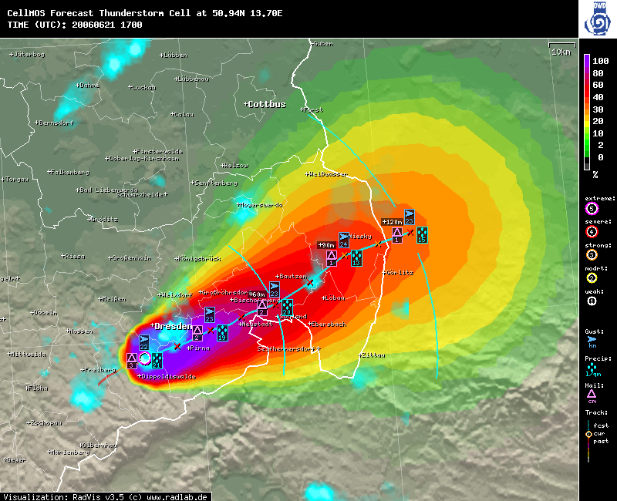
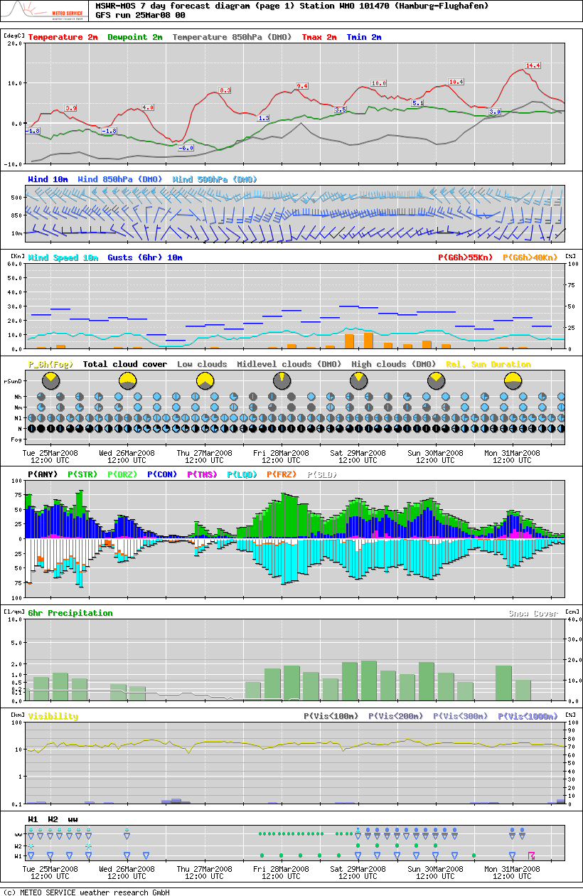
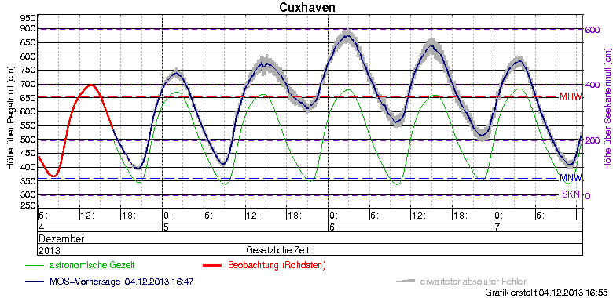
四
Product Developments
CellMOS, 21Jun06, 17 UTC
Interpolation-MOS for 20Apr05, 13 UTC
Products:
General MOS
Auto-TAF (Presentation: Bernd Richter)
Water level prediction: Rivers and Tidal Sea
Energy market
High resolution downscaling
by coefficient interpolation
NowCast
  Lightning-MOS
  Radar-MOS, integrated into MOS
  Cell-MOS
MSwr-MOS Prediction for Hamburg, issued 25Mar08
Waterlevel: Observed (red) and Predicted (blue) with Error Bars (grey)
Summary:
Anything that is observed and depends on
the NWP output can be predicted by MOS.

Slide 27
四
Product Developments
Summary:
Horse Riding:
You get the best result when the best horseman rides the best horse. Weather Prediction:
… when the best MOS is applied to the best NWP output.
The error variance of MOS is only half the error variance of DMO
- constantly for decades -

Slide 28
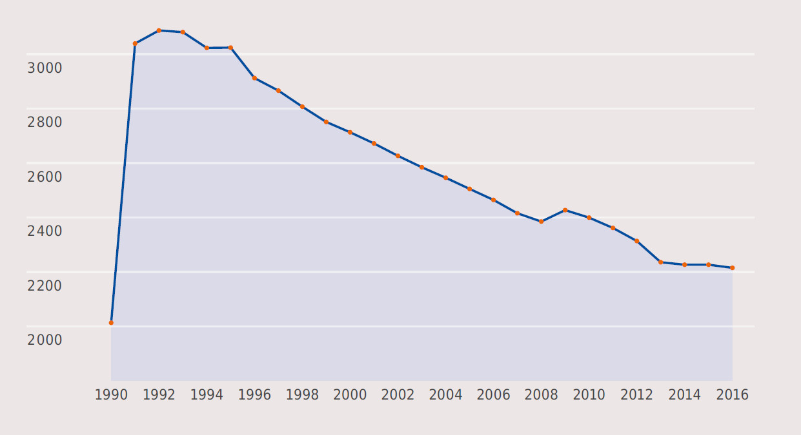
五
MSwr and Aviation: Relationship with Natl. Weather Services
Staff Development and Requirements for New Technologies:
Special Situation after German Reunification
Merging of National Weather Services of
East and West Germany
Regional Forecasting Centers
  Early 1990s:
  1 Regional Forecast Center for each State
  (11 Federal States)
  Mid 1990s:
  7 Regional Centers for now 16 States
Target by Government: Significant staff reduction to below West-Germany in 1989
1990
Deutscher Wetterdienst Staff Members

Slide 29
五
MSwr and Aviation: Relationship with Natl. Weather Services
1993
Change of legal situation in Germany:
Forecasting exclusively governmental by National Weather Service
Authorization of private
weather forecasting companies
Challenge for Deutscher Wetterdienst (DWD):
Operational implementation of staff
reduction target
Competition with private meteorological services
Use of modern forecasting technologies to avoid accusation of not using state-of-the-art-technology in case of severe weather warning problems
Deutscher Wetterdienst Staff Members

Slide 30
五
MSwr and Aviation: Relationship with Natl. Weather Services
History of Introduction of MOS in Deutscher Wetterdienst:
DWD was focused on Direct Model Output of NWP Models:
Strategic adjustment due to the new market situation as mentioned before
Introduction of Kalman Filtering
Beginning of co-operation DWD with Klaus Knüpffer to start MOS-based TAF-Project
Introduction of TAF Guidance with aviation-specific predictands
Beginning of FM15-compliant encoded TAF as additional support for aviation forecasters
1992
1993
1994
1996

Slide 31
五
MSwr and Aviation: Relationship with Natl. Weather Services
Introduction of MOS Guidance for General Weather Forecasting
High acceptance of MOS by forecasters due to close co-operation during development
Implementation of TAF predictands into TAF templates for aviation forecasts
Role of MOS within DWD today:
MOS Forecasts are accepted by aviation and general forecasters
MOS Forecasts improved the forecast quality (verification)
MOS-Forecasts reduced the forecaster‘s workload and increased his efficiency
MOS Forecasts are the basis for all automated forcast procedures (AUTO-WARNING)
Qualification of Forecasters:
Then: Master degree required for forecasters
Now: Bachelor degree for forecasters (except Central Forecasting Office)
1998

Slide 32
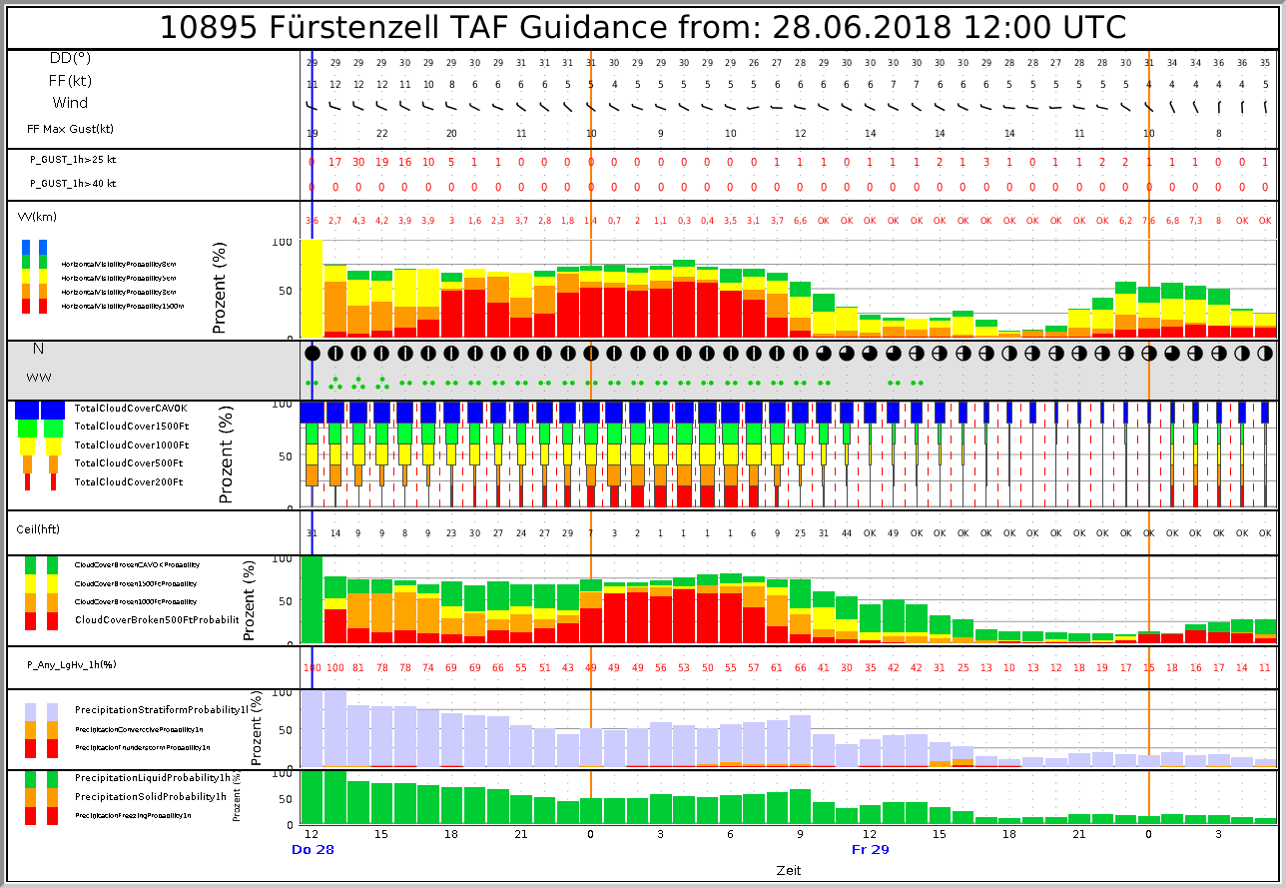
五
MSwr and Aviation: Relationship with Natl. Weather Services
MOS Guidance Products for Aviation Meteorology:
Aviation Forecasting within DWD early 1990s before MOS:
Mostly traditional procedures applied
in Aviation Forecasting
Most aviation-relevant predictands not forecast
by NWP (Ceiling, Visibility)
External pressure to improve forecasts quality
by Airlines, ATC, Airport operators

Slide 33
五
MSwr and Aviation: Relationship with Natl. Weather Services
Introduction of MOS-TAF-Guidance products offered
Forecast of ceiling, visibility
Forecast of Probabilities, also for
significant threshhold values e.g.
  PROB(TS), PROB(FZRA)
  PROB(Visibility < 1000m)
  PROB(Ceiling < 500ft)
  PROB (MAXGUST > 25KT)

Slide 34
五
MSwr and Aviation: Relationship with Natl. Weather Services
Forecast accuracy is of special importance for
Airport Operations:
No open ground handling activities on apron during TS
Air Traffic Control:
Planning of runway in use and approach management
Airline Operations:
TAF for fuel planning, Max. Take-off Weight (Tmax)
These requirements have been met by introduction of
MOS Products, which have been fully integrated into operational aviation forecast procedures

Slide 35
六
A Step by Step approach ...
… FOR TECHNICAL INTEGRATION OF MSwr MOS DATA INTO FORECAST PRODUCTS:
MSwr can deliver the following services now:
Graphical presentation of MOS forecasts for the meteorologists.
MOS forecast in CSV format can be downloaded from our ftp-server.
MOS forecasts can be read from an operational database as a backend service.
Meteorological support.
  Is this forecast correct?
  Why is this forecast like it is?
  Can we use MOS to do this or that?
Technical support
  We us a redundant and highly available infrastructure with an
  availability of 99.8%.

Slide 36
六
A Step by Step approach
We regularly extend the MOS system on request of our customers:
adding forecast locations
adding a huge number of forecasting locations in a grid
adding observation data and use it in the MOS optimisation process
adding a model and using it in the MOS optimisation process
adding elements for post-MOS processing
adding elements for MOS optimisation
Creating a specialized aviation project
Adding a Model and creating a specialized project are done less than once a year.

Slide 37
六
A Step by Step approach
The processing can be done by the customer on its own hardware cluster:
Running the daily operational forecast.
Running the seasonal optimisation
Managing the system can be done by the customer
extending the system
doing MOS research by a highly specialized team
At this point the customer has become independent of MSwr.

Slide 38
七
Future of MSwr
At the moment MSwr is dowing the following research:
Integrating Radar products for 1km resolution MOS forecast
Quick and automatic adding of locations and elements
Calculating specialized products post-MOS processing
Separation of IT and Meteorology
Using python for enhanced IT integration and AI.
In 10 Years time, the MOS system handles a variety of data on input and output. It is the kernel of many automatic forecasting products and can be easily extended for new products. The technical maintenance is handled offshore in a large company.

Slide 39

ご静聴いただき、
ありがとうございました。
We welcome your questions, suggestions, comments!
Thank you for your attention
✉ klaus@mswr.de
 www.mswr.de

